Slide 1


Systemic sclerosis: research in Canada
…and beyond…
Dr Maggie Larché, MBChB, PhD
Professor, University of Calgary
Director, Canadian Scleroderma Research Group

Slide 2
Come up with one word to describe my presentation topic

Slide 3
Why does meaningful research take so much time?
3 main types of research
Basic science – trying to figure out who starts the fight
Clinical epidemiology – looking for patterns in data collected eg CSRG, SPIN
Clinical trials – new medications for systemic sclerosis. Medications take around 10yrs to get to market…

Slide 4
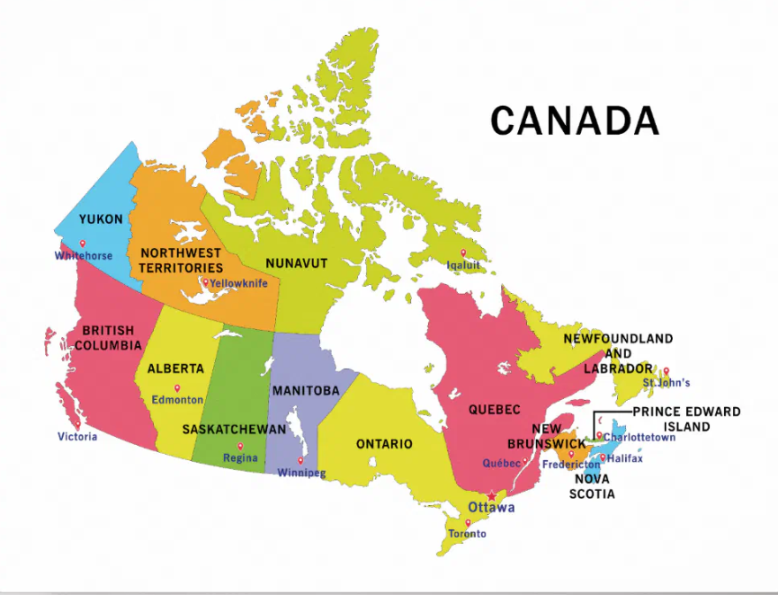


Canadian sites doing research
Vancouver
Calgary
Edmonton
London
Hamilton
Toronto
Ottawa
Montreal
Quebec city

Slide 5
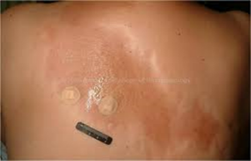
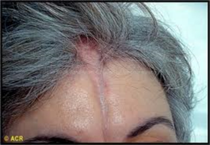
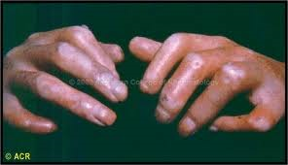
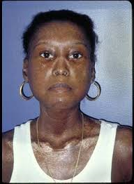
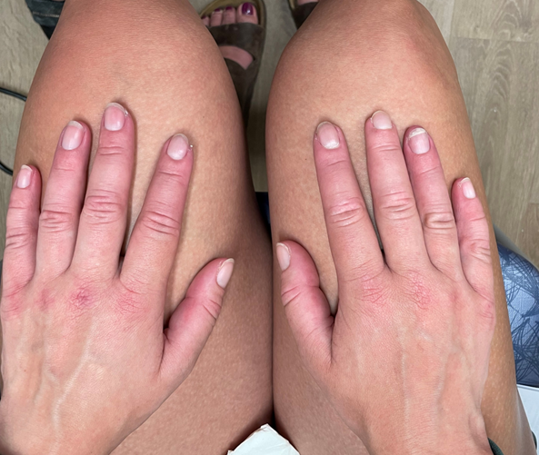
Scleroderma … Systemic Sclerosis
Non systemic
Morphea
Generalized morphea
Linear scleroderma
Systemic Sclerosis
Limited cutaneous
Diffuse cutaneous
Sine
Scleroderma
Localised
Morphea
Linear (en coup de Sabre)
Systemic
Limited (distal to elbows or knees)
Diffuse
Sine (without skin involvement)
Images from ACR Image bank

Slide 6
Which type do you/your loved one have?
Limited,
Diffuse
Sine
Localised
What are/were your symptoms?
Similar features but
EVERYONE IS DIFFERENT

Slide 7
Patient at the centre of the questions
Add word cloud (interactive)
What are the main 3 symptoms that trouble you most?
Fatigue
Pain
Change in appearance
Raynauds
Finger ulcers
Itch
swelling
Heartburn
Dry mouth/eyes
Skin changes
Bloating
Constipation
Diarrhea
Shortness of breath
Cough

Slide 8
Multiple different subtypes of each of these diseases
 | Early/very early systemic sclerosis | Limited cutaneous systemic sclerosis | Diffuse cutaneous systemic sclerosis
Clinical | Raynauds, puffy hands, finger ulcers, GI issues | Raynauds, finger ulcers, contractures, calcinosis, GI issues, telangiectasis, shortness of breath, swelling in ankles | Rayanuds, skin tightness, pigment changes,
Bloodwork | Any of the scleroderma Abs | Anticentromere | Anti-Scl70 Multiple others
Imaging | Often normal | ECHO | CT chest may show fibrosis Lung function abnormal
Treatments | Immunosuppression vs wait | Vasodilators, MTX, mycophenolate | Vasodilators, MTX, mycophenolate
Prognosis | Depends on trajectory | Often better than diffuse | Often worse

Slide 9
Scleroderma … Systemic Sclerosis
Scleroderma
Localised
Morphea
Linear (en coup de Sabre)
Systemic
Limited (distal to elbows or knees)
Diffuse
Sine (without skin involvement)
Non systemic
Morphea
Generalized morphea
Linear scleroderma
Systemic Sclerosis
Limited cutaneous
Diffuse cutaneous
Sine
Images from ACR Image bank

Slide 10
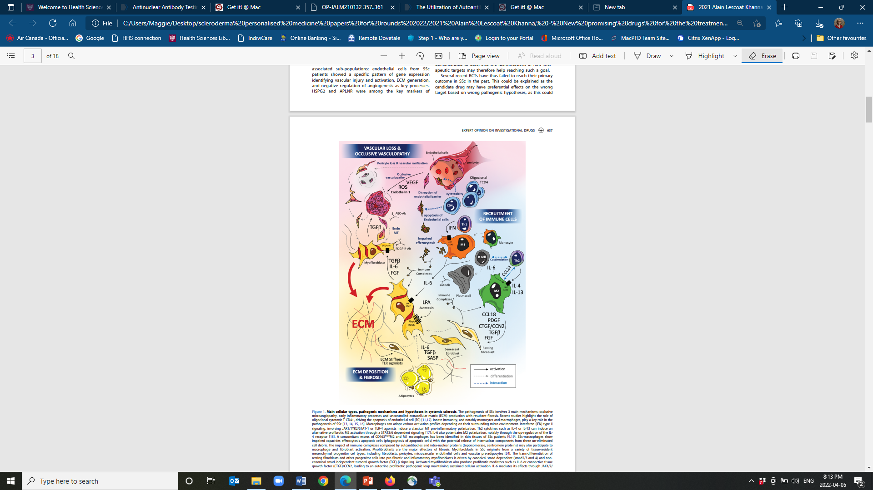
Immune dysregulation (autoimmunity)
Vasculopathy (platelet and endothelial activation)
Fibrosis (scarring)
Lescoat et al 2021 Exp Opinion Invest Drugs

Slide 11

Stratifying pathophysiology: 3 main processes
Immune dysregulation (autoimmunity)
Vasculopathy (platelet and endothelial activation)
Fibrosis (scarring)
Image from Shutterstock
Unmet need: unclear who starts the fight!

Slide 12
Basic science helps determine who starts the fight
Mo Osman
May Choi
Maggie Larché
Jim Dunne
Elena Netchiporouk
Jean-Luc Senecal
Oceane Landon-Cardinal
Mark Larché
Fei Geng

Slide 13
Immune dysregulation

Slide 14

Mo Osman

Slide 15

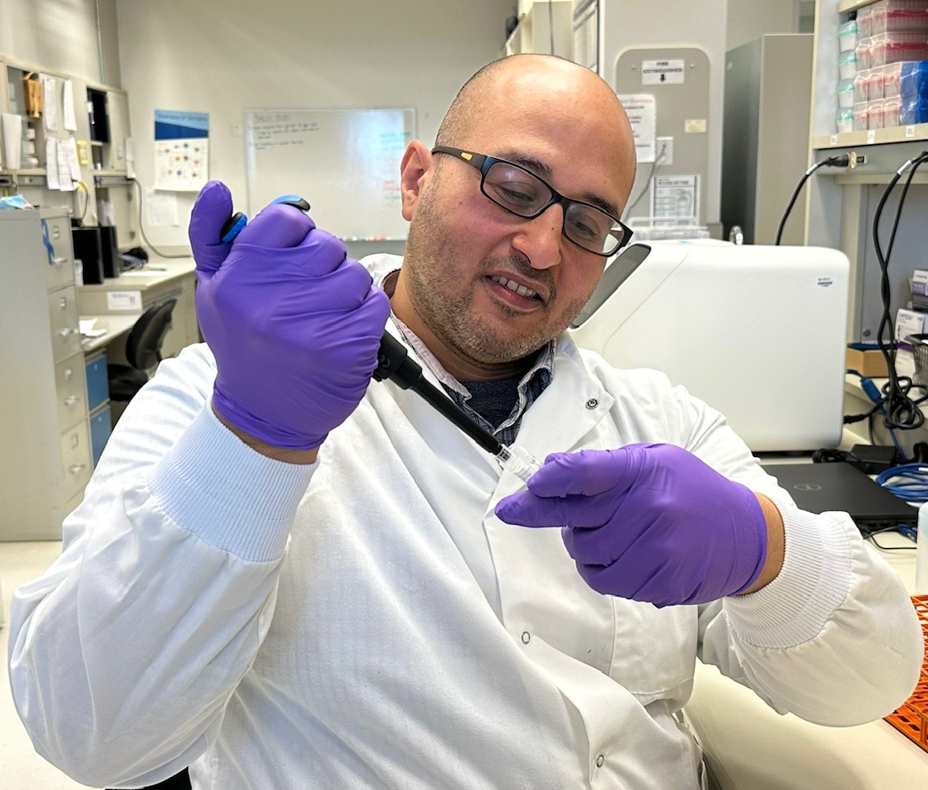
Mo Osman, University of Alberta SSc Translational Research Program
Patient-centred research in SSc
Mechanisms, biomarkers and targets re: fatigue
Vascular dysfunction, Breathlessness and Cognitive impairment
How fatigue is promoted by defects along the oxygen-transport-cascade in SSc
Cancer-like FB changes in SSc
Mitochondrial dysfunction in SSc
Genomic instability, mitochondrial dysfunction and effects on immune dysregulation
Post-translational polysialic acid modifications as a prognostic biomarker and therapeutic target in SSc and SSc-ILD.

Slide 16
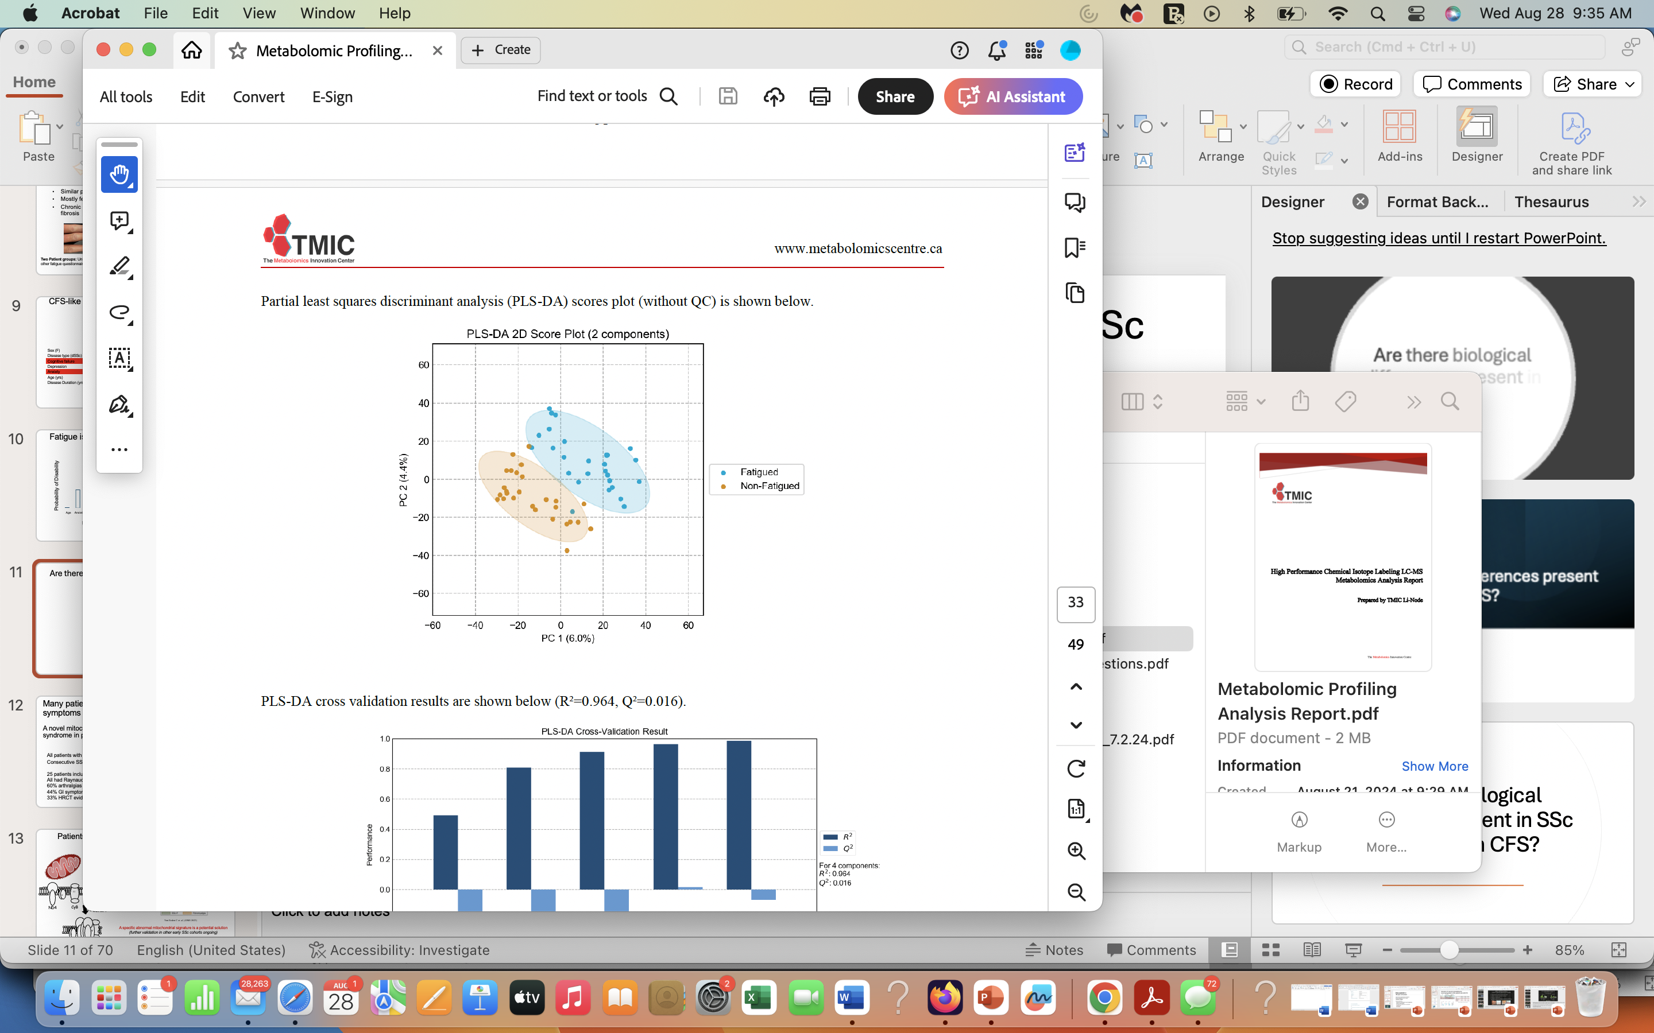
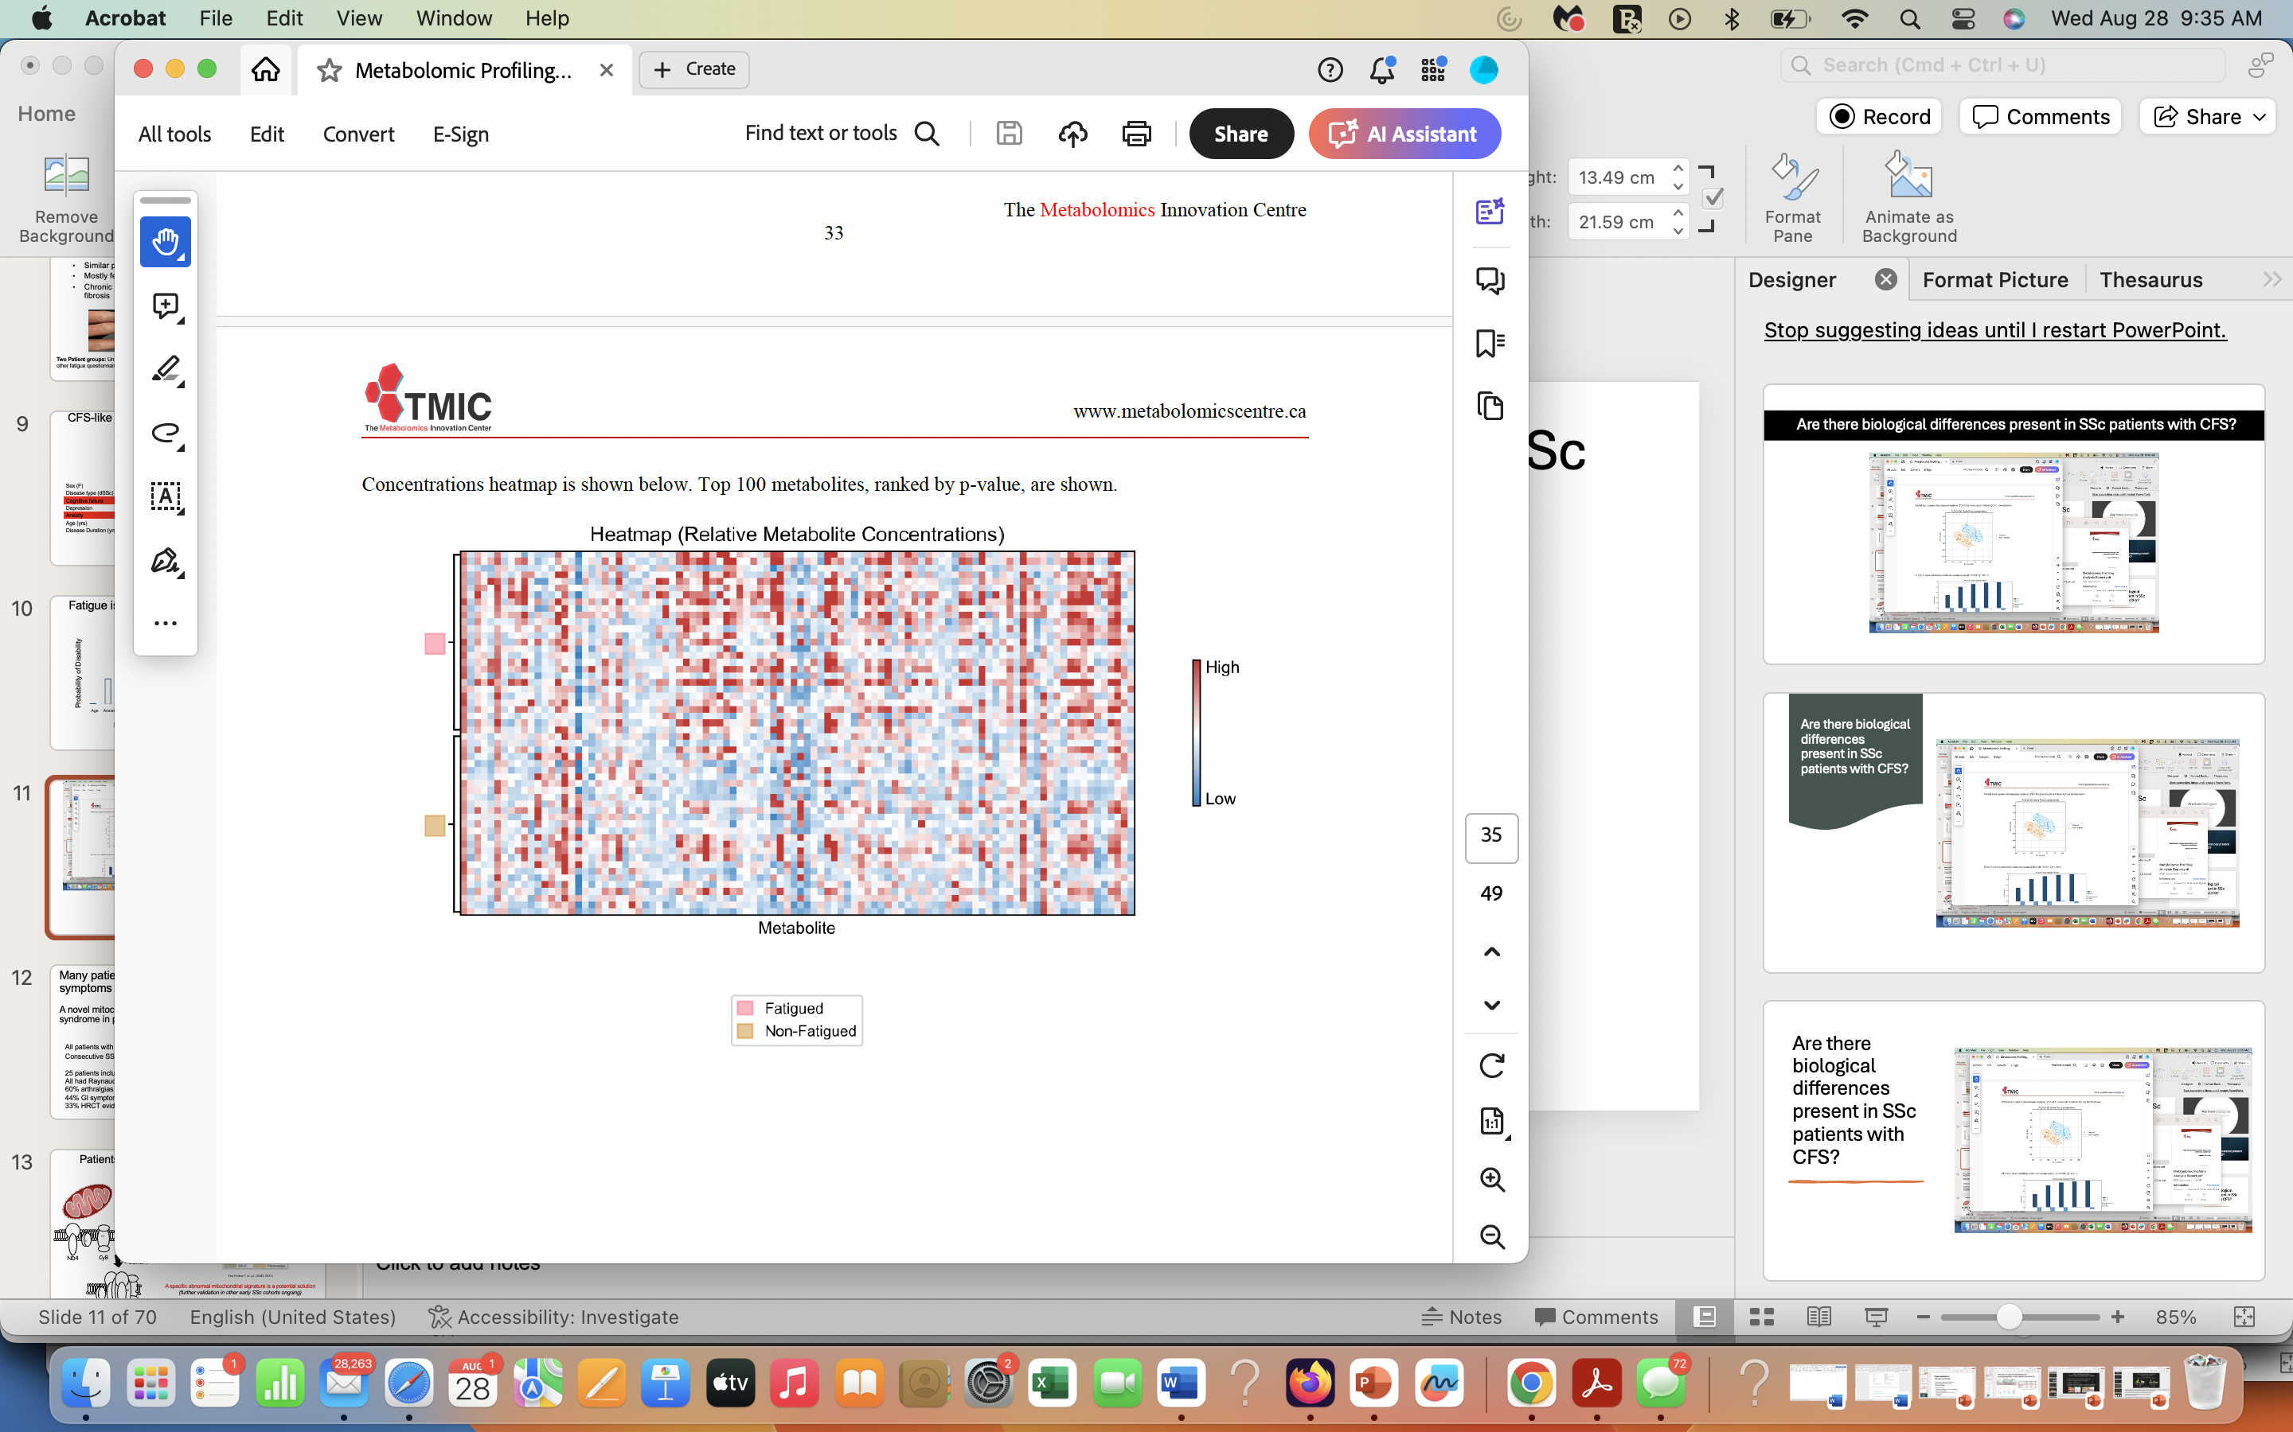

Metabolites associated with mitochondrial dysfunction are dysregulated in patients with elSSc and severe fatigue
U of A cohort
27 F lcSSc < 5 years with CFS
27 lcSSc without CFS 27 non-fatigued
(age matched)
Metabolomic screen
(5400 metabolites in the blood)

Slide 17
Simple blood test can predict who will get severe disease and could also point the way to future treatments. Polysialic acid U of A team uncovers new biological marker for scleroderma
a biomarker is something that can be used cheaply in a clinic
patients who had received a bone marrow transplant showed reduced levels of polysialic acid, an indicator that changes in the glycan are directly related to the disease process.
5 healthy control patients,
5 patients with skin fibrosis only, \
11 patients with more severe fibrosis and
4 patients who had received transplants.
the glycan is interfering with the body’s ability to deal with scarring.
“Sugars form a really thick layer on the outside of a cell that is responsible for mediating the interactions between the cell and its environment. The sugars are what the immune system uses to say, ‘OK, this is self, I don’t want to attack this’ or, ‘This is foreign, I should deal with it.’
“Normally, the immune system should recognize those pathogenic scleroderma cells, but the scleroderma cells make the glycan so they can grow without being killed.”
“We’ve developed some more technology that allows us to find the proteins this glycan is attached to, so we can start to figure out how it is actually causing these changes,” explains Willis. “That might hint as to how we could potentially develop new therapeutics to intervene.”

Slide 18
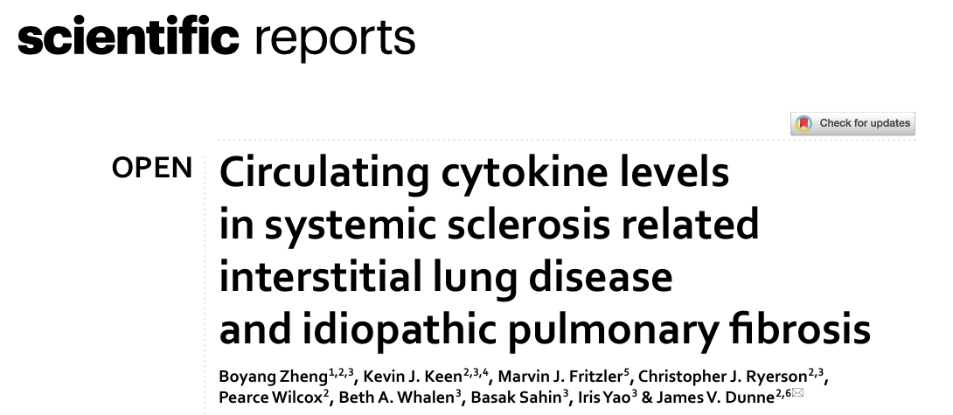
BC: Boyang Zheng and Jim Dunne

Slide 19
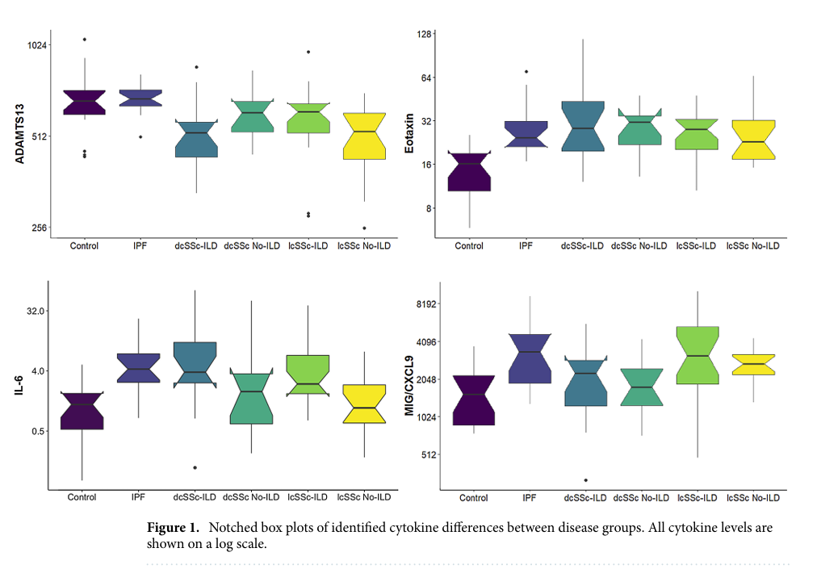
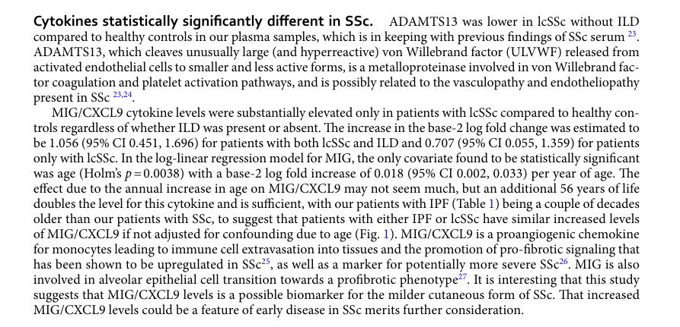
87 cytokines (proteins released from cells)
Serum from:
39 pts with SSc-ILD
29 SSc no ILD
17 with IPF
19 healthy controls
Eotaxin-1 levels 2X higher in all patients comparted to HC
IL-6 levels x6 higher in all ILD patients comparted to HC
MIG/CXCL9 higher
ADAMSTS13 was lower in all groups compared to HC

Slide 20
Vasculopathy markers

Slide 21
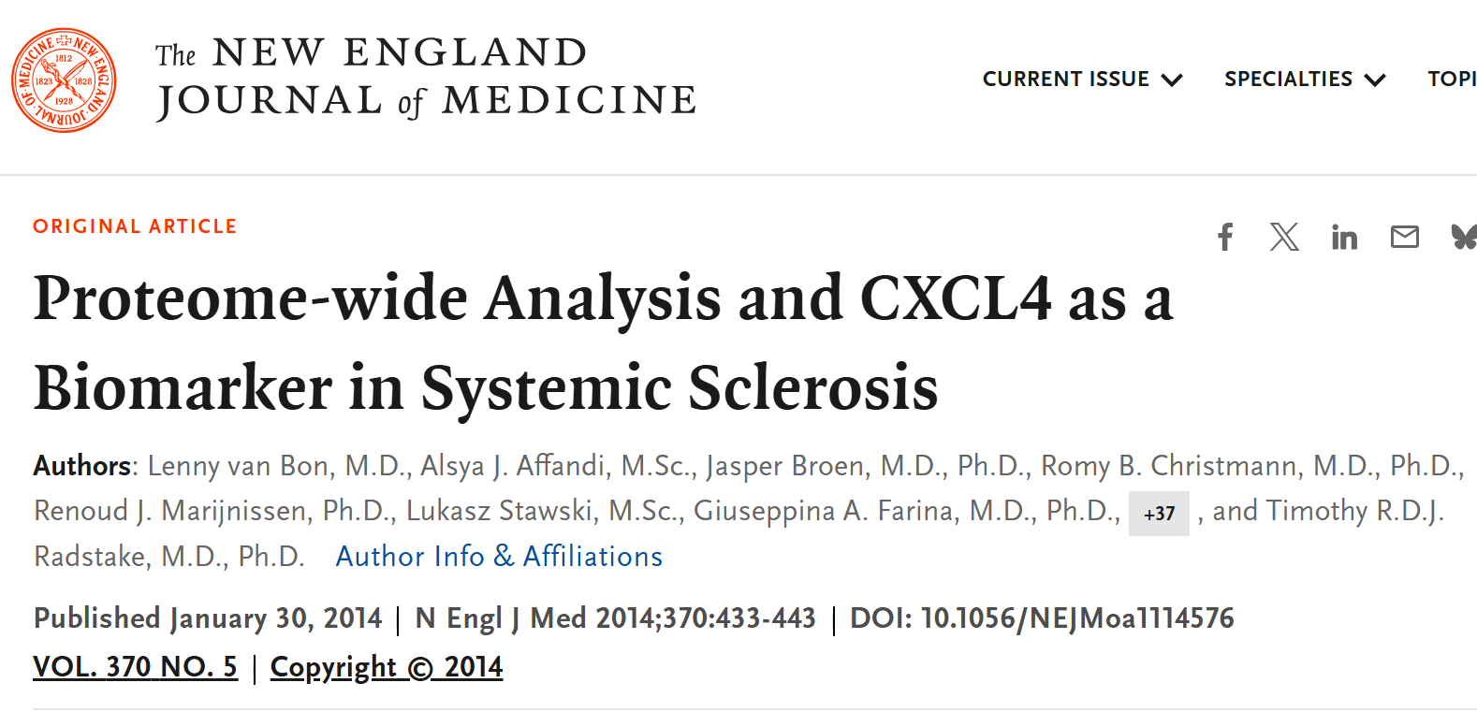

Slide 22
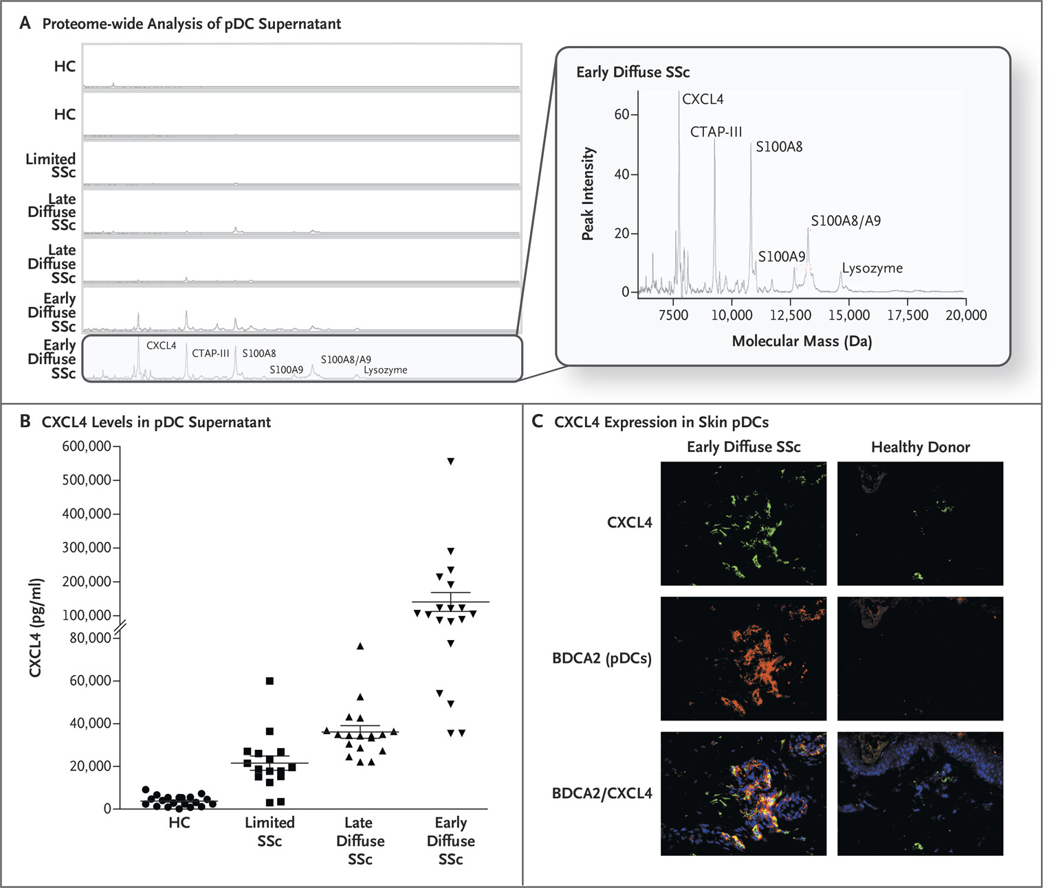
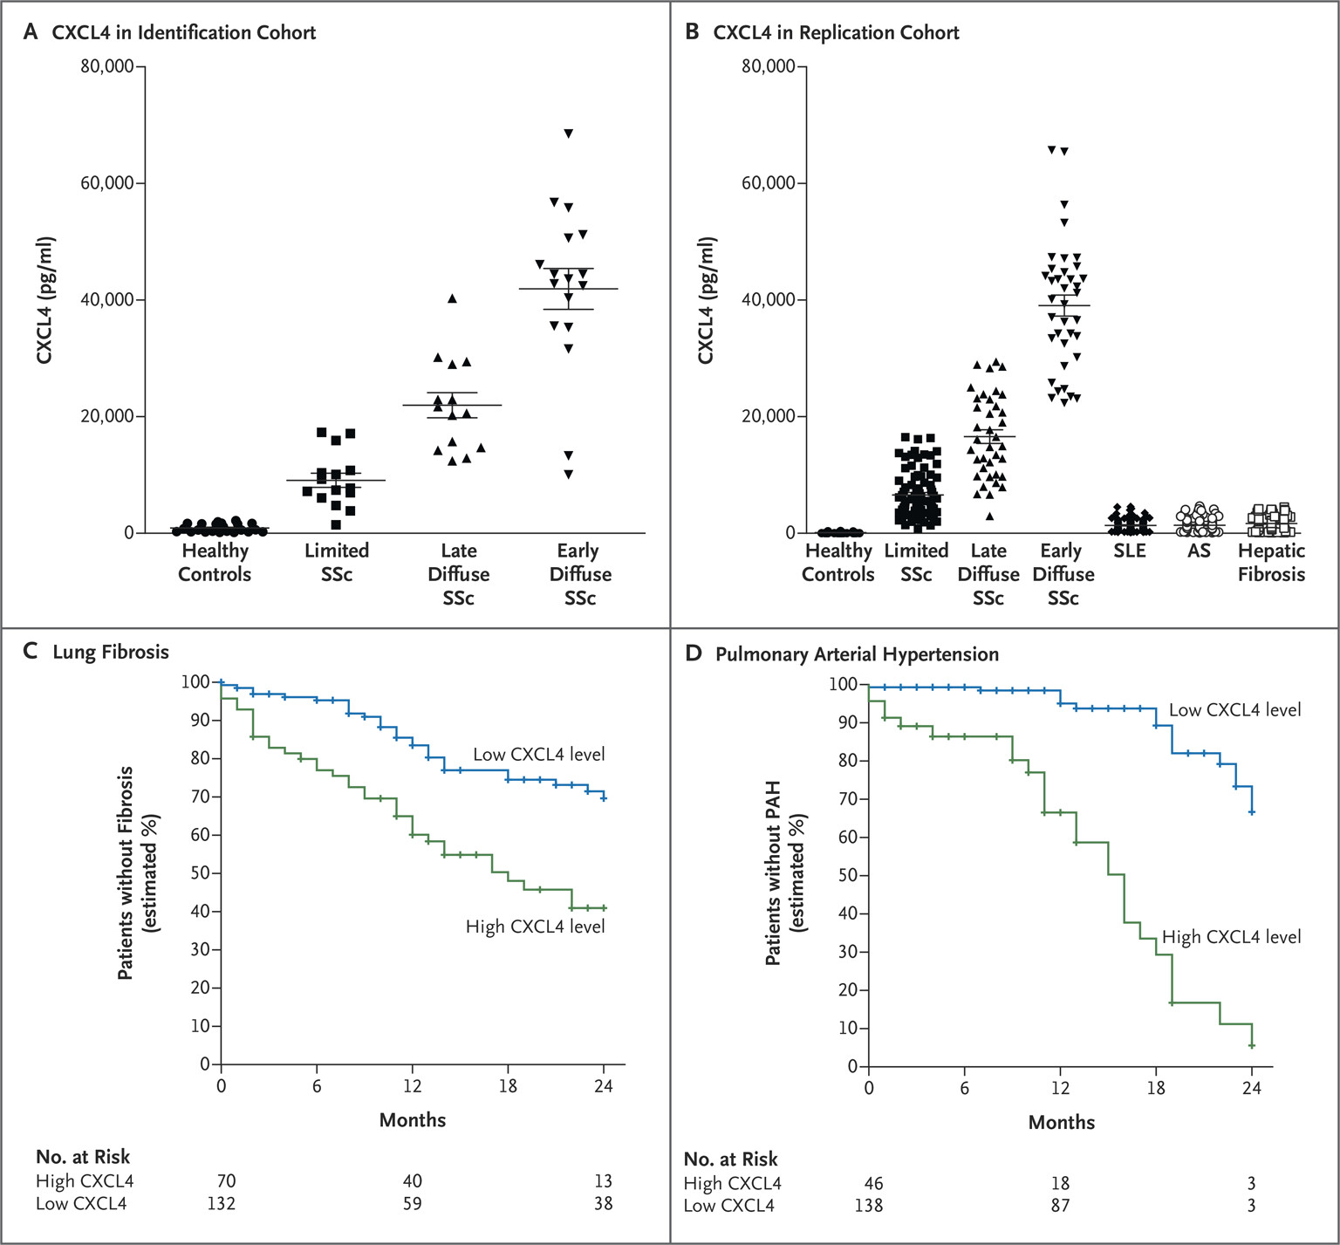
CXCL4 : increased in patient with early SSc, and in those with pulmonary fibrosis and pulmonary hypertension

Slide 23
CXCL4 - Radstake
Validation of CXCL4 as a Therapeutic Target in Systemic Sclerosis
Introduction
Systemic Sclerosis (SSc) is a chronic progressive disease characterized by inflammation, fibrosis, and vascular dysfunction (1). Although the disease is named after its primary and perhaps most obvious clinical presentation of thickened skin, its extra-dermal features are wide and varied. These organ manifestations may include fibrotic phenomenon such as interstitial lung disease and esophageal stricturing, immune phenomena such as the abnormal presence of disease specific autoantibodies (such as anti-Scl70 and anti-centromere antibodies). SSc is also marked by vascular phenomenon such as Raynaud’s (and its associated complications i.e. digital pits and ulcers, acro-osteolysis, and in severe cases autoamputation), pulmonary arterial hypertension, gastric telangiectasias that predispose to bleeding, and scleroderma renal crisis with thrombotic microangiopathy.
The etiology of SSc remains incompletely understood, although most experts agree on a multifactorial disease process whereby individuals with a genetic predisposition may develop disease upon being exposed to an environmental trigger. Various genetic alleles have been linked to SSc, including DRB1*1101 (associated with anti-Scl70) and DRB1*0401-22 (associated with anti-centromere) (1). Some of the most tightly associated markers that predict risk of developing SSc are indeed those that encode signaling molecules within the immune system such as IRF-5, T-bet, STAT4, and T-cell receptor zeta chain (2). Environmental exposures that have been associated with SSc include silica, chlorinated solvents, welding fumes in male patients, and aromatic ketones/solvents in females.
Regardless of the inciting factors or initiation of disease, it appears that vascular dysfunction is ultimately the common denominator in the pathophysiology of SSc (3). There are various observations and lines of evidence to support this. Firstly, Raynaud’s phenomenon is present in almost all SSc patients and is usually the first clinical manifestation. It reflects a pathological process of vasoconstriction as well as intimal thickening in the small arteries of the distal extremities that lead to luminal narrowing and chronic tissue ischemia. Sclerodactyly ensues after the onset of Raynaud’s, and follows the same distribution starting in the digit tips and progressing proximally, suggesting that fibrosis may be causally related to the preceding vasculopathy. Indeed, it is well established that hypoxia is a potent trigger for the recruitment of local fibroblasts and subsequent deposition of extracellular matrix factors resulting in tissue fibrosis. Secondly, examination of the nailfold capillaries is highly informative in predicting which patients with isolated Raynaud’s phenomenon will progress to SSc. Although the changes in nailfold capillaries vary with the chronicity and stage of disease, key features include loss of capillary density, capillary enlargement, microhemorrhages, and disorganization of the normal capillary arrangement. It appears that this vasculopathy is not limited to the microvasculature in the digits, but also has macrovascular implications, as loss of nailfold capillary density is correlated with the severity of pulmonary arterial hypertension in SSc. Thirdly, endothelial cell dysfunction is an early event in SSc where vasoconstrictors such as endothelin-1 are overexpressed while local vasodilators such as nitric oxide and prostacyclin are downregulated.
More recent research into vasculopathy has suggested that a cytokine released by plasmacytoid dendritic cells named CXCL4 may play an important role in the pathogenesis of SSc (2). CXCL4, otherwise known as platelet factor 4 (PF4) is a 70 amino acid long protein with anti-angiogenic properties. Serum levels of PF4 were shown to be elevated in patients with SSc but not in those with systemic lupus, ankylosing spondylitis, liver fibrosis, or controls. It was associated with fibrosis of skin and lung parenchyma, as well as with pulmonary arterial hypertension. Interestingly, the levels of PF4 correlated with the stages of developing SSc; i.e. they increased in order of the following groups: primary isolated Raynaud’s, Raynaud’s with antinuclear antibodies, and finally Raynaud’s with nailfold capillary abnormalities and SSc specific autoantibodies. PF4 is able to downregulate antifibrotic cytokines such as interferon-y, and enhance expression of profibrotic cytokines. Vascular endothelial growth factor (VEGF) levels are increased in patients with Raynaud’s presumably in response to hypoxia, but PF4 has been shown to attenuate its effects which may explain the absence of neovascularization despite high VEGF levels. Interestingly, in vivo experiments showed increased immune cell infiltration and skin fibrosis in mice treated with PF4 via a subcutaneous pump, compared to controls.
In addition to this, research into a potentially life-threatening condition termed Heparin Induced Thrombotic Thrombocytopenia (HITT), has also revealed that PF4 binds with high affinity to heparin (4). HITT most commonly occurs in patients undergoing cardiac surgery and treated with heparin, who for unknown reasons also have baseline low levels of pre-existing anti-PF4 secreting B cells. Exposure to heparin triggers the formation of antibodies targeting the PF4-heparin complex leading to thrombocytopenia, thromboses, as well as an increase in circulating PF4.
Taken together, we hypothesize that PF4 may be central to the vasculopathy that characterizes SSc. Specifically, the pathogenesis of SSc may start with an environmental exposure that triggers an immune response causing injury to endothelial cells. This is histologically supported by perivascular immune cell infiltrates of macrophages, B and T cells, and autoantibody generation (3). Local inflammation and injury lead to endothelial dysfunction, with platelet activation and microthromboses driven at least in part by PF4. Downstream hypoxia and reperfusion injury arise from this, and results in activation of fibroblasts causing scarring in the vasculature which further exacerbates hypoxia, fibrosis, and tissue damage.
Furthermore, in SSc patients who do not have pre-existing autoantibodies to PF4, the administration of heparin may effectively sequester circulating PF4 without inducing HIT, thereby preventing PF4-induced vasculopathy. In order to test this novel hypothesis, we performed three pilot analyses to generate data that will underpin future larger studies with the ultimate goal of providing an inexpensive, yet efficacious therapy for SSc, particularly in its early stages.
References
1. Claire A, Cacoub P. Autoimmunity Reviews Systemic sclerosis : An update in 2016. Autoimmun Rev. 2016;15(5):417–26.
2. Bon L Van, Affandi AJ, Broen J, Christmann RB, Marijnissen RJ, Stawski L, et al. Proteome-wide Analysis and CXCL4 as a Biomarker in Systemic Sclerosis. 2014;433–43.
3. Matucci-cerinic M, Kahaleh B, Wigley FM. Arthritis & Rheumatism Evidence That Systemic Sclerosis Is a Vascular Disease. 2013;65(8):1953–62.
4. Nazy I, Clare R, Staibano P, Warkentin TE, Larché M, Moore JC, et al. Cellular immune responses to platelet factor 4 and heparin complexes in patients with heparin-induced thrombocytopenia. J Thromb Haemost. 2018;16(7):1402–12.
Need to look at Radstake paper NEJM 2014 – I don’t see it cited
Add Radstake paper from NEJM 2014
Need journal for 2. please

Slide 24
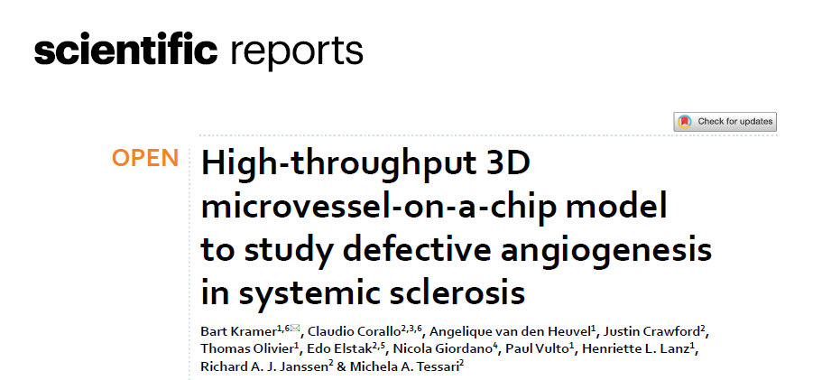
Dutch paper
Shows vascular organoid changes with perfusion of serum

Slide 25
Fibrosis markers
John McDonough and Kjetil Ask work

Slide 26
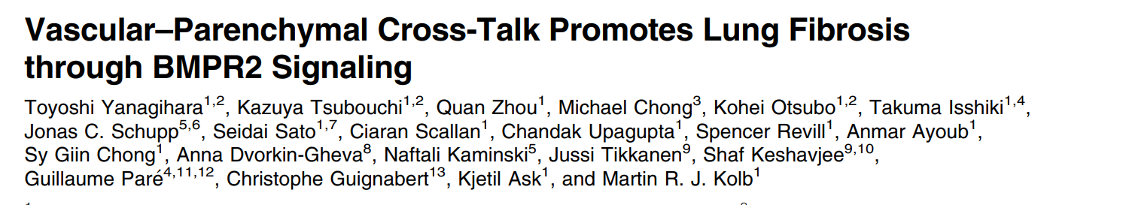
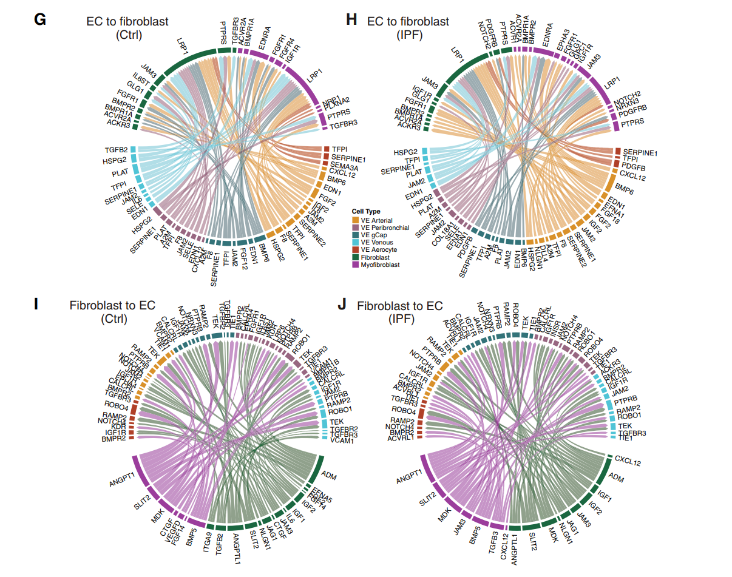
(G–J) Circos (R software Connectome [v1.0.1]) plots of EC–FB intercellular communication using single-cell RNA sequencing data from control and IPF lungs: (G) EC to FB (control), (H) EC to FB (IPF), (I) FB to EC (control), and (J) FB to EC (IPF)

Slide 27
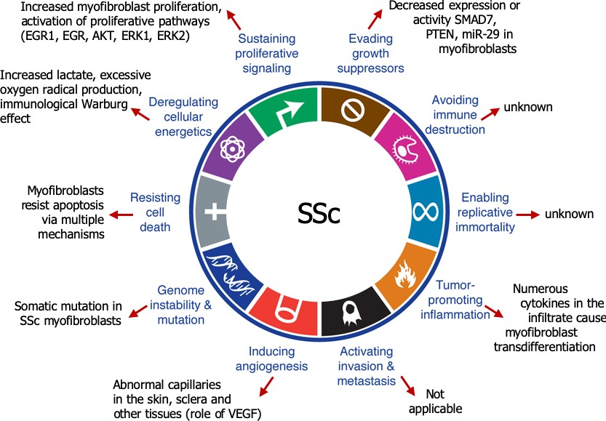
SSc FB share many properties with cancer
Osman et. al, (2025) (under review)

Slide 28
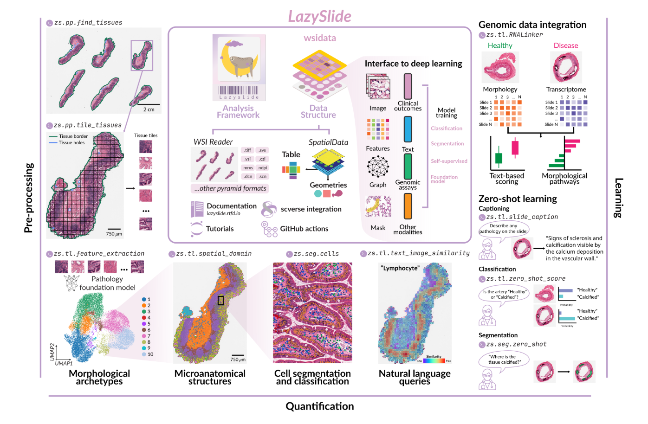
CXCL4 data
Mark has serum levels of CXCL4 data
Boyang has data on perfusing pt serum through HUVECs
Next steps – human “Primary Cells”, perfusion of patients serum through this

Slide 29
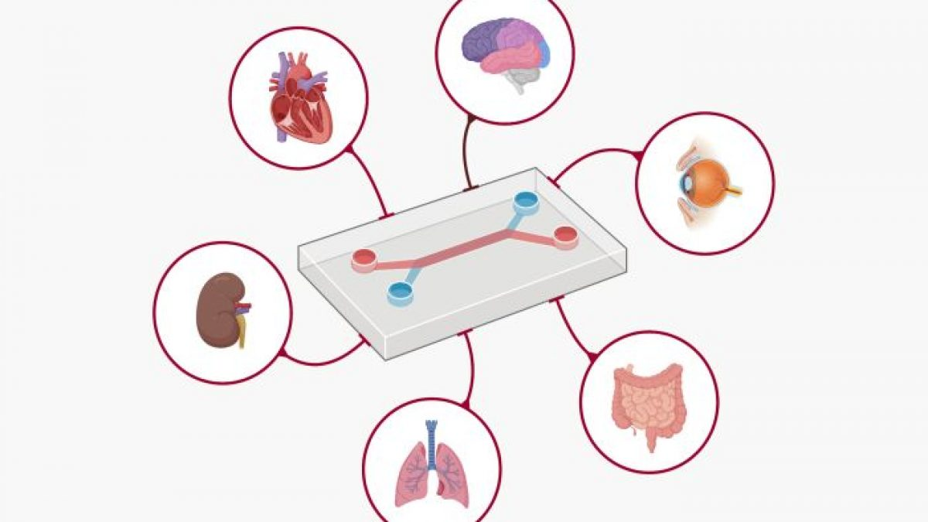
Organ on a chip technology

Slide 30

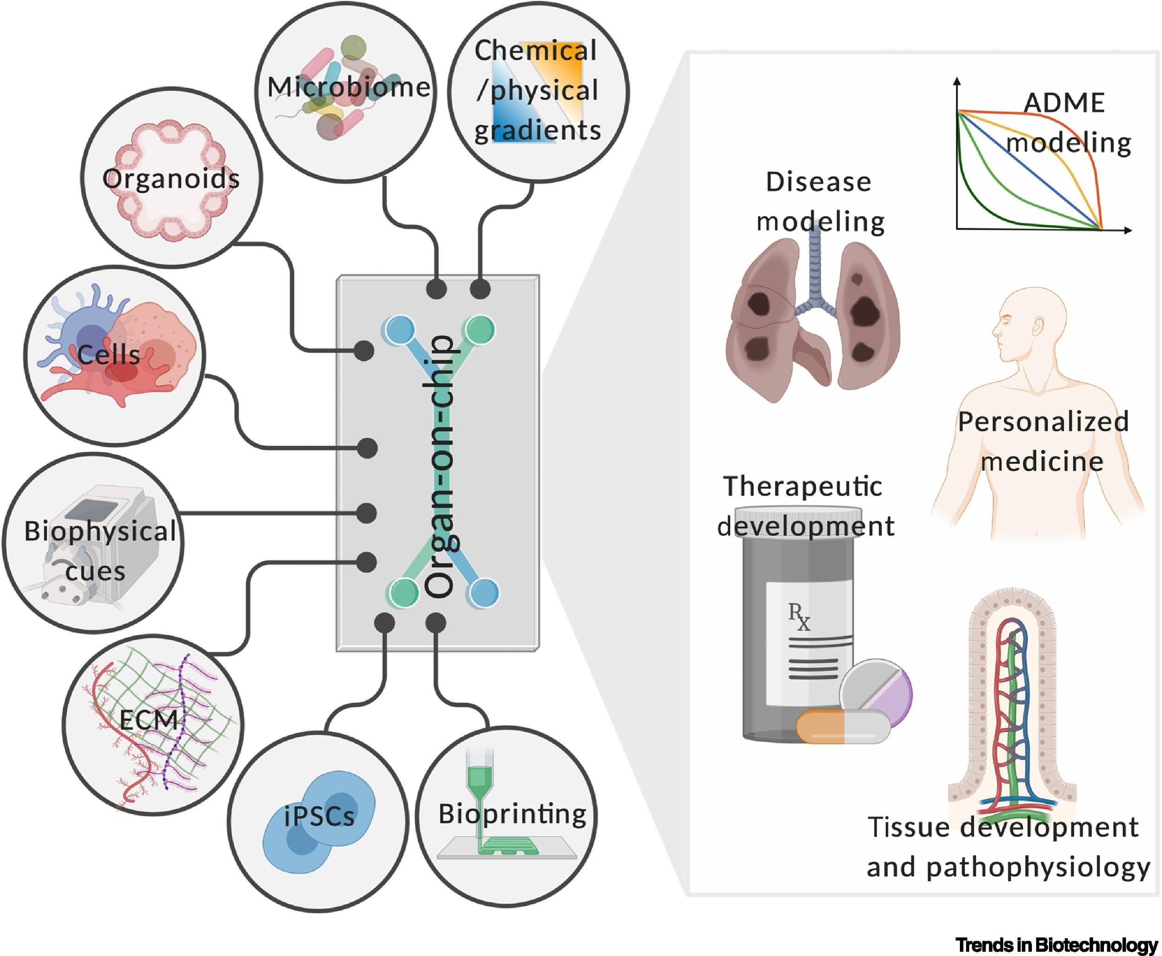

Slide 31
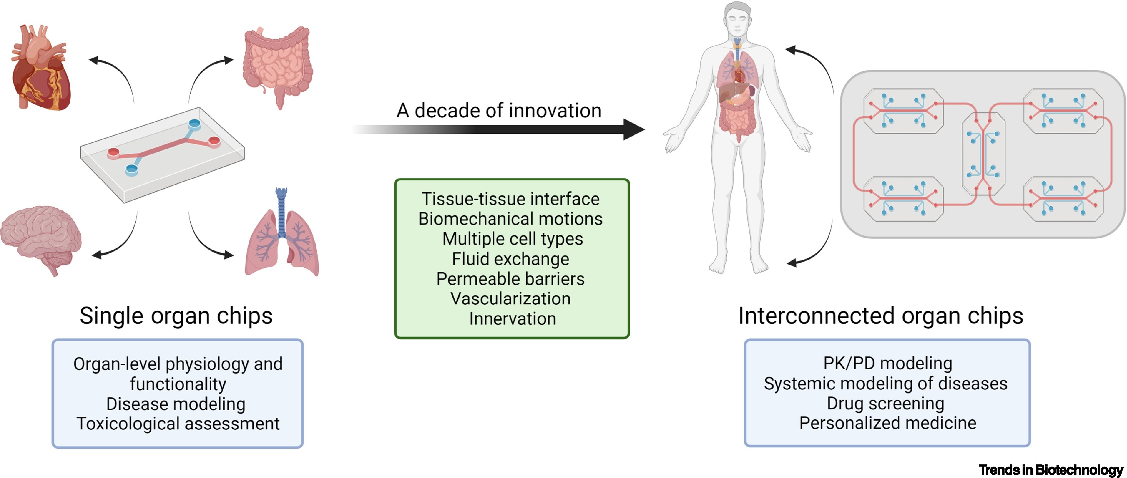

Slide 32
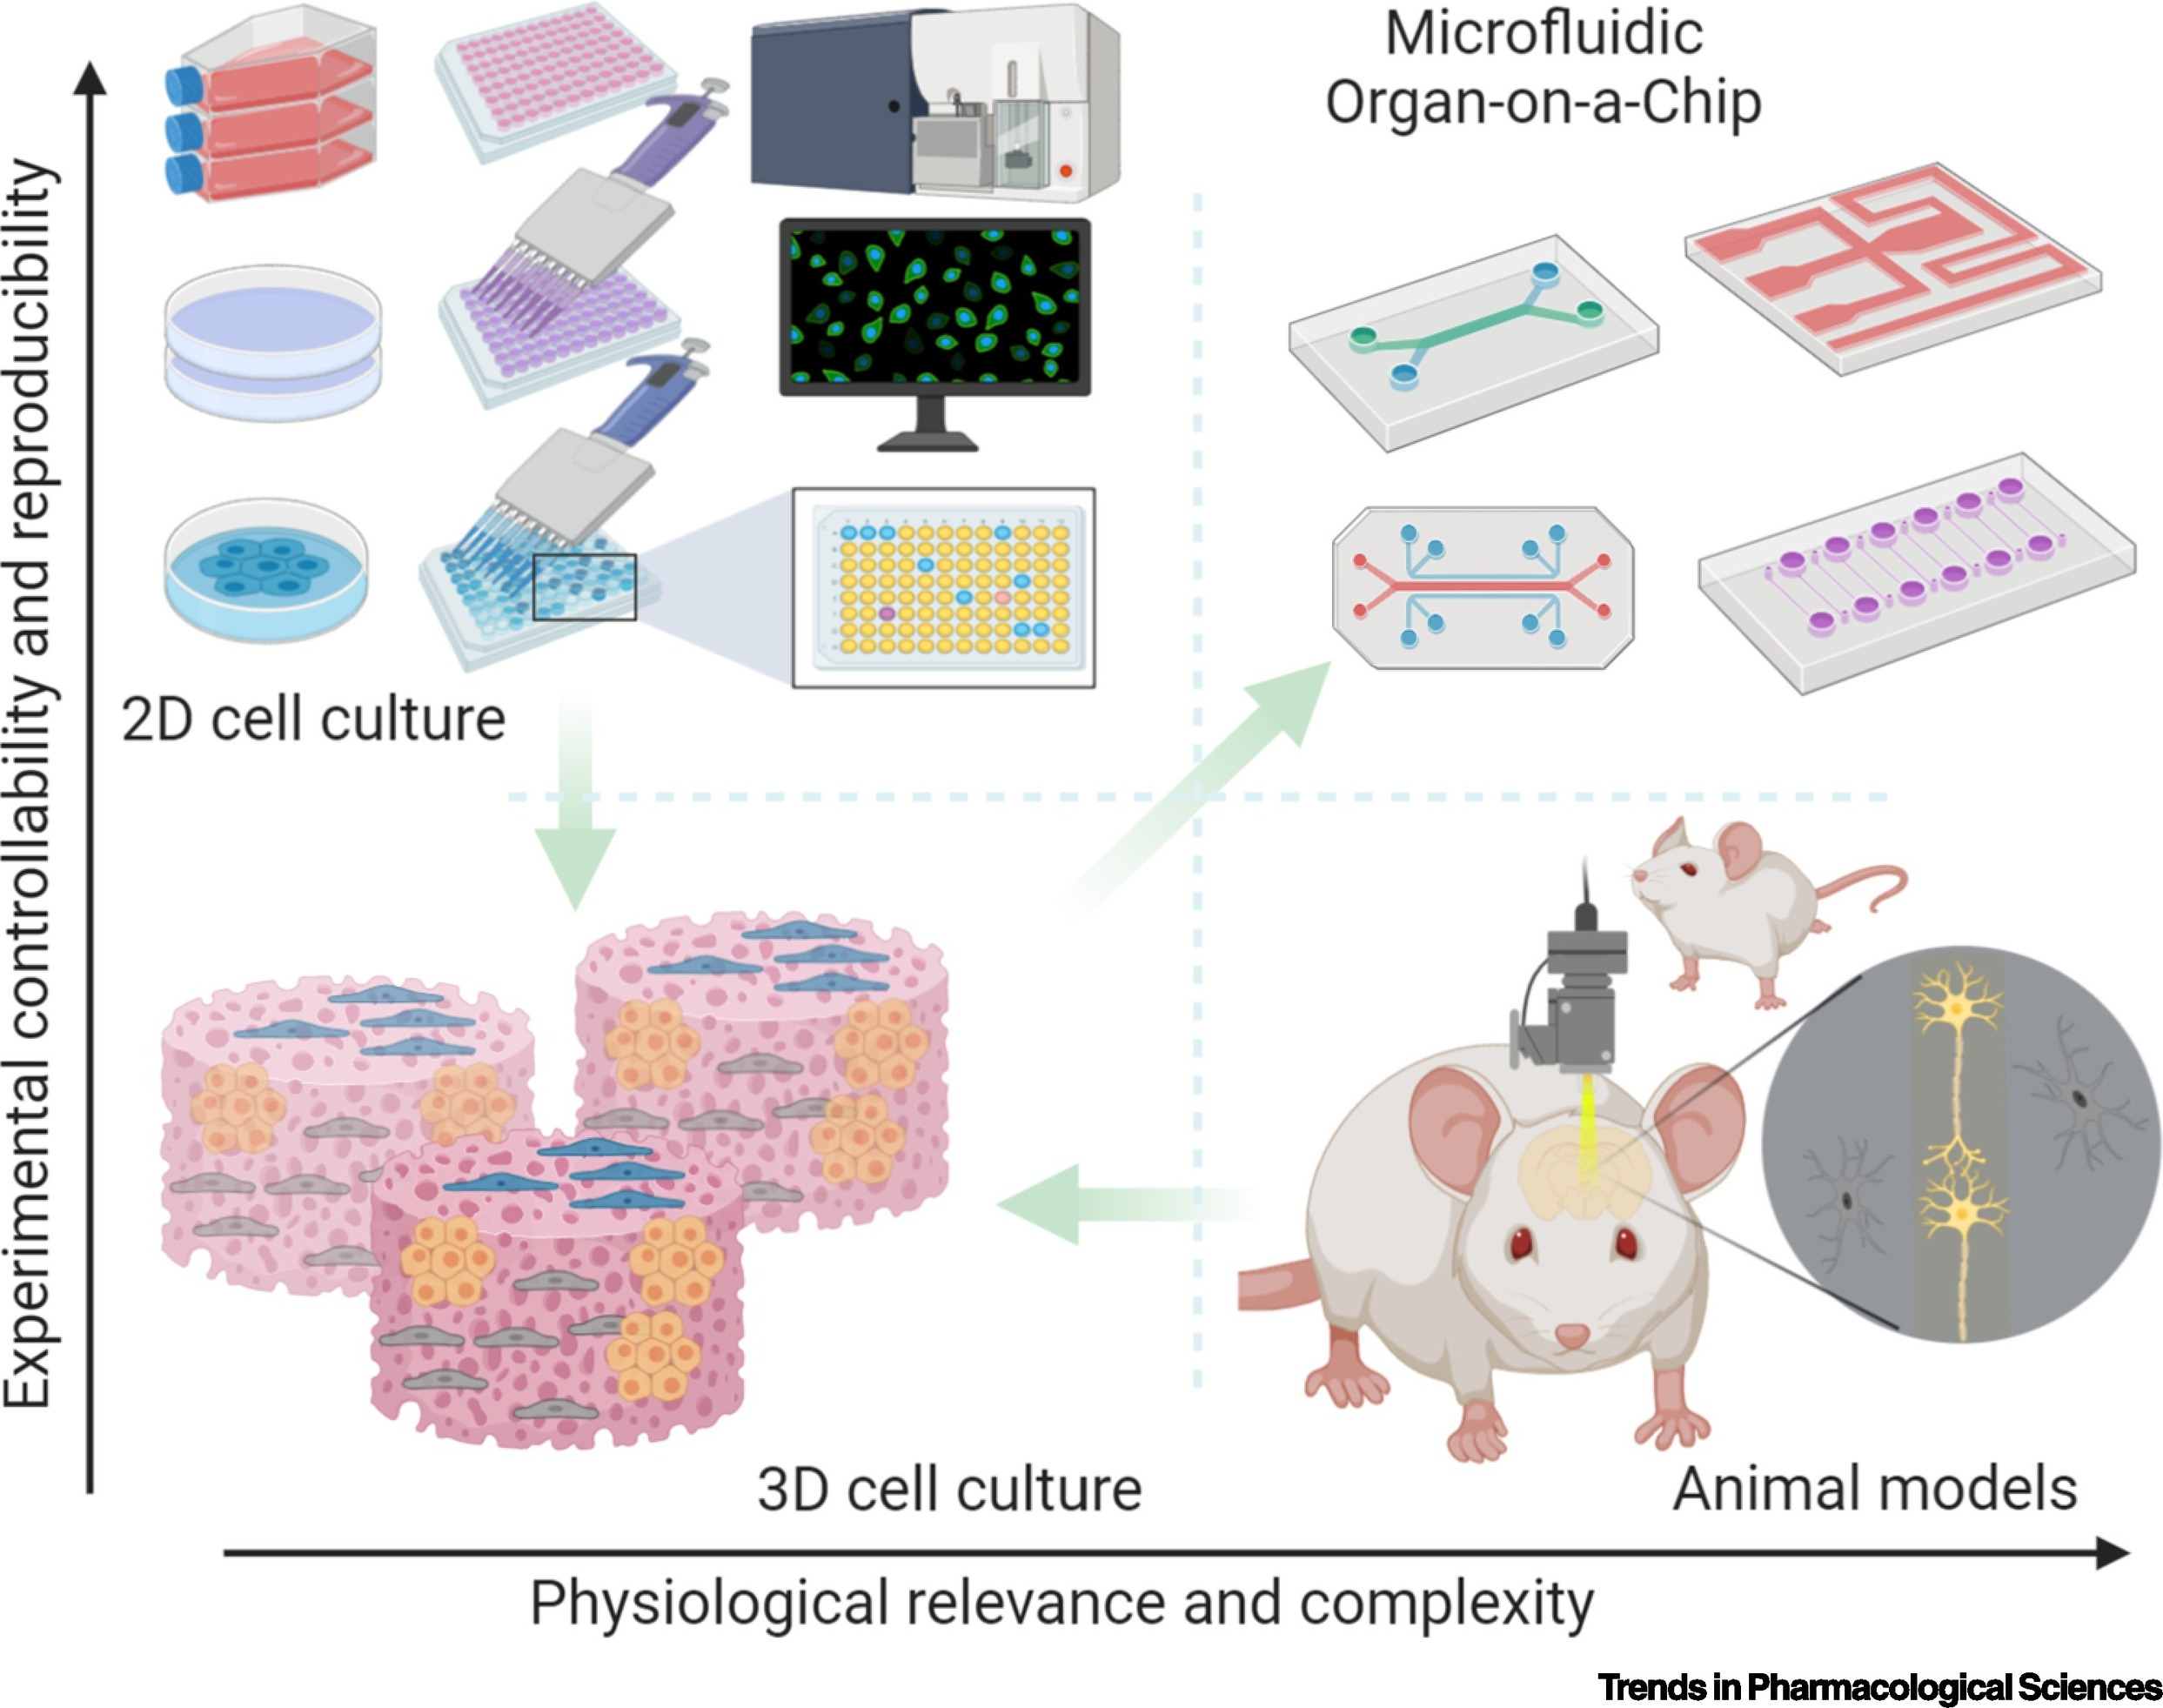
Animal Models

Slide 33
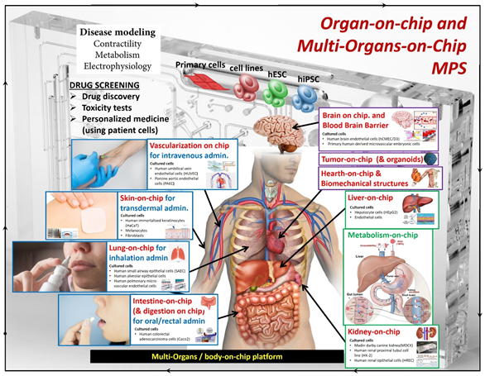

Slide 34
Dr May Choi, University of Calgary
Autoantibody markers in connective tissue diseases
Mitogen lab – multiple novel antibody discovery

Slide 35
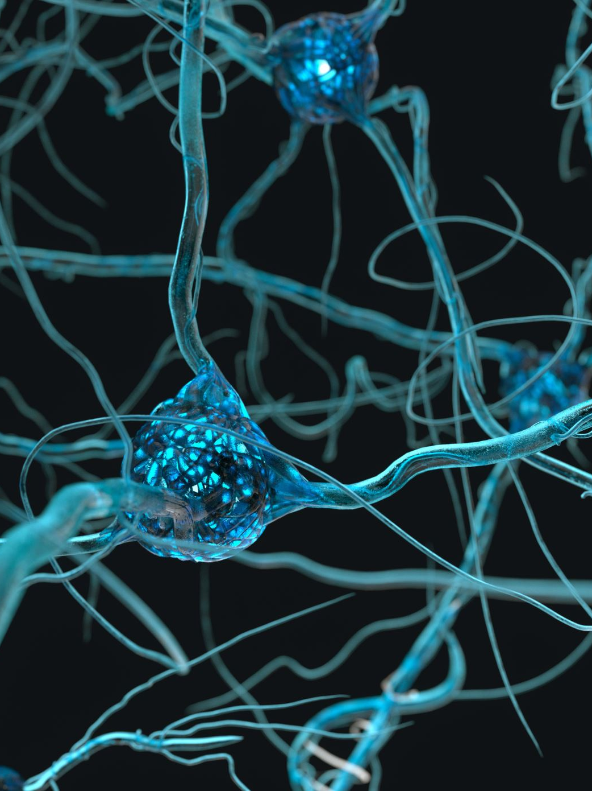
Dr Nancy Maltez, University of Ottawa
Cellular based therapies
Stem cell transplantation
CD19 CAR-T cells
Bispecific cells

Slide 36
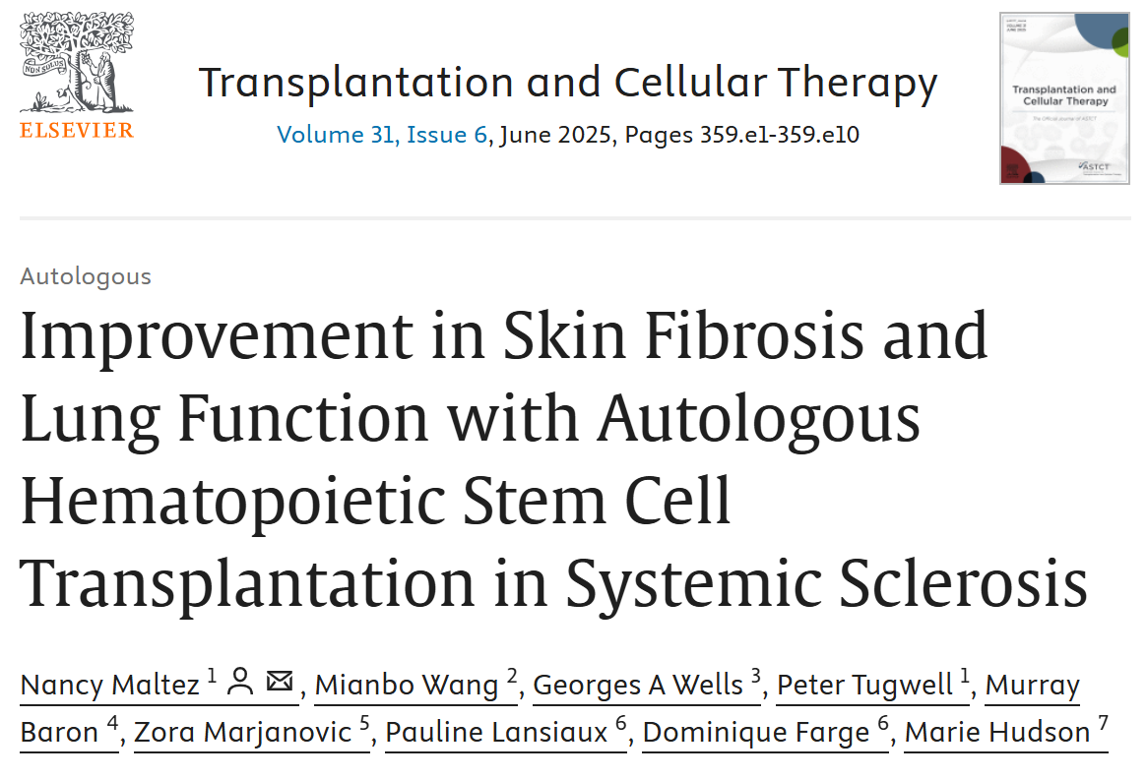

Slide 37
Clinical epidemiology – helps see patterns in disease leading to improved monitoring or treatment
Marie Hudson
Sabrina Hoa
Brett Thombs
Murray Baron – developed CSRG collaboration with Australian interest group
Nancy Maltez

Slide 38


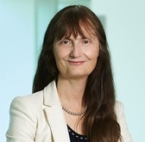



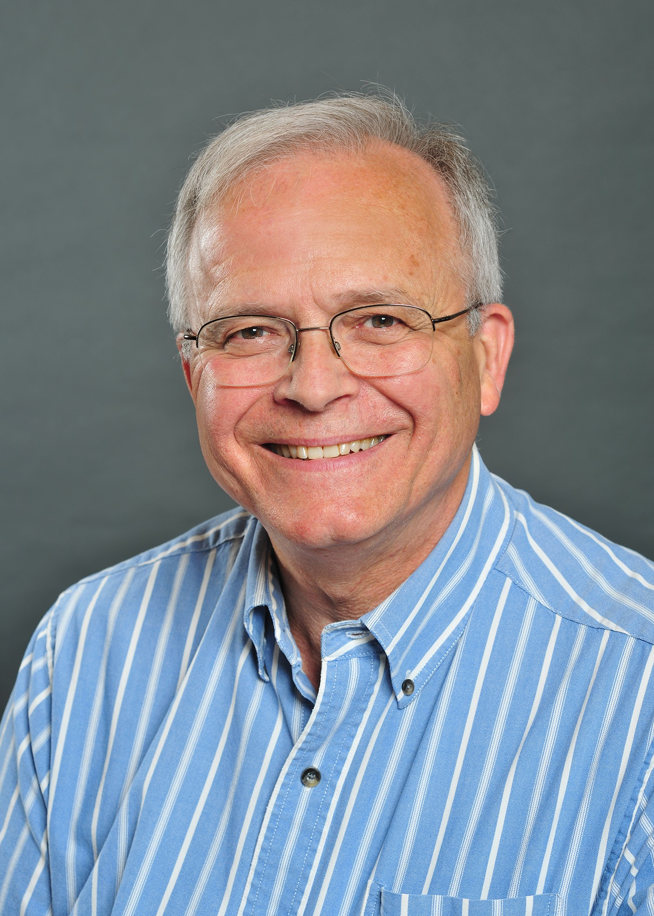
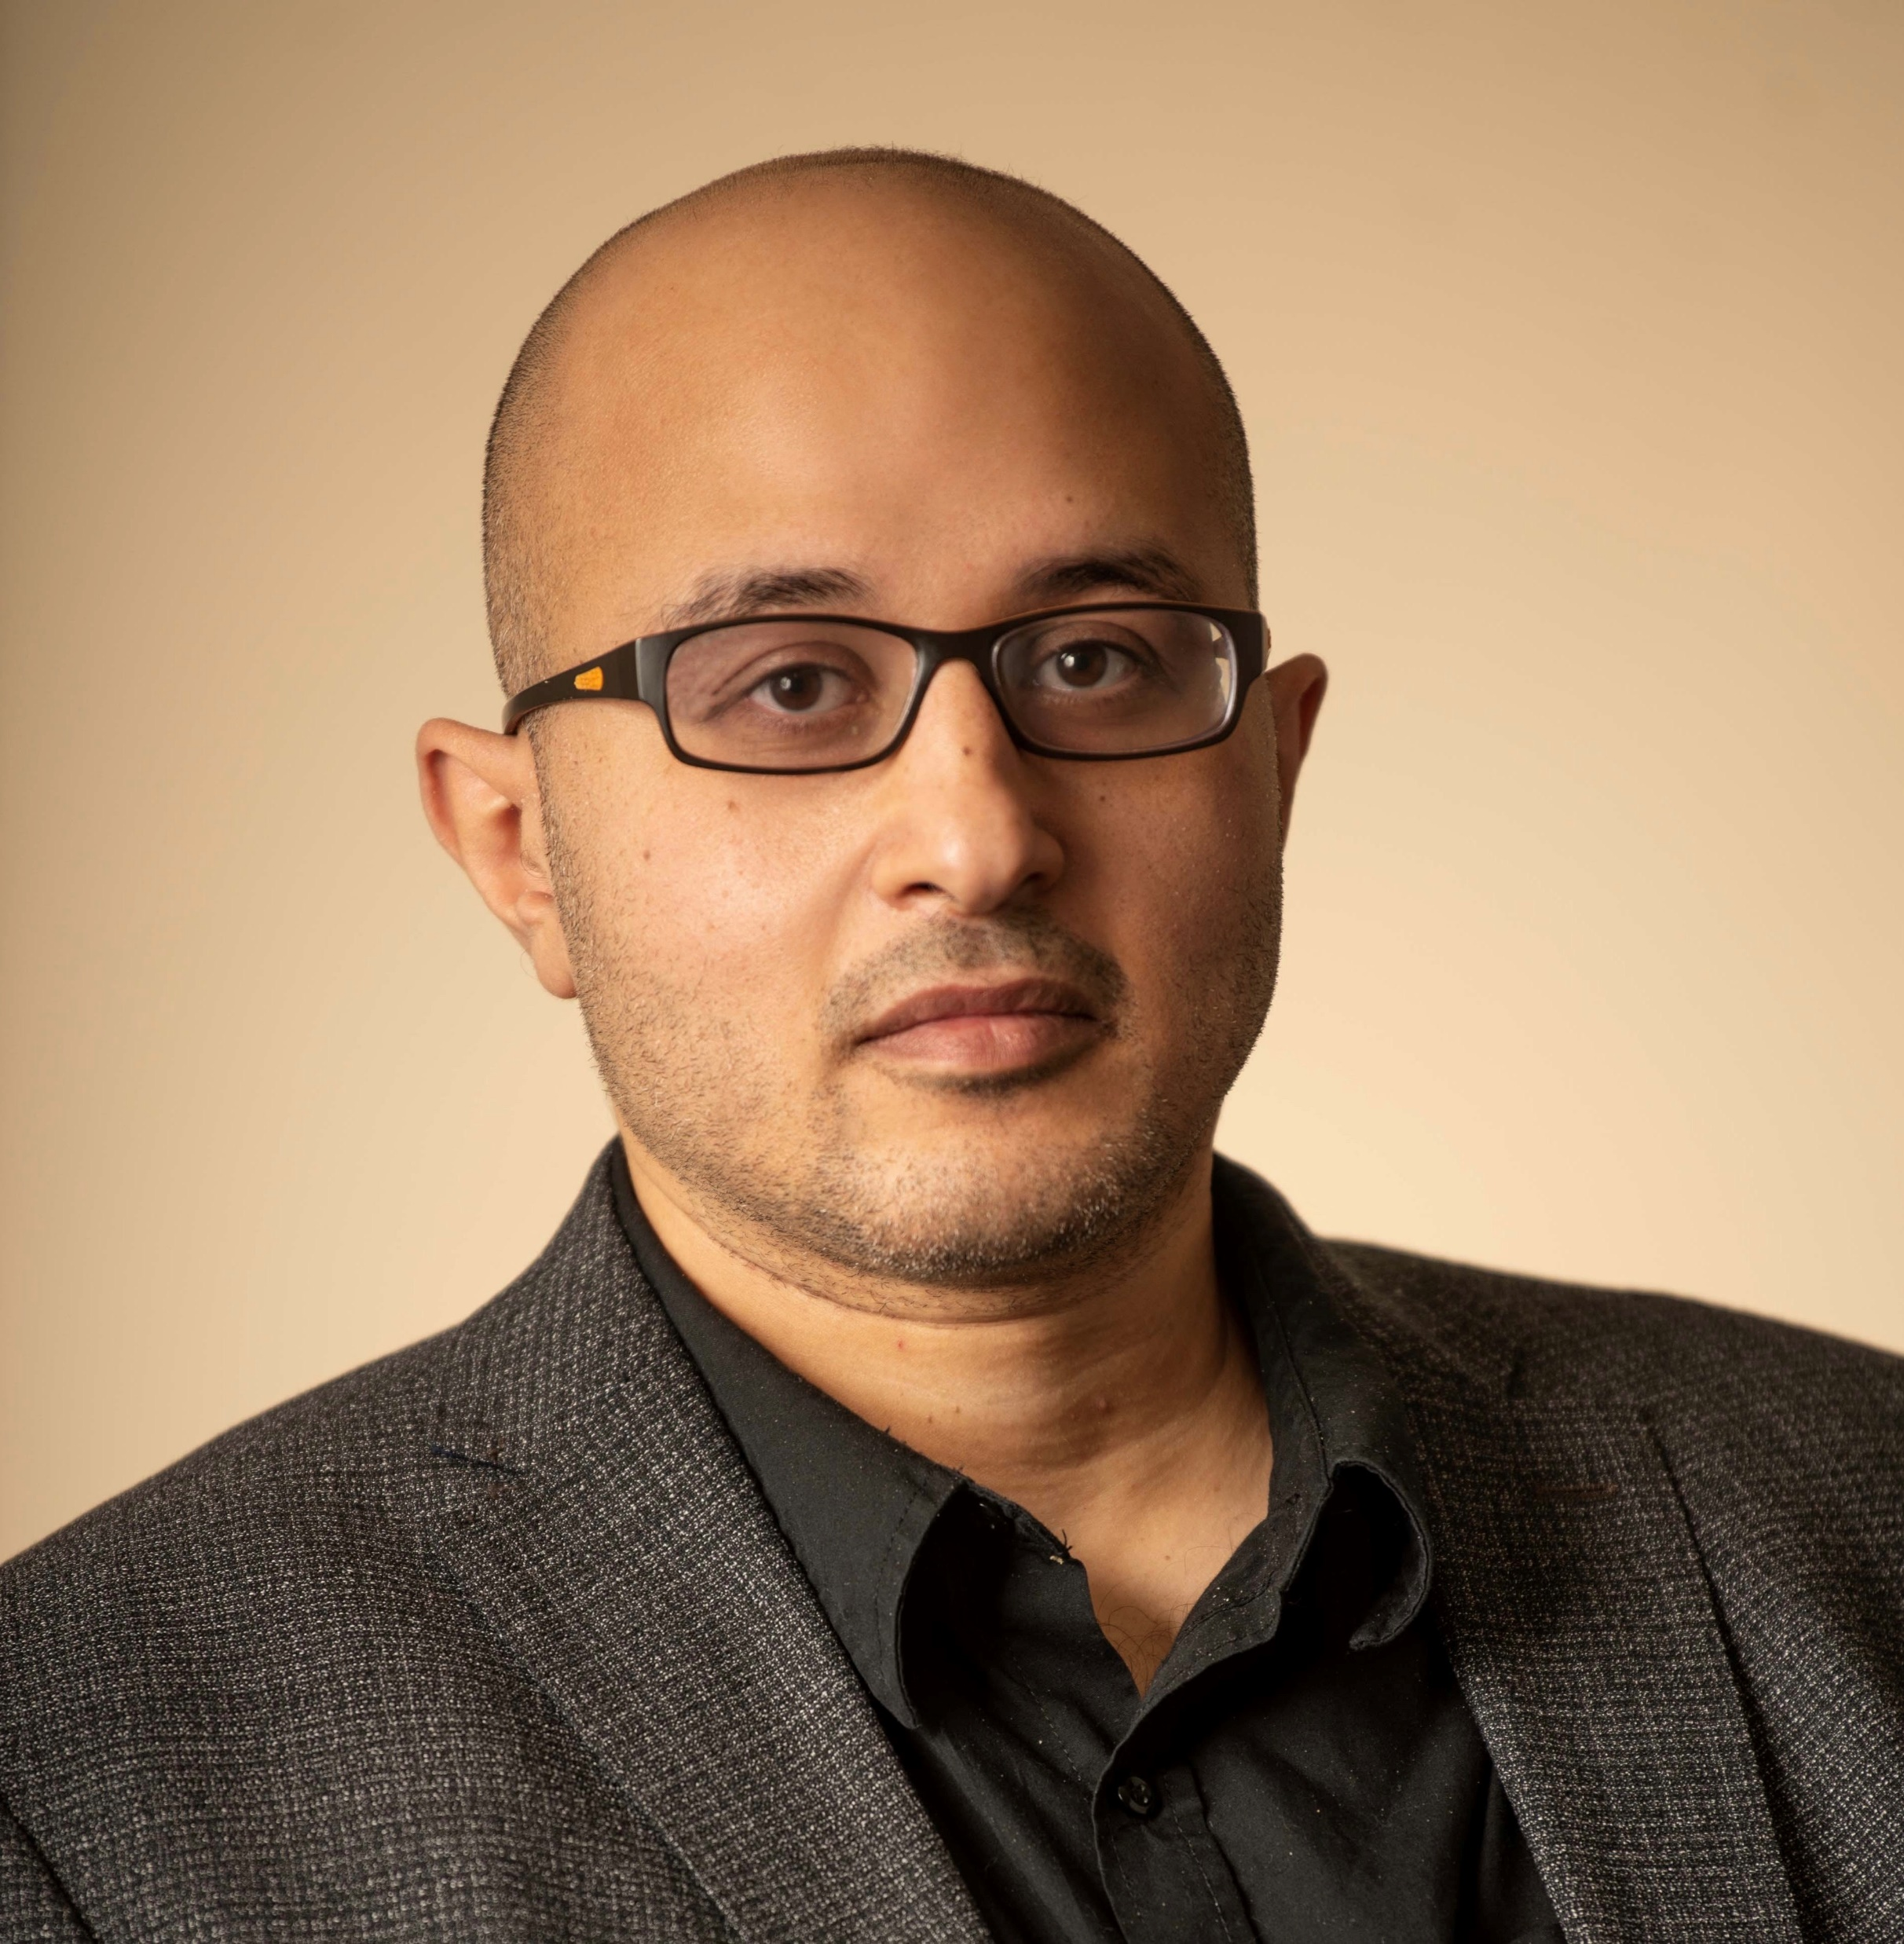
Meet Our Executive Team:
Dr. Janet Pope
Dr. May Choi
Dr. Murray Baron
*Founding PI and Previous Director
Dr. Maggie Larché
Dr. Sabrina Hoa
Dr. Carter Thorne
Dr. Mo Osman

Slide 39
Top 5 CSRG publications (past ~10 years) — short list & why they matter
Alhajeri H, Hudson M, Fritzler M, Pope J, et al. — “2013 ACR/EULAR classification criteria for systemic sclerosis outperform the 1980 criteria: data from the Canadian Scleroderma Research Group.” Arthritis Care & Research 2015. Why impactful: Provided strong, multicenter CSRG evidence that the 2013 ACR/EULAR criteria substantially improve sensitivity over the 1980 criteria — important for case-finding, clinical trials eligibility, and earlier diagnosis. PubMed
Valenzuela A, Baron M, et al. — “Calcinosis is associated with digital ulcers and osteoporosis in patients with systemic sclerosis: a Scleroderma Clinical Trials Consortium study.” Seminars in Arthritis and Rheumatism 2016. Why impactful: Large international analysis (including CSRG data) that clarified risk factors and clinical associations for calcinosis — a disabling SSc manifestation — guiding clinicians on screening and management priorities. (Highly cited.) PubMed+1
Racine M, Hudson M, Baron M, et al. — “The impact of pain and itch on functioning and health-related quality of life in systemic sclerosis: an exploratory study.” J Pain Symptom Manage 2016. Why impactful: Demonstrated that pain and pruritus in SSc substantially worsen depression, disability, sleep and fatigue — shifting attention toward symptom-directed care and patient-reported outcomes in SSc. PubMed+1
Muntyanu A, Milan R, Rahme E, LaChance A, Hudson M, Baron M, Netchiporouk E, et al. — “Exposure to silica and systemic sclerosis: a retrospective cohort study based on the Canadian Scleroderma Research Group.” Frontiers in Medicine 2022. Why impactful: Used CSRG registry data to strengthen the association between occupational/environmental silica exposure and SSc — important for prevention, occupational health policy, and etiologic understanding. PubMed+1
Barbacki A, (and collaborators from CSRG & ASCS) — “Damage trajectories in systemic sclerosis using group-based trajectory modelling” (multi-registry analysis including CSRG) — 2023. Why impactful: Identified distinct trajectories of organ damage over time using registry data (CSRG + Australian cohort), which helps risk-stratify patients and tailor monitoring intensity and therapeutic strategies. PubMed

Slide 40
Brett Thombs: Top 5 SPIN publications (past ~10 years) — short list & why they matter
Effects of a multi-faceted education and support program (SPIN-CHAT) — Thombs BD et al., Lancet Rheumatology, 2021. Why it matters: First high-quality, pragmatic trial from SPIN testing a brief videoconference-based mental-health/support intervention for people with scleroderma during COVID-19 — showed feasibility and important effects on anxiety/depression outcomes and demonstrated the network’s ability to rapidly deliver remotely-based, scalable psychosocial interventions. The Lancet
Pain levels and associated factors in the SPIN cohort — Lee YC et al., Lancet Rheumatology, 2021. Why it matters: Large multicentre cross-sectional analysis (SPIN cohort) that quantified the very high prevalence and contributors to pain in systemic sclerosis — helped prioritise pain as a central clinical and research target. The Lancet
SPIN-SSLED (Support-group Leader EDucation) — BMJ Open, non-randomised feasibility trial, Thombs BD et al., 2019. Why it matters: Demonstrated practical feasibility and acceptability of a program to train peer support-group leaders — important for capacity building, patient empowerment and sustainable delivery of peer support across countries. PubMed
SPIN Cohort baseline/profile paper — Dougherty DH et al., 2018 (SPIN Cohort description / baseline features). Why it matters: The cohort profile that established SPIN’s web-based cohort infrastructure (how patients are enrolled, measures collected, cohort comparability to other SSc cohorts). This paper underpins all subsequent SPIN intervention trials and cohort analyses. PubMed+1
Randomized feasibility trial of the SPIN-SELF self-management program — Kwakkenbos L et al., Pilot & Feasibility Studies (PMC), 2022. Why it matters: Tested feasibility (and informed modifications) for an online self-management program for people with SSc; results guided later design changes (eg. adding facilitator-led groups) and showed how to adapt digital interventions to improve engagement in this rare-disease population. PMC+1

Slide 41
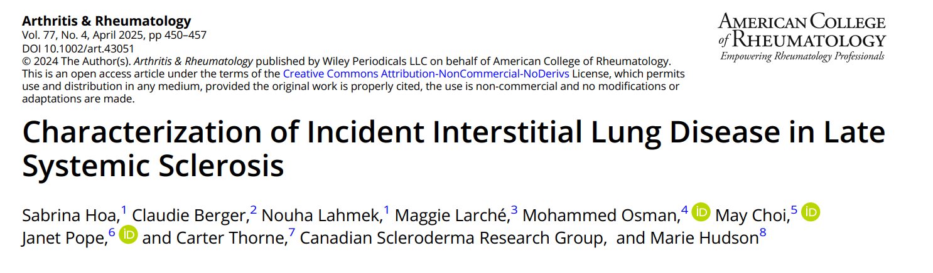
ILD occurs just as frequently in early SSc as late SSc - male sex, non-White race, diffuse cutaneous involvement, arthritis, myositis, antitopoisomerase I antibodies, and high C-reactive protein levels.

Slide 42

Dr Sabrina Hoa, University of Montreal
Observational CSRG studies:
incidence of ILD and PAH in early vs late disease;
disease phenotypes according to ethnicity;
role of KL-6 biomarker to predict lung disease progression and treatment response;
role of autoantibody titers to predict lung and skin disease course
Clinical studies
Upfront treatment of limited scleroderma to prevent disease complications: we are in planning phase to conduct this study across all CSRG sites
Upfront treatment of mild scleroderma lung disease to prevent lung damage: based on promising results from CSRG cohort studies, we are funded to conduct a pilot randomized controlled trial testing the efficacy of MMF vs placebo to preserve lung function. Recruitment is ongoing at 3 sites in Quebec.

Slide 43
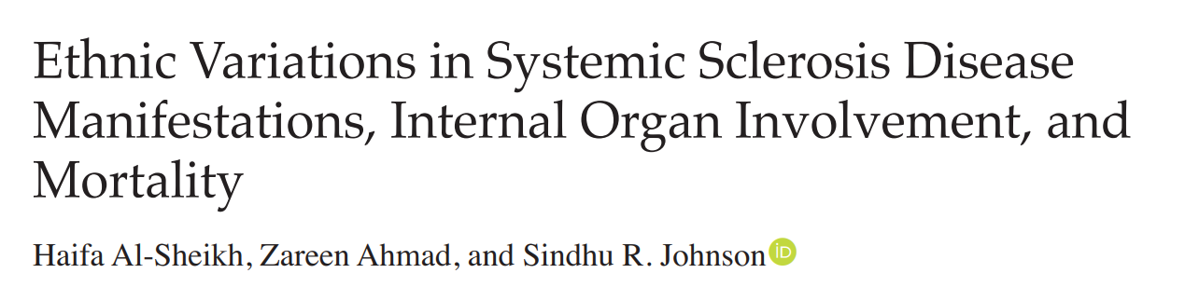
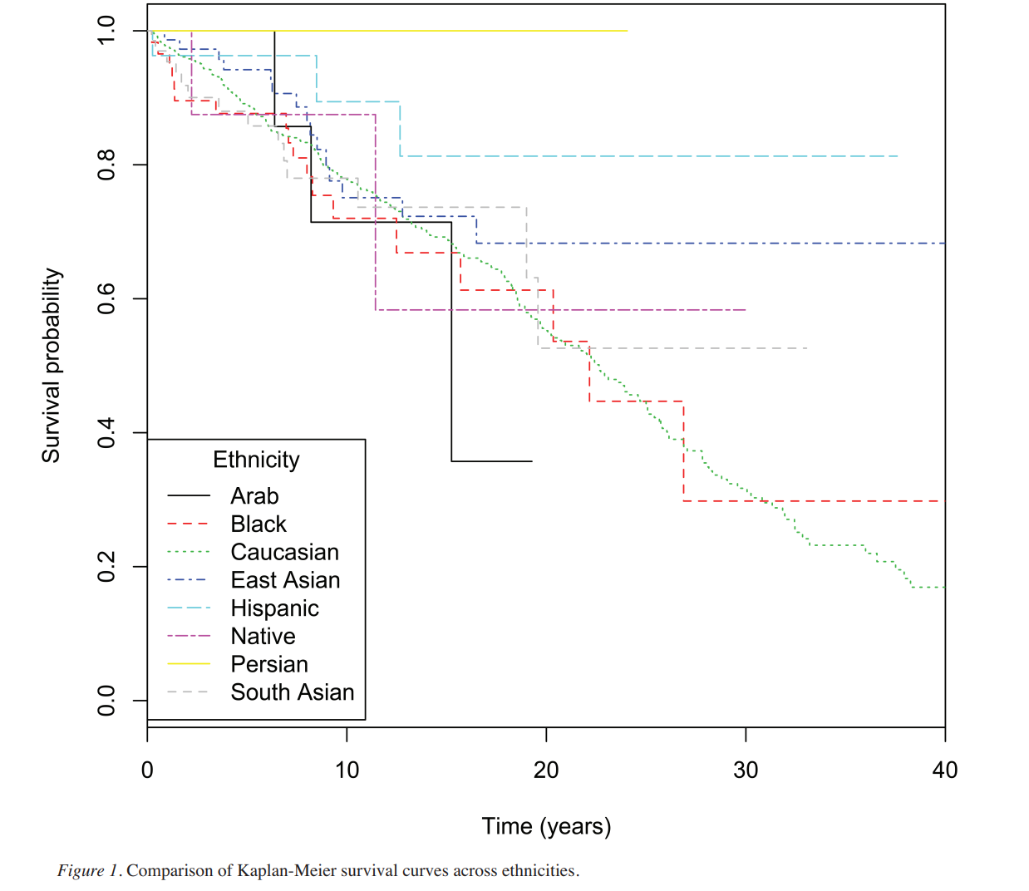
Dr Zahreen Ahmad and Sindhu Johnson, University of Toronto

Slide 44
Elena Netchiporouk Localised scleroderma
Incidence, prevalence, and mortality of localized scleroderma in Quebec, Canada: a population-based study The Lancet Regional Health — Americas, Volume 44, 101044
showed the disease affects women three times more often than men,
between ages 60 and 79.
Cases rose until about 2004, plateaued, and began declining after 2013.
identified geographic hotspots in southern Quebec, suggesting potential environmental or genetic factors.

Slide 45

Clinical Trials – determine whether new treatments improve outcomes
148 studies recruiting

Slide 46
What about the rest of the world: New therapy trials – clinicaltrials.gov
Anifrolumab
Antifibrotics
CAR-T
ECP
Stem cell transplantation

Slide 47
Take home messages
Very variable disease
Makes studying it challenging
Trying to dissect “who starts the fight” – basic science
Epidemiology looks at trends in data – CSRG, SPIN
Clinical trials determine which medications are useful
GET INVOLVED…

Slide 48

Thank you

