Slide 1
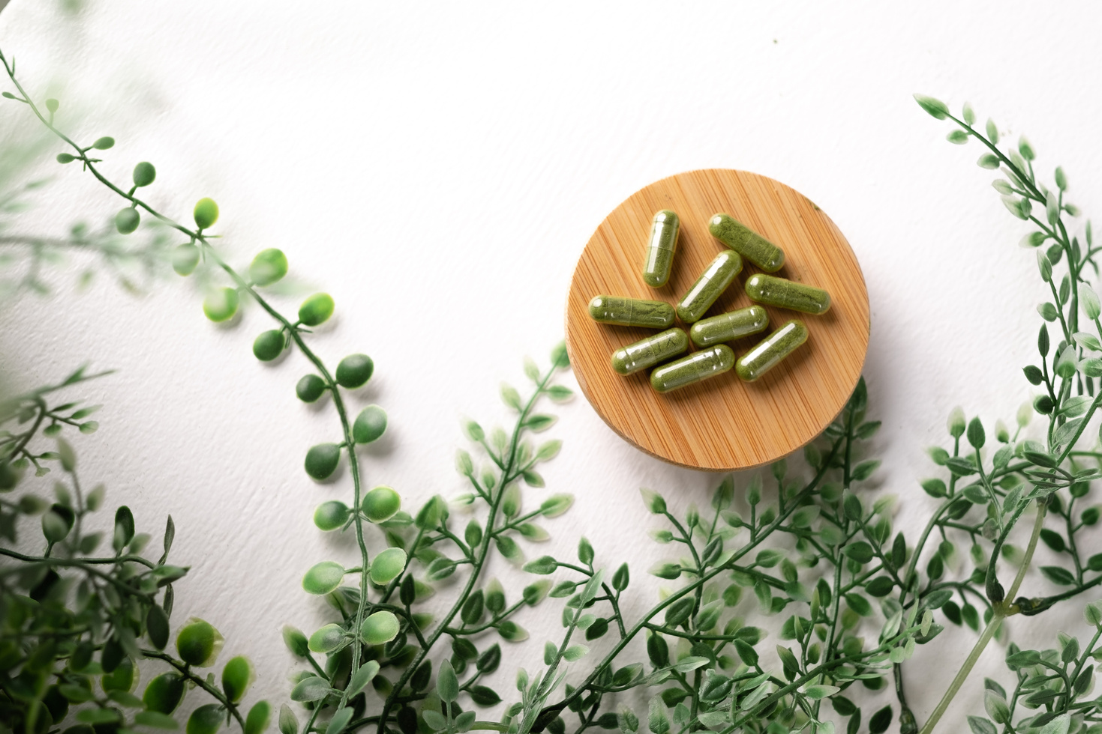
NOURISHING DIETS & SCLERODERMA: FOUNDATIONS OF NUTRITION & INTEGRATIVE CARE
EDUCATION TO ENHANCE YOUR WELL-BEING

Slide 2

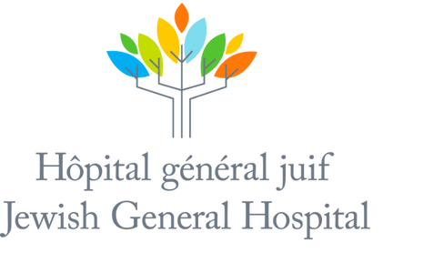
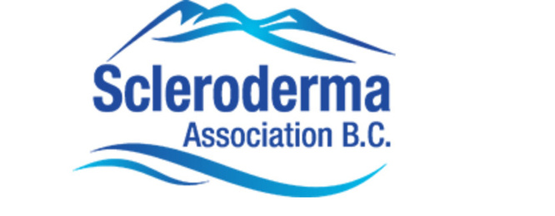
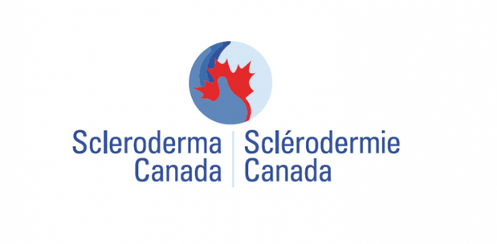

DISCLOSURES:
Lady Davis Institute of Medical Research (SPIN)
Scleroderma Canada Board Member
Canadian College of Naturopathic Medicine
Scleroderma Association of BC

Slide 3
DISCLAIMER
Not intended to be medical advice & is intended for self-educational purposes. The information shared is not a substitute for professional medical guidance, diagnosis, or treatment. Always consult a qualified healthcare provider with any questions regarding a medical condition or treatment options.

Slide 4

KEY CONCEPTS
  BLOOD SUGAR HOMEOSTASIS
  Catabolism vs Anabolism
  Your individual macronutrient needs
  Micronutrients deficiencies
  Differing diets in scleroderma
  Individual food sensitivities
  Tools for cooking
  Types of fiber

Slide 5
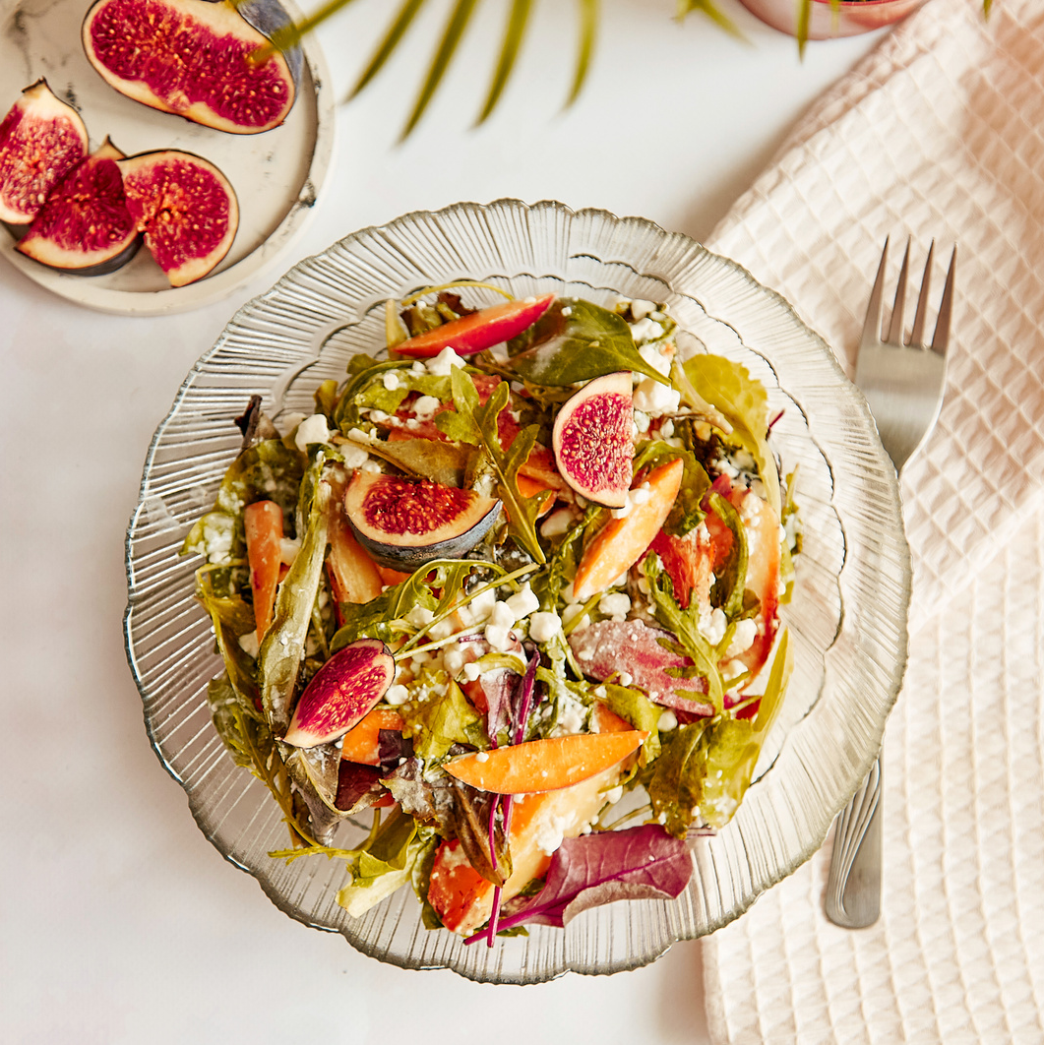
KEY TAKEAWAYS
  Holistic Care for Chronic Disease: Understand why chronic diseases like scleroderma can benefit from integrative care
  The Role of Diet: Explore how nutrition impacts symptoms and overall health in scleroderma
  Food Sensitivities & Individualized Health: Recognize common sensitivities related to scleroderma and how they can affect symptoms

Slide 6
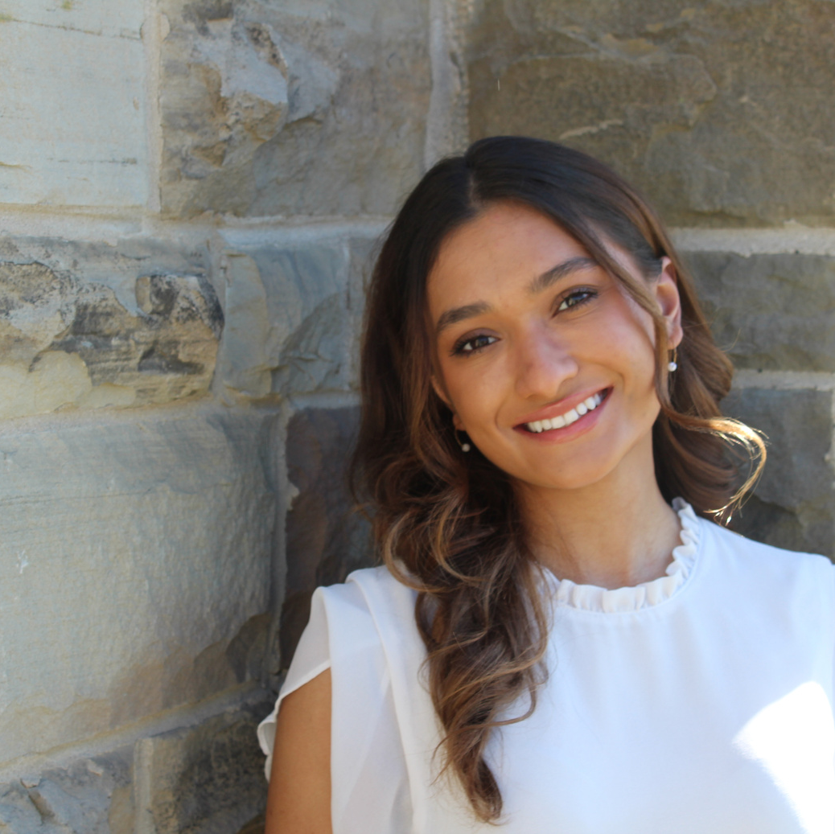
MY JOURNEY TO NATUROPATHIC MEDICINE

Slide 7

UNDERSTANDING SCLERODERMA
  Scleroderma is a chronic, inflammatory autoimmune disease
  Incurable pathology, often overlooked
  Naturopathic care as an adjunct to conventional medicine
Living with scleroderma affects many aspects of your health and well-being, meaning optimal treatment should have an integrative approach
Notes:
As we all know, scleroderma is a chronic meaning lifelong, inflammatory, autoimmune disease.
And with anything chronic or life long in nature, the disease, symptom picture and needs of a patient are bound to change and fluctuate.
With this being said, conventional medicine generally uses mechanisms to target the autoimmunity to find healing via symptom suppression (ex. This is expressed with your Immunosuppressants, vasodilators, PPI’s) those kind of life-saving and preserving drugs that are entirely necessary in many scenarios. Now this is not a knock at conventional medical care at all. Where naturopathic medical care fits into this puzzle is the day to day and person underneath the disease.
Being that this disease is lifelong, there are so many gaps that we are looking to address. For example, I always use the ideology of being put on antibiotics xxxxxx.
CONVENTIONAL VS NATRUOPATHIC MEDICINE
**mechanism of the autoimmunity
mechanism, very cell specific or general inflammatory stuff ***
THEREFORE since it’s a chronic autoimmune pathology there is a lot to cover
POINTS TO STRESS: conventional interventions have so much value, but based on the nature of the disease, being chronic autoimmune pathology there will always be gaps that we are looking to address with naturopathic medicine
ND’s are adjunctive
SLIDES: drug nutrient interactions, biologics, immunosuppressants
SLIDES: Immunosuppressants, picking the worst of two evils, how can we build and offset your risk of contracting infections, how diet, supplements, acute pathologies are opportunistic (HAP AND CAP, C.DIFF), probiotics

Slide 8
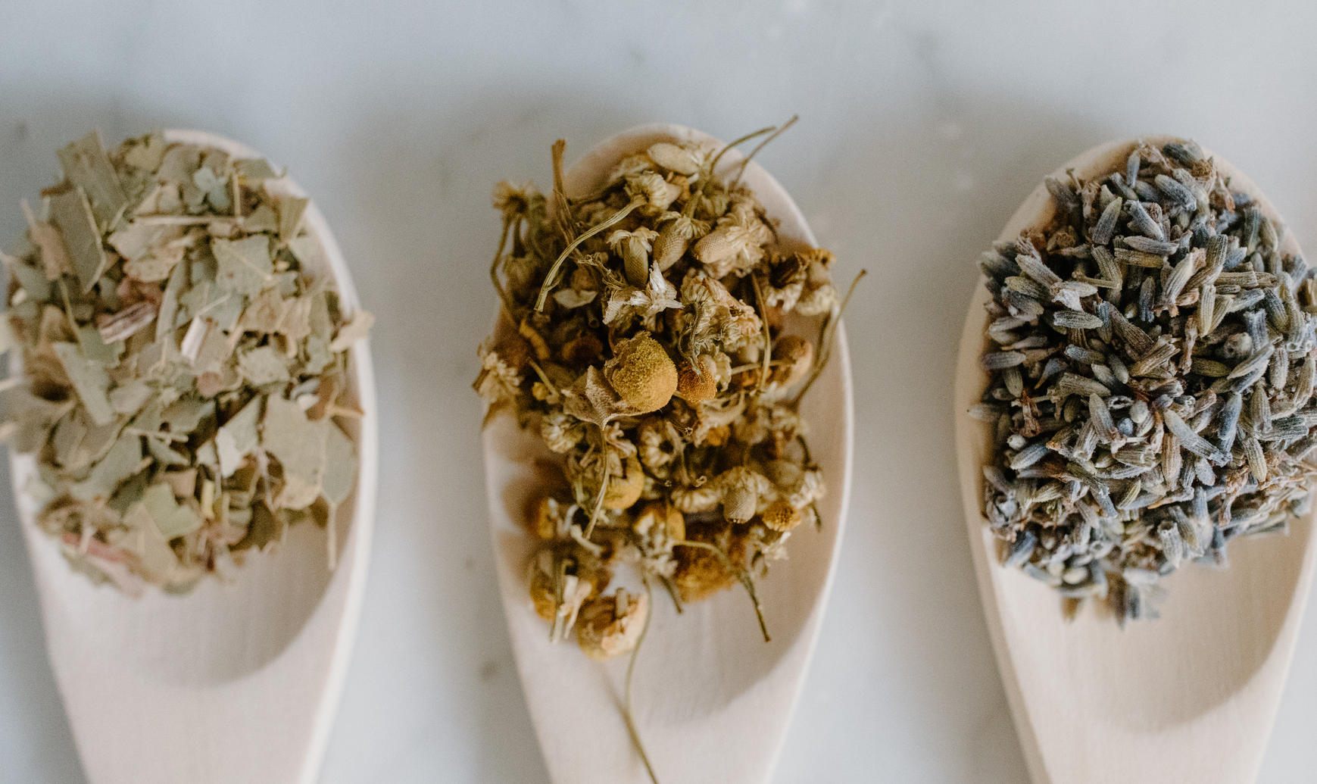
WHAT IS NATUROPATHIC MEDICINE
Registered Naturopathic Doctors (ND) attend a 4 year post-grad naturopathic medical school.
Naturopathic Doctors are trained to diagnose & treat conditions through:
  Natural & traditional therapies
  Biomedical perspectives & pharmacology
  Root cause perspective of symptoms
  Diet & lifestyle
  Physical modalities (including acupuncture, cupping, laser, ultrasound therapy etc)
Notes:
What does Naturopathic Medicine have to offer you as a scleroderma patient?
Personalized approach
Support for the whole individual
Natural therapies in conjunction to pharmacological interventions
Health optimization
Preventative care

Slide 9

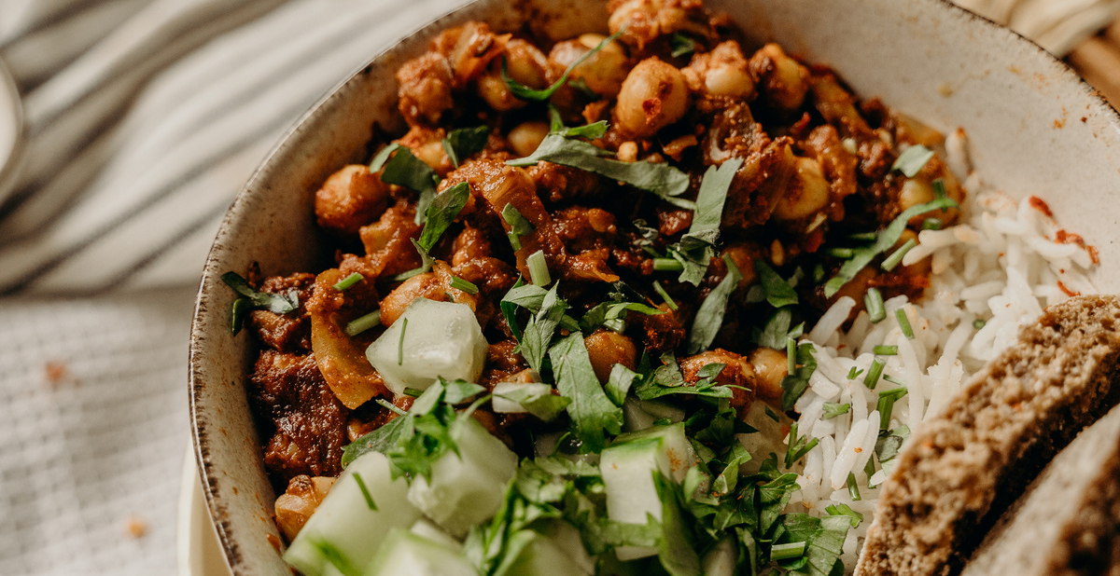
DIET & NUTRITION
Why does it matter?
Scleroderma is an inflammatory condition with common food and GI sensitivities. What you eat can influence inflammation, gut health, energy levels, and GI-related pain and discomfort. Through diet we can combat oxidative stress in the body, modulate immunity & make your body more tolerant to adversities.

Slide 10
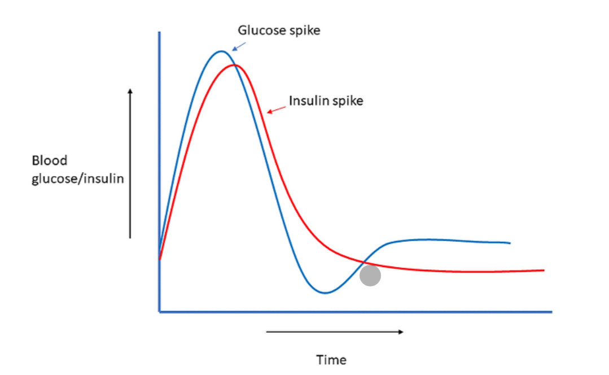
BLOOD SUGAR
  Build muscle → more glucose uptake, smaller blood sugar spikes
  Move after meals → walking improves glucose disposal and insulin sensitivity
  Prioritize protein & fiber → slow carbohydrate absorption, reduce post-meal spikes
  Limit refined sugar & ultra-processed carbs → prevents rapid surges and crashes
Steady blood sugar comes from movement, muscle mass, balanced nutrition, and lifestyle habits that support healthy insulin sensitivity.
Notes:
As we all know, scleroderma is a chronic meaning lifelong, inflammatory, autoimmune disease.
And with anything chronic or life long in nature, the disease, symptom picture and needs of a patient are bound to change and fluctuate.
With this being said, conventional medicine generally uses mechanisms to target the autoimmunity to find healing via symptom suppression (ex. This is expressed with your Immunosuppressants, vasodilators, PPI’s) those kind of life-saving and preserving drugs that are entirely necessary in many scenarios. Now this is not a knock at conventional medical care at all. Where naturopathic medical care fits into this puzzle is the day to day and person underneath the disease.
Being that this disease is lifelong, there are so many gaps that we are looking to address. For example, I always use the ideology of being put on antibiotics xxxxxx.
CONVENTIONAL VS NATRUOPATHIC MEDICINE
**mechanism of the autoimmunity
mechanism, very cell specific or general inflammatory stuff ***
THEREFORE since it’s a chronic autoimmune pathology there is a lot to cover
POINTS TO STRESS: conventional interventions have so much value, but based on the nature of the disease, being chronic autoimmune pathology there will always be gaps that we are looking to address with naturopathic medicine
ND’s are adjunctive
SLIDES: drug nutrient interactions, biologics, immunosuppressants
SLIDES: Immunosuppressants, picking the worst of two evils, how can we build and offset your risk of contracting infections, how diet, supplements, acute pathologies are opportunistic (HAP AND CAP, C.DIFF), probiotics

Slide 11

ANABOLISM VS CATABOLISM
Anabolism vs Catabolism
  Anabolism: Building and repairing tissue
  Catabolism: Breaking down tissue for energy
In Scleroderma
  Chronic inflammation and malabsorption increase catabolism
  Leads to muscle loss, weight loss, and fatigue
  Autoimmune flares
Ensure adequate protein and calories, reduce inflammation, address GI absorption issues, correct micronutrient deficiencies, and maintain light resistance or mobility exercise.
Notes:
As we all know, scleroderma is a chronic meaning lifelong, inflammatory, autoimmune disease.
And with anything chronic or life long in nature, the disease, symptom picture and needs of a patient are bound to change and fluctuate.
With this being said, conventional medicine generally uses mechanisms to target the autoimmunity to find healing via symptom suppression (ex. This is expressed with your Immunosuppressants, vasodilators, PPI’s) those kind of life-saving and preserving drugs that are entirely necessary in many scenarios. Now this is not a knock at conventional medical care at all. Where naturopathic medical care fits into this puzzle is the day to day and person underneath the disease.
Being that this disease is lifelong, there are so many gaps that we are looking to address. For example, I always use the ideology of being put on antibiotics xxxxxx.
CONVENTIONAL VS NATRUOPATHIC MEDICINE
**mechanism of the autoimmunity
mechanism, very cell specific or general inflammatory stuff ***
THEREFORE since it’s a chronic autoimmune pathology there is a lot to cover
POINTS TO STRESS: conventional interventions have so much value, but based on the nature of the disease, being chronic autoimmune pathology there will always be gaps that we are looking to address with naturopathic medicine
ND’s are adjunctive
SLIDES: drug nutrient interactions, biologics, immunosuppressants
SLIDES: Immunosuppressants, picking the worst of two evils, how can we build and offset your risk of contracting infections, how diet, supplements, acute pathologies are opportunistic (HAP AND CAP, C.DIFF), probiotics

Slide 12
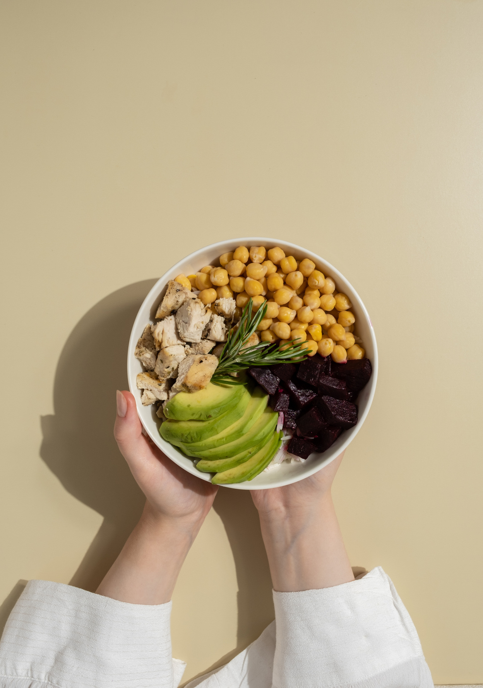
COMPONENTS OF FOOD & WHY THEY MATTER
  Protein: builds and repairs muscle, supports immune function
  Carbohydrates: main energy source, fuels brain and muscles
  Fats: supports hormones, brain health, and nutrient absorption
  Fiber: slows digestion, supports gut health and blood sugar balance
  Vitamins, Antioxidants & Minerals: regulate metabolism, immunity, and tissue repair, oxidative stress
  Probiotics: support a healthy gut microbiome and digestion
  Fluids: maintain hydration, digestion, and nutrient transport
Notes:
As we all know, scleroderma is a chronic meaning lifelong, inflammatory, autoimmune disease.
And with anything chronic or life long in nature, the disease, symptom picture and needs of a patient are bound to change and fluctuate.
With this being said, conventional medicine generally uses mechanisms to target the autoimmunity to find healing via symptom suppression (ex. This is expressed with your Immunosuppressants, vasodilators, PPI’s) those kind of life-saving and preserving drugs that are entirely necessary in many scenarios. Now this is not a knock at conventional medical care at all. Where naturopathic medical care fits into this puzzle is the day to day and person underneath the disease.
Being that this disease is lifelong, there are so many gaps that we are looking to address. For example, I always use the ideology of being put on antibiotics xxxxxx.
CONVENTIONAL VS NATRUOPATHIC MEDICINE
**mechanism of the autoimmunity
mechanism, very cell specific or general inflammatory stuff ***
THEREFORE since it’s a chronic autoimmune pathology there is a lot to cover
POINTS TO STRESS: conventional interventions have so much value, but based on the nature of the disease, being chronic autoimmune pathology there will always be gaps that we are looking to address with naturopathic medicine
ND’s are adjunctive
SLIDES: drug nutrient interactions, biologics, immunosuppressants
SLIDES: Immunosuppressants, picking the worst of two evils, how can we build and offset your risk of contracting infections, how diet, supplements, acute pathologies are opportunistic (HAP AND CAP, C.DIFF), probiotics

Slide 13
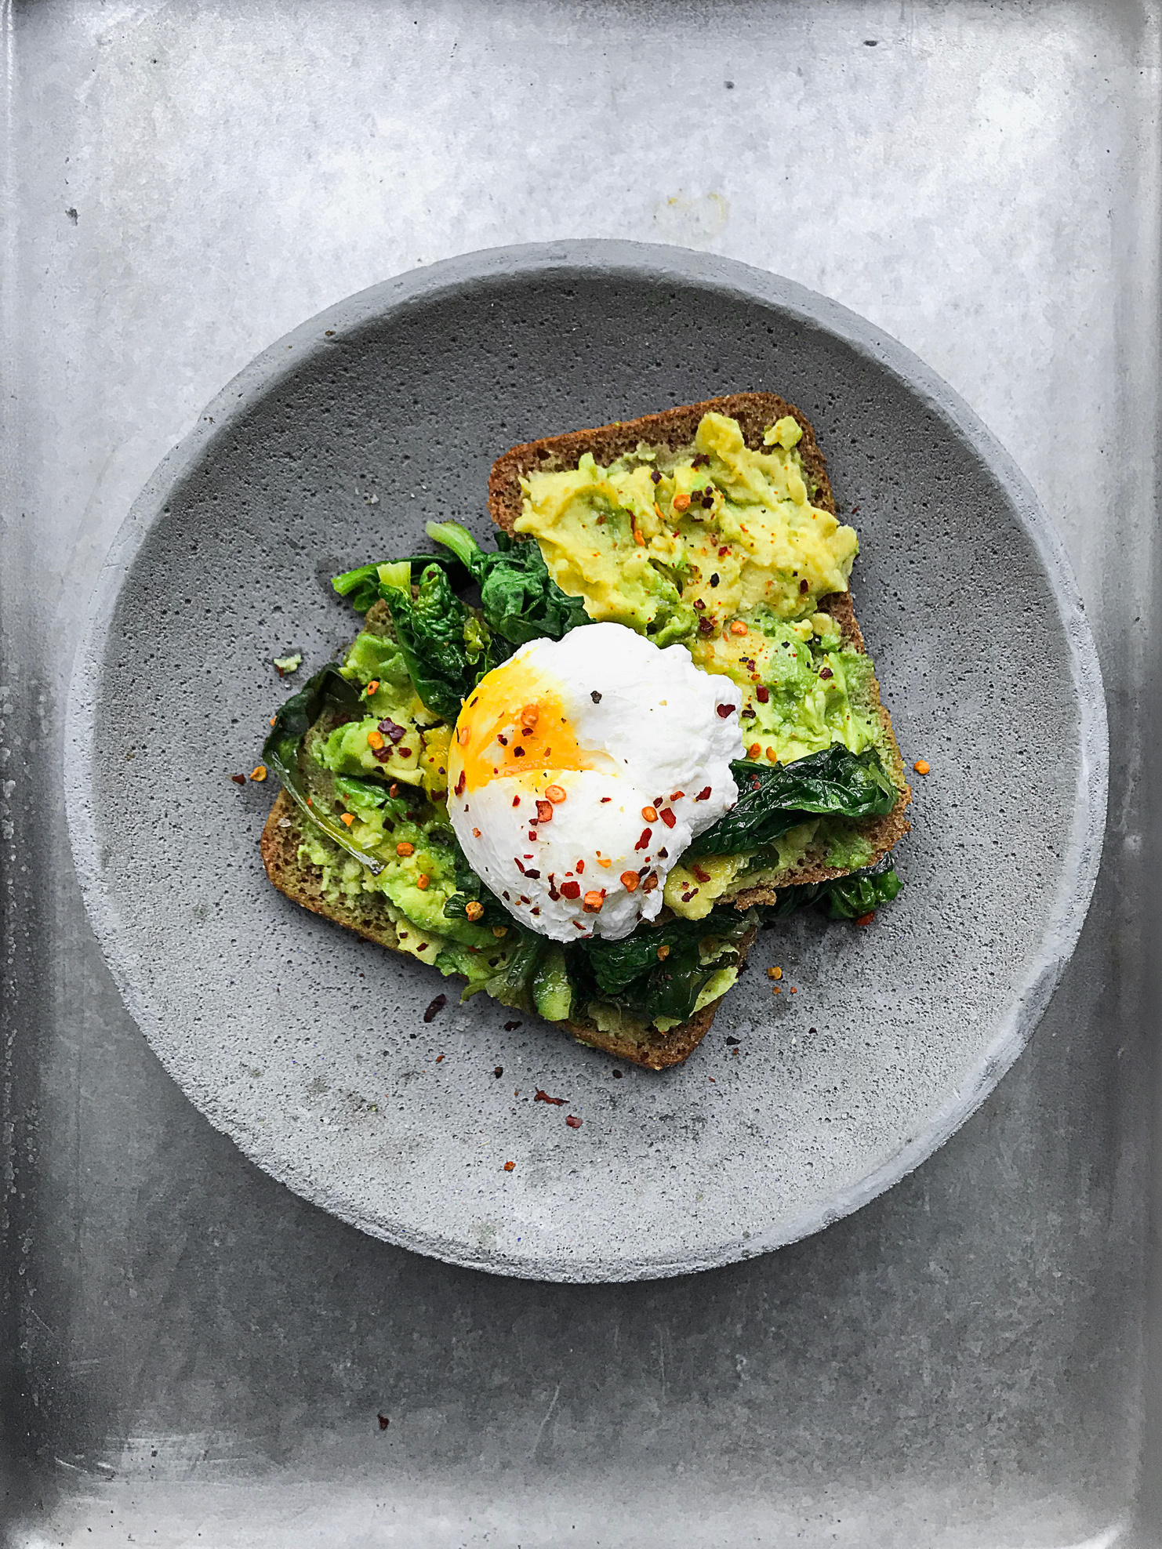
Individual macronutrient needs
Protein: Approx. 0.5-1g/lb of bodyweight
Fiber: Approx 21-30g
Fat: 20-30% of calories
Carbohydrates: 45-65%
Protein: 10-20%
*Use a macronutrient calculator for individual needs

Slide 14
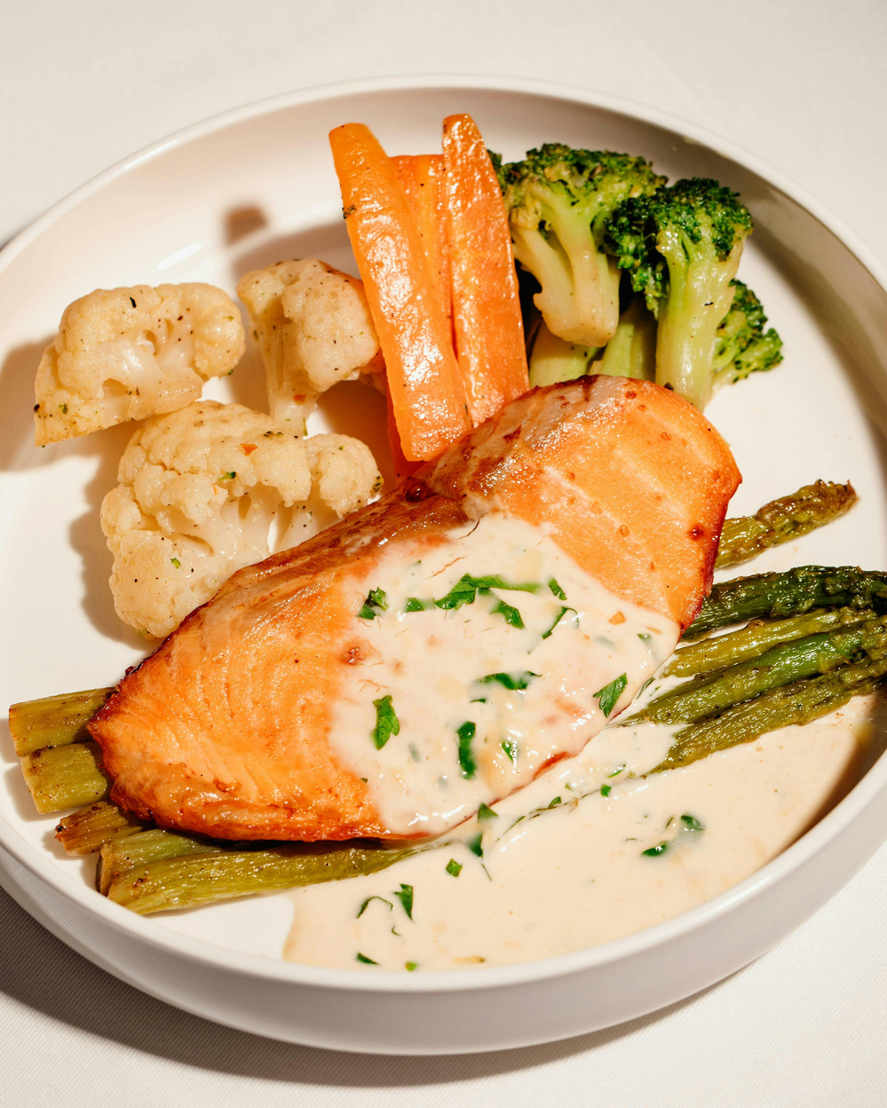
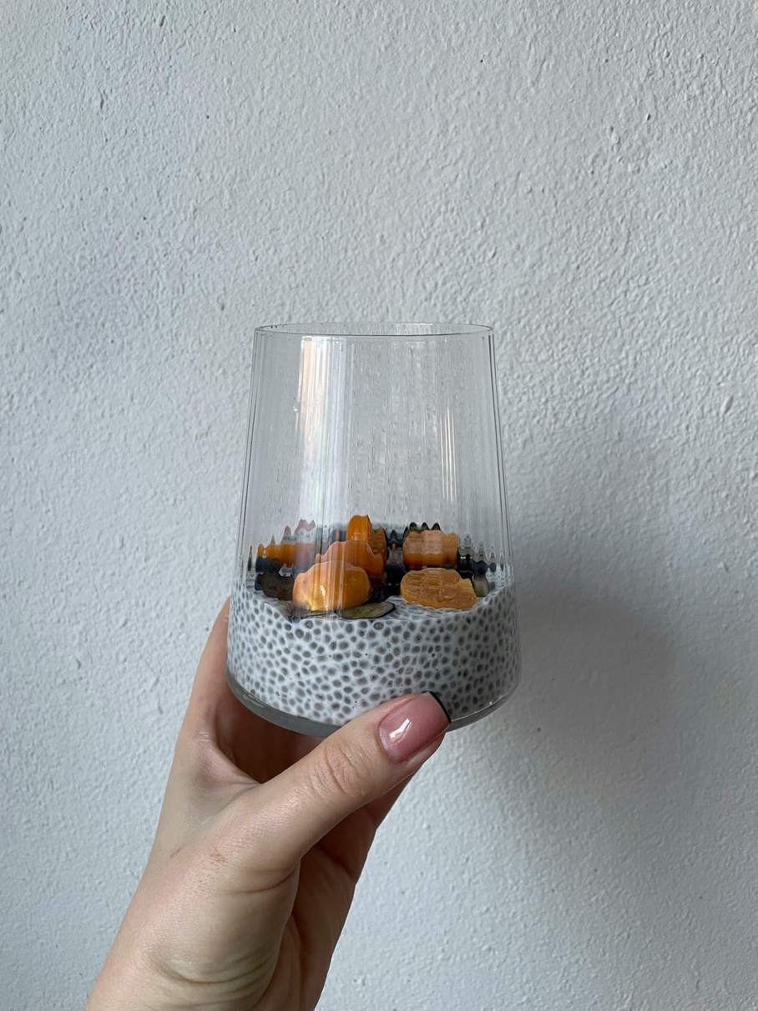
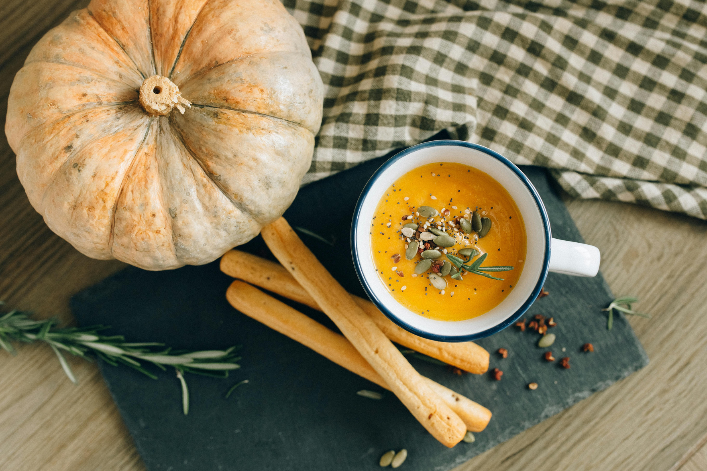
What does a healthy, scleroderma-friendly meal look like?

Slide 15
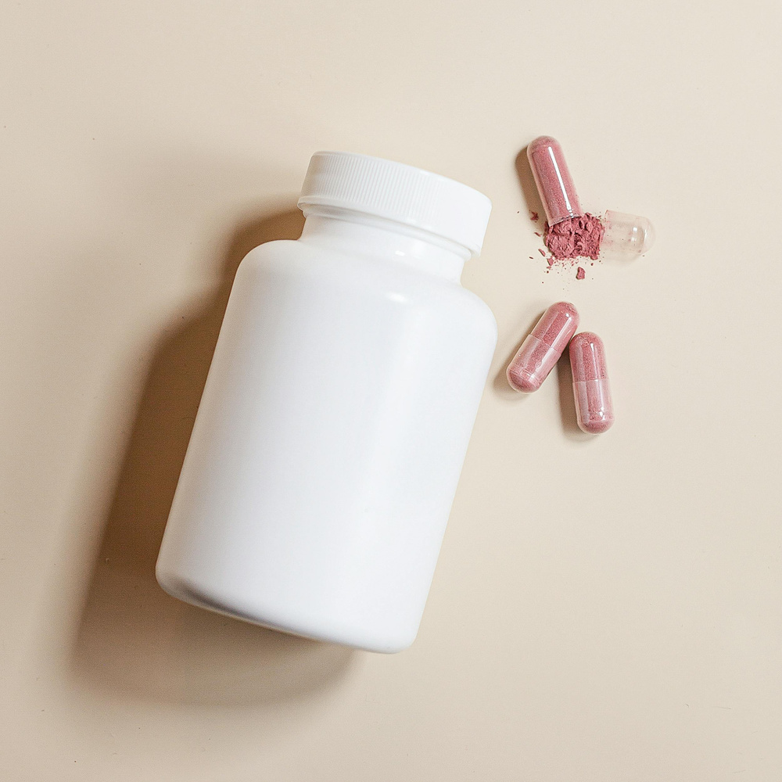
COMMON MICRONUTRIENT DEFICIENCIES
  Iron
  Vitamin B12
  Vitamin D
  Calcium
  Folate*
  Magnesium
  Zinc*
Enhancing Absorption
Use strategies like cooking or blending foods to make nutrients easier to digest, eating small frequent meals, pairing iron with vitamin C or tools like Lucky Iron Fish, and addressing GI issues (e.g., SIBO, malabsorption) to support nutrient uptake.

Slide 16
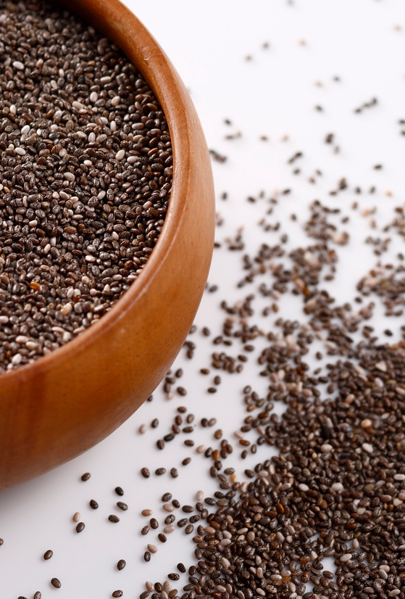
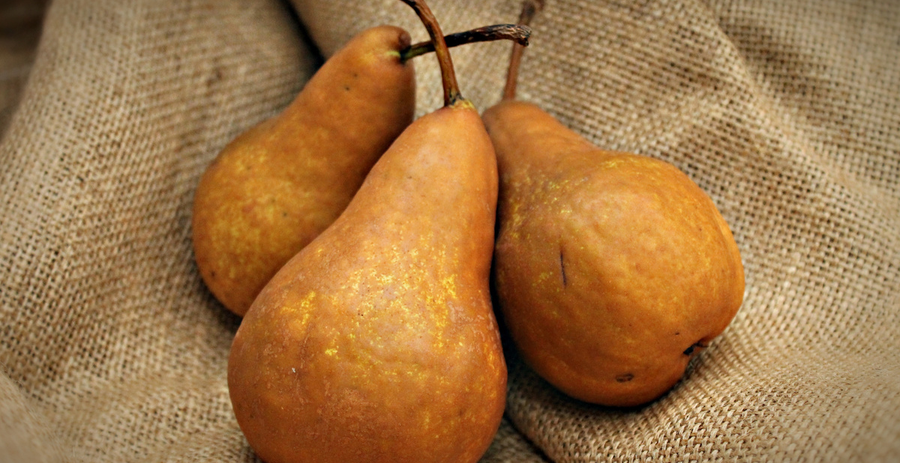

Soluble vs Insoluble Fiber
Fiber supports digestion, gut health, and blood sugar balance. Soluble fiber slows digestion and helps regulate glucose and cholesterol, while insoluble fiber adds bulk and promotes regularity.
  Soluble fiber: oats, apples, beans, chia, psyllium
  Insoluble fiber: whole grains, bran, nuts, seeds, vegetable skins

Slide 17

Different types of diets in Scleroderma
  Low-Residue / Low-Fiber Diet: To reduce bowel obstruction risk and ease symptoms during flares or strictures
  Low-FODMAP Diet: To manage bloating, gas, and symptoms from small intestinal bacterial overgrowth (SIBO)
  Gluten-Free Diet: Sometimes tried if overlapping celiac disease or gluten sensitivity is suspected
  Anti-Inflammatory Diet: Rich in omega-3s, antioxidants, and whole foods to reduce systemic inflammation
  Mediterranean Diet: Emphasizes whole, minimally processed foods; supports cardiovascular and gut health
  Nutrient-Dense, High-Protein Diet: To support muscle mass, repair, and counteract catabolic states

Slide 18
DIETARY RECOMMENDATIONS
Mediterranean Diet
Focuses on whole, minimally processed foods, rich in fruits, vegetables, whole grains, legumes, nuts, and healthy fats like olive oil. Emphasizes seasonal, local eating and moderate intake of fish, poultry, and dairy, with limited red meat and processed foods.
Mediterranean Diet: Yes Foods
  Fruits & Vegetables: Tomatoes, spinach, cucumbers, oranges, berries
  Whole Grains: Brown rice, quinoa, whole wheat, barley
  Legumes: Lentils, chickpeas, beans
  Nuts & Seeds: Almonds, walnuts, chia seeds
  Healthy Fats: Extra virgin olive oil, avocado
  Protein: Fatty fish (salmon, sardines), chicken, eggs
  Dairy: Greek yogurt, feta cheese (in moderation)
  Herbs & Spices: Garlic, basil, oregano, rosemary

Slide 19

COMMON SENSITIVITIES
  High-FODMAP foods (onions, garlic, beans) — can worsen bloating and gas due to SIBO
  Dairy — may cause intolerance or exacerbate reflux symptoms
  Gluten — sometimes avoided if overlapping autoimmune conditions or gut sensitivity
  Spicy and acidic foods — can aggravate esophageal reflux and mucosal irritation
  Fatty or fried foods — may slow gastric emptying, worsening symptoms
  Nightshades — occasionally reported to increase inflammation or GI discomfort
  Carbonation

Slide 20
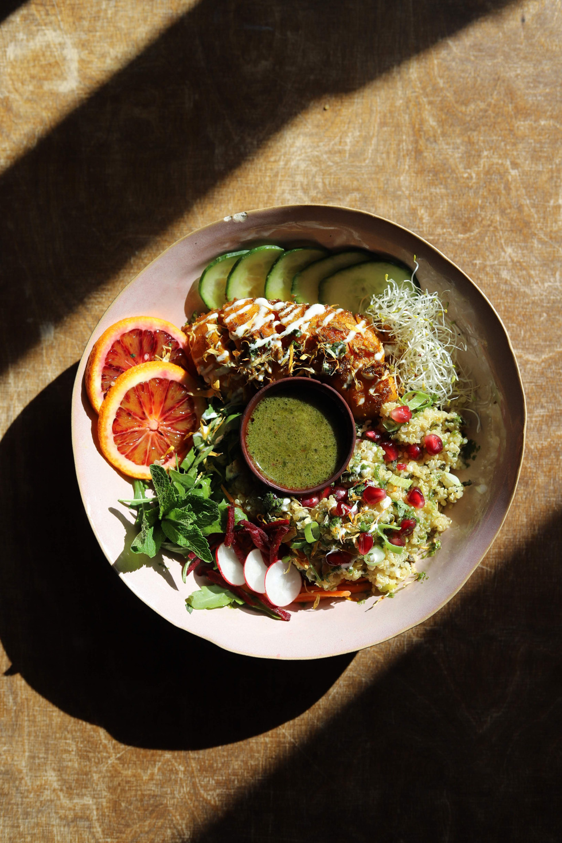
WHAT CAN I DO TODAY?
  Calculate macros to meet energy and protein needs
  Diet diary
  Monitor micronutrients with regular bloodwork
  Use cooked and blended foods to aid absorption
  Increase protein during flares for healing
  Include fiber and diverse foods for gut health
  Stay hydrated and eat small, frequent meals
  Limit processed and high-sugar foods
  Include anti-inflammatory foods (omega-3s, veggies)
  Use adaptive tools for easier food prep
  Adjust diet based on symptoms and work with healthcare providers

Slide 21

THANK YOU FOR LISTENING
Further questions? Email: vanessa@scleroderma.ca
@vanessacookhealth
Vanessa Cook (ND Candidate 2026), Dr. Sean McConnell ND

