Slide 1
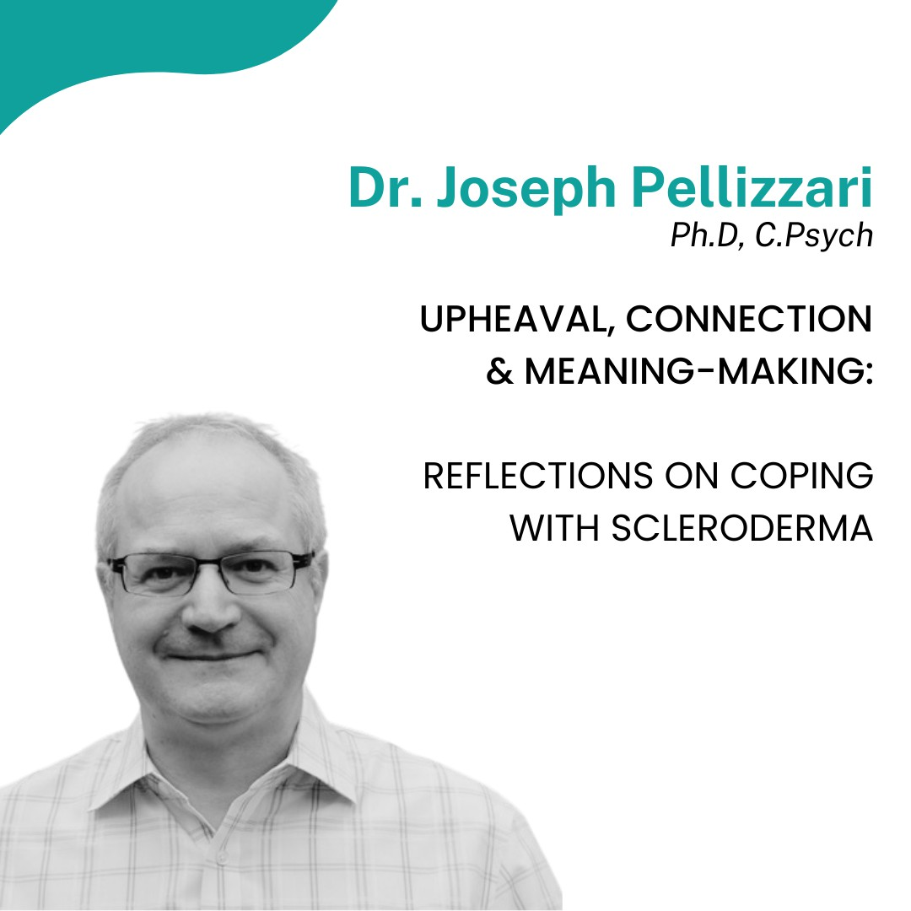

Slide 2
Upheaval, Connection, & Meaning-Making:
Reflections on Coping with Scleroderma
Joseph Pellizzari, PhD, CPsych
40th AGM & Conference 2024
Scleroderma Association of BC
Burnaby, BC
February, 2021

Slide 3
The information in this presentation is solely intended for informational purposes and is not a substitute for advice, diagnosis, or treatment regarding medical or mental health conditions. The information should not be taken for medical or psychiatric advice. Always consult your health care provider(s) before making any decisions related to your physical or mental health.

Slide 4
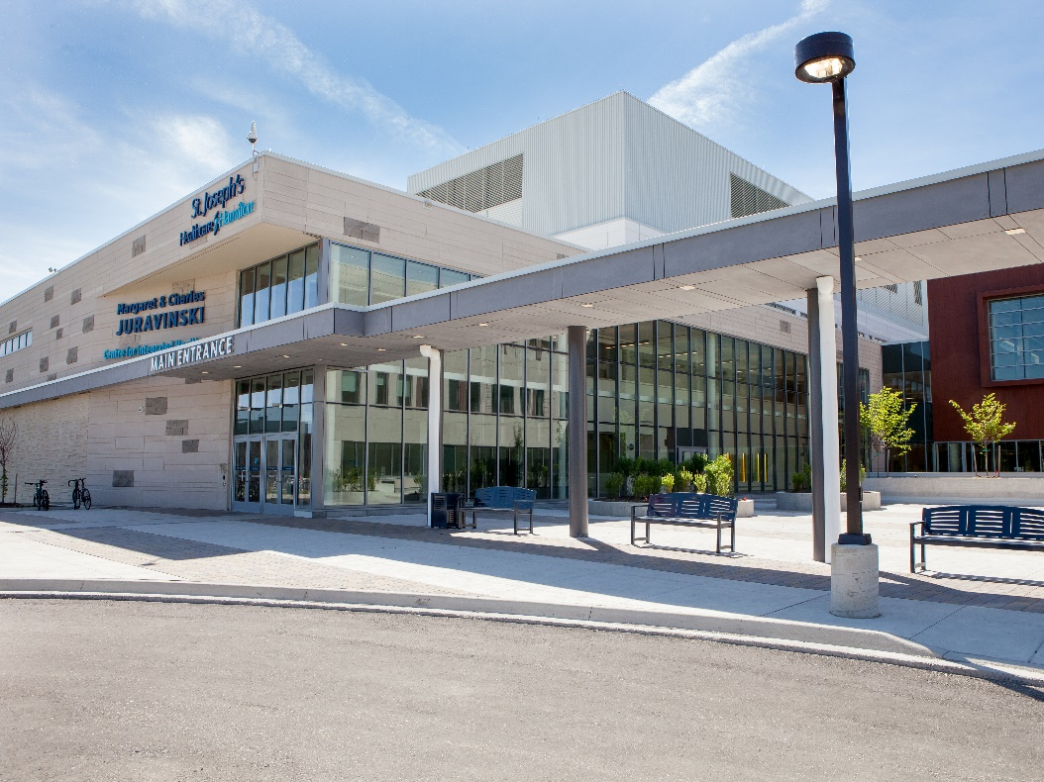

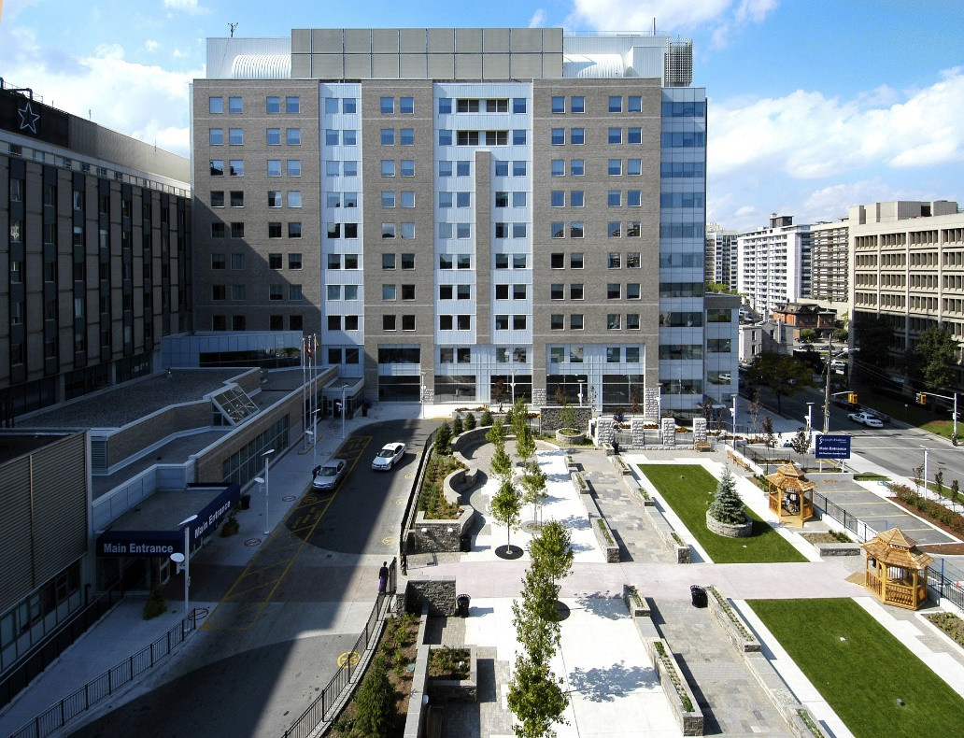
A Little About St. Joe’s

Slide 5

Reflection:
What are areas of upheaval for you?

Slide 6
Upheaval
SCLERODERMA STRESS
Sad
Social
Fatigue
Loss
Fear / Anxiety
Body Image
Itch
Access to Care
Pain
Sleep
Thombs et al. (2010)
Kwakkenbos et al. (2015)
Newton et al. (2012)

Slide 7
Upheaval
SCLERODERMA
UNCERTAINTY
Unpredictability
Worry About the Future
Fear of Physical Disability
Fear of Dependency on Others
Fear of Disease Progression
Mortality
ANXIETY
Kwakkenbos et al. (2015)

Slide 8
Upheaval
SCLERODERMA
Emotional Distress
Facing a New Reality
Daily Struggles
Work, $
Changing Family Roles
Navigating Health Care System
Social Interactions
Gumuchian et al. (2016)

Slide 9
Upheaval
DEPRESSION
Identified With Self-Report Questionnaires
36% to 65% of SSc patients
Identified With Diagnostic Interviews (lifetime prevalence)
53% - hospitalized patients (France)
59% - community patients (France)
23 % - outpatients (Canada)
Thombs et al. (2007)
Nassar et al. (2023)
Baubet et al. (2011)

Slide 10
Upheaval
DEPRESSION – “take home messages”
rates consistently as high or higher than other patient groups – acute & chronic disease conditions
some prevalence rates (e.g. Canadian) double than general population rate
patients with SSc may benefit from non-psychiatric interventions that support coping from psychosocial perspectives
Thombs et al. (2007)
Nassar et al. (2023)
Baubet et al. (2011)

Slide 11
Reflection:
How do you get through?

Slide 12
Ways of Coping: general perspectives
Ways of Coping
Social Support
Meaning- Making
Faith-Based
Problem-Focused
Emotion-Focused
Adapted from:
Aldwin, C. M., & Yancura, L. A. (2004). Coping and health.

Slide 13
Ways of Coping: among people living with SSc
Problem – Focused Coping
Any action taken to modify sources of stress
seeking out professional support (e.g., seeing a mental health therapist)
seeking out disease-relevant information (e.g. symptoms, treatments, methods of coping)
organization (e.g., list making)
Gumuchian et al. (2018)

Slide 14
Ways of Coping: among people living with SSc
Emotion – Focused Coping
Any action taken to reduce or manage the intensity of distressing emotions
seeking out social support (e.g., family, friends, support groups)
adaptive distraction techniques (e.g. pets, hobbies, busy with other activities)
relaxation techniques (e.g., breathing, meditation, yoga, exercise, prayer)
Gumuchian et al. (2018)

Slide 15
Ways of Coping: among people living with SSc
Meaning – Focused Coping
Any action taken to reduce stress or cope with adversity by looking for positives or meaning
benefit finding / cognitive re-appraisal (e.g., orientation toward acceptance)
accepting symptoms when they cannot be changed (e.g., opportunities for learning)
self-acceptance, self-compassion
positive affirmations – “one day at a time”
values clarification (e.g. focusing on what is most important – family, faith)
Gumuchian et al. (2018)

Slide 16
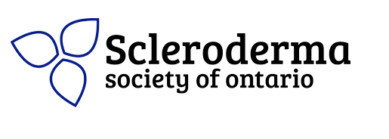
Connection:
Caregiver Support
“Family and loved ones play an essential role in the emotional, physical and mental well-being of individuals living with scleroderma.
The purpose of this handbook is to hopefully make the role of caregiving easier and will lighten your load, while increasing the rewarding aspects of caregiving. There is a summary and "take home tips" at the end of each chapter if you need a quick reference on the go.
You are not alone in your experiences. “
Supporting a Loved One with Scleroderma:
A Handbook
Dr. Danielle Rice
2021
Free Book!

Slide 17
Connection
SPIN
The Scleroderma Patient-centered Intervention Network
led by Dr. Brett Thombs, McGill University
“ SPIN’s mission is to work with people with scleroderma to identify their needs and prioritize research in areas most important to them and to develop, test, and disseminate accessible patient programs that improve quality of life and empower people with scleroderma and their loved ones.”

Slide 18

Mental Health Toolkit
Grundmann, Gumuchian, Rosenau, Schrama, Cook, Pellizzari, Larche, Malcolmson, Rice. Development & Implementation of the Scleroderma Mental Health Toolkit & Webinar Series. 2024. [Can Psychol Assoc - Ottawa; Scleroderma Canada Conf - St. John’s]

Slide 19
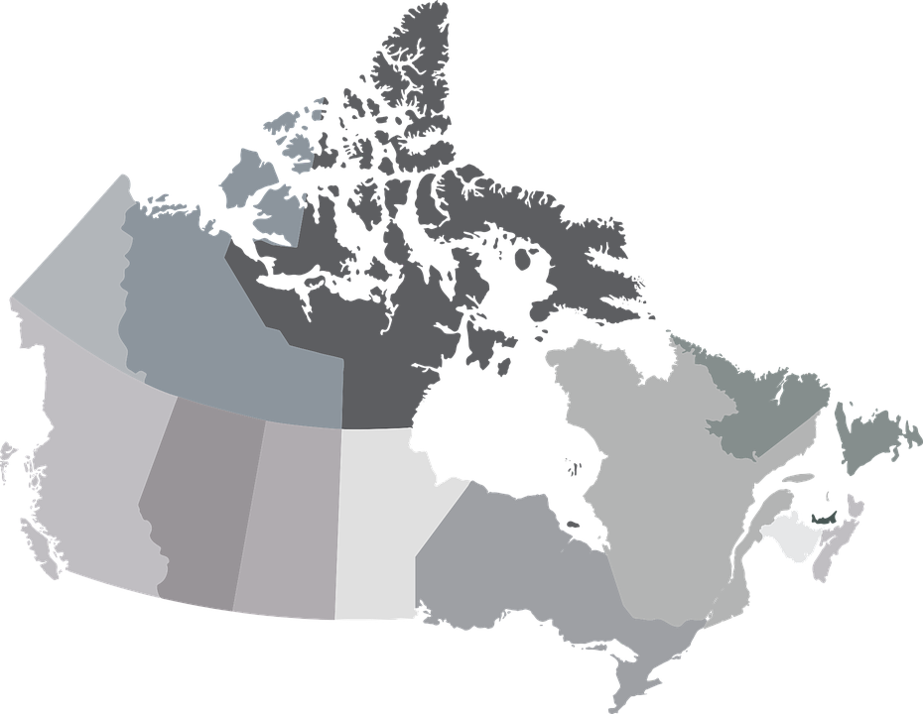
Q1: Which Canadian province or territory are you from?
1%
1%
37%
12%
6%
5%
1%
8%
25%
4%
Answered by 81/82 respondents

Slide 20
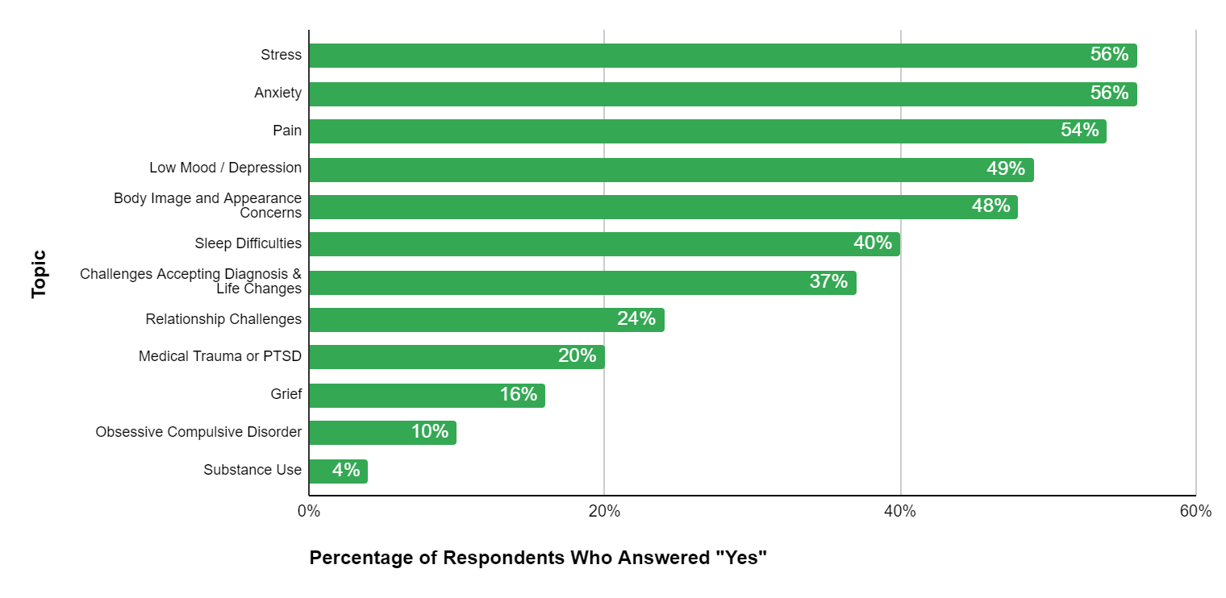
Q2: Which of the following mental health topics are relevant to you?
Answered by 82/82 respondents

Slide 21
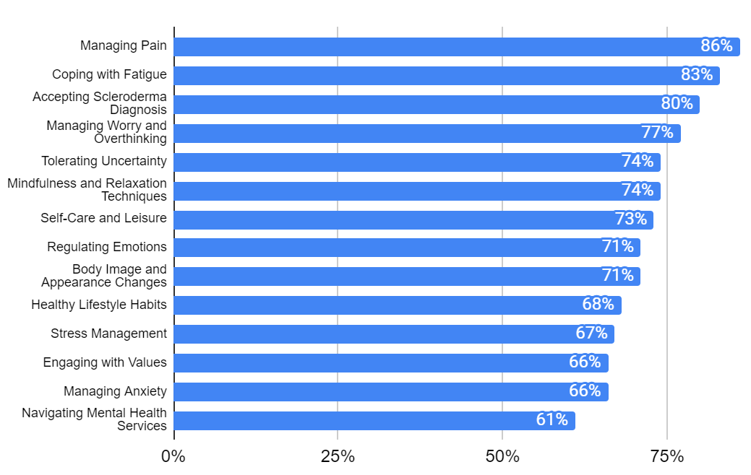
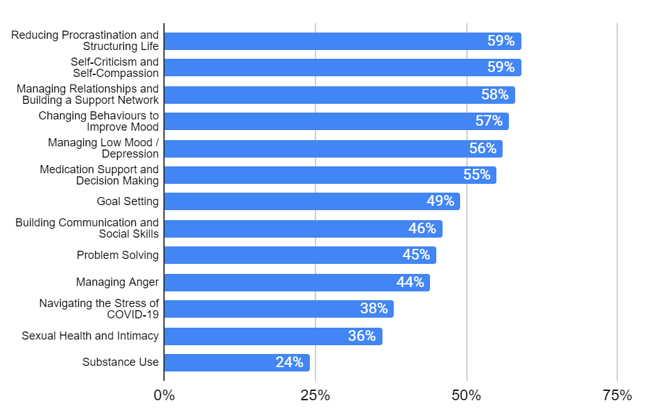
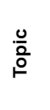
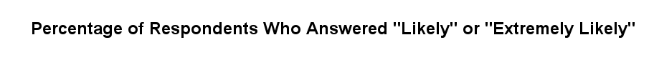
Q3: How likely are you to attend a mental health webinar on the following topics?
Answered by 65-68/82 respondents

Slide 22
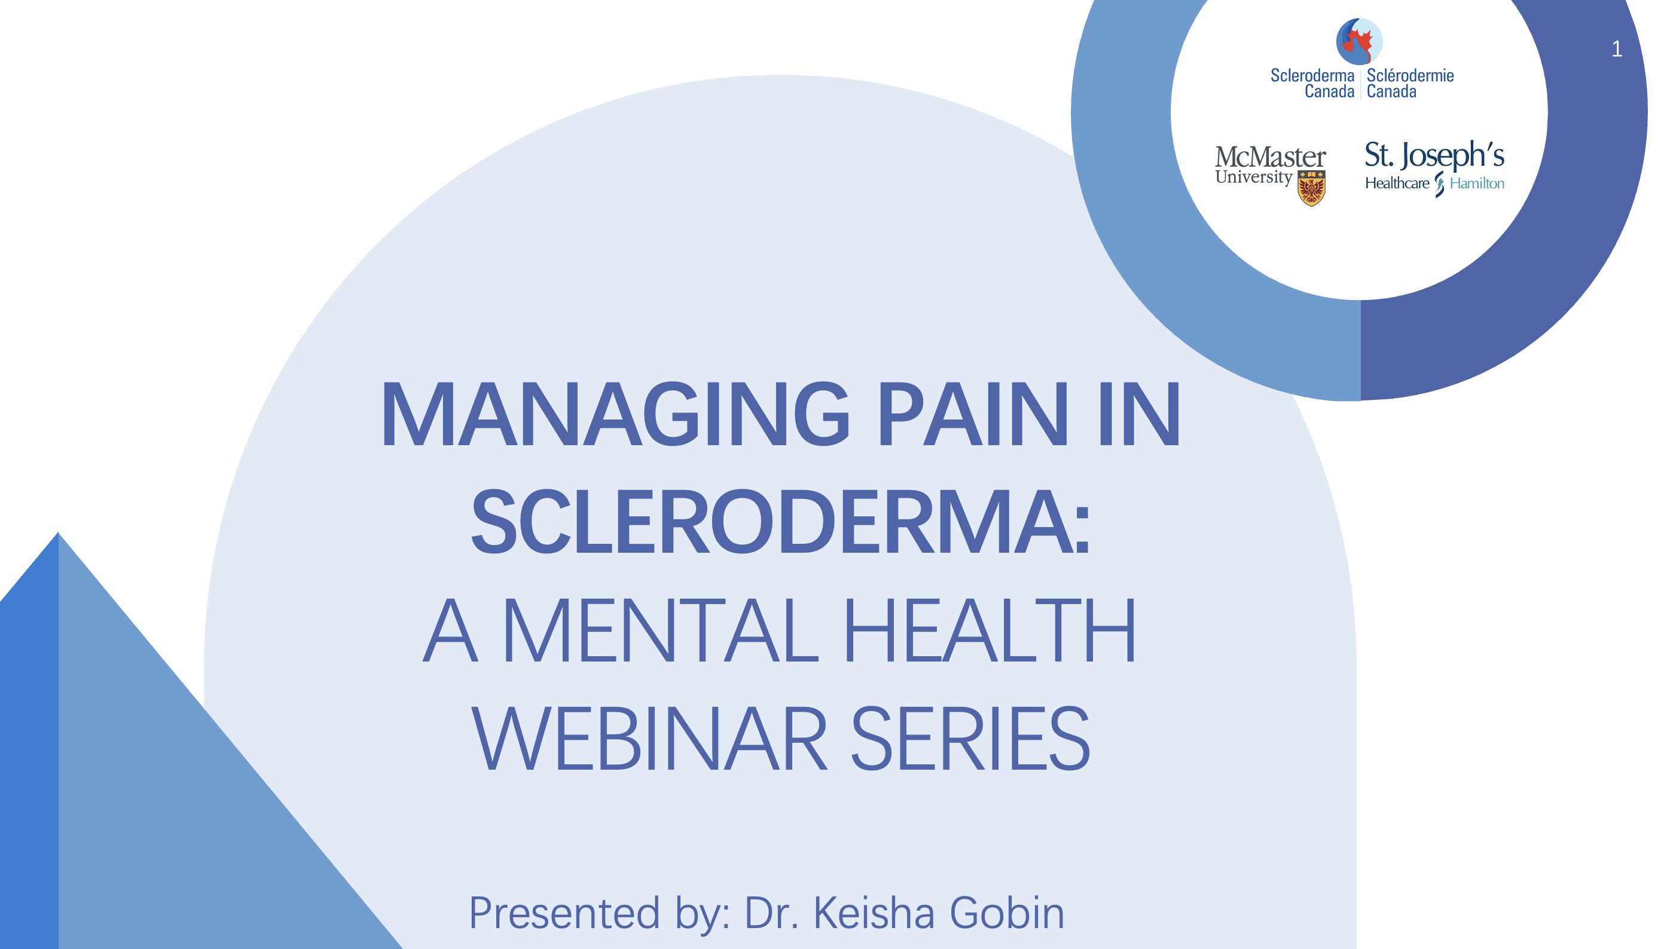
Managing Pain Webinar part of the Mental Health Toolkit
16 attendees : Dec 17, 2023, January 7, 2024

Slide 23
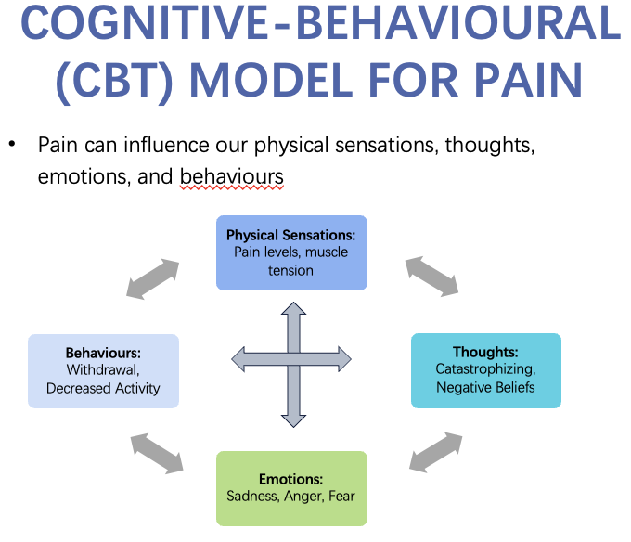
Managing Pain Webinar part of the Mental Health Toolkit
Excerpts

Slide 24
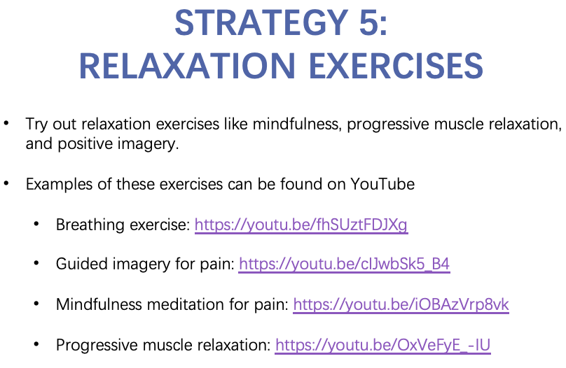
Managing Pain Webinar part of the Mental Health Toolkit
Excerpts

Slide 25
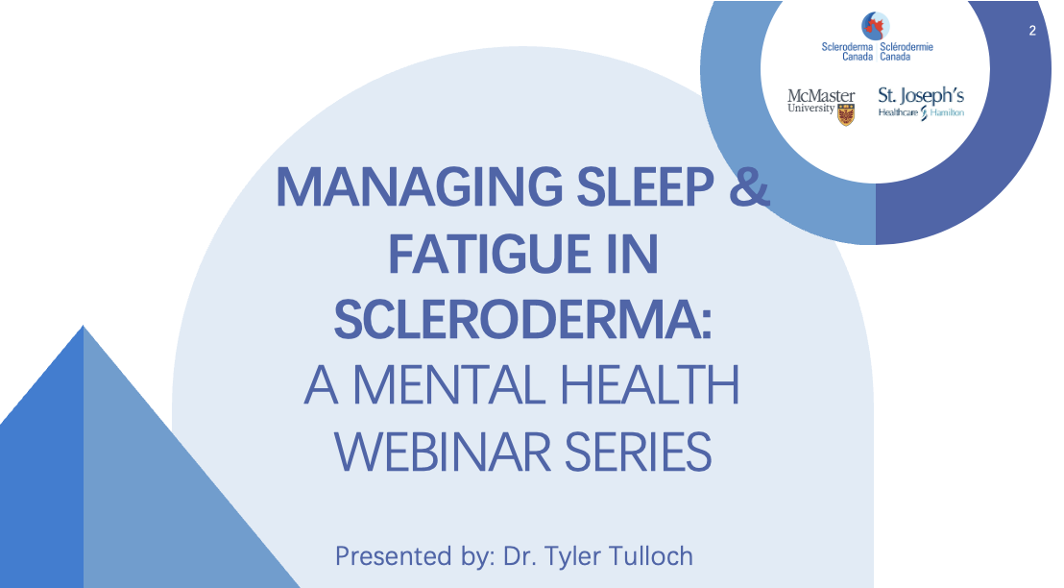
Managing Sleep & Fatigue Webinar part of the Mental Health Toolkit
Coming Soon !

Slide 26
Connection: participating in support groups
WHY?
from a SPIN peer-support group leader trainee ...
“It makes me feel good”
”I feel like I am giving back
“I can’t work…. this makes me feel like I am doing something”
”I want to help”
“It helps me with my fear”
“I get to meet people to talk to and share stories”

Slide 27

Reflection:
Take home messages?

Slide 28
Thank You
Upheaval, Connection, & Meaning-Making:
Reflections on Coping with Scleroderma
Joseph Pellizzari, PhD, CPsych
40th AGM & Conference 2024
Scleroderma Association of BC
Burnaby, BC
February, 2021

Slide 29
Questions & Discussion
With Joseph Pellizzari, PhD, CPsych

