Slide 1
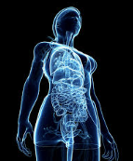
Overview: Impact of Scleroderma on Gastrointestinal Tract
Dr. Sarvee Moosavi
MD FRCPC MEd. (Harvard’25)
Neurogastroenterology and GI Motility Disorders
Vancouver General Hospital
St. Paul’s Hospital GI Motility Lab

Slide 2
Objectives:
Overview of GI manifestation of Scleroderma
Pertinent diagnostic tests (what is currently available in BC)
Helpful life-style modifications, impacting gut health
Pharmacologic options

Slide 3
Quiz 1: What percentage of Patients with Scleroderma have GI symptoms?
A: 50%
B: 60%
C: 70%
D: More than 80-90%

Slide 4
Quiz 2: What is the most common GI manifestation of Scleroderma?
A: Gastroesophageal reflux and esophageal symptoms
B: Nausea and vomiting
C: Abdominal pain
D: Diarrhea

Slide 5
Quiz 3: When is the best time to use PPI therapy?
A: With eating
B: After eating
C: 30-60 minutes before eating
D: Doesn’t really matter when you use it

Slide 6
Overview of Systemic Sclerosis
Derived from Greek term “scelros”: thickened, “dermos”: skin
Characterized by damage to small vasculature, inflammation secondary to auto-antibodies, and extensive scarring due to excessive collagen deposition
Prevalence of Scleroderma conditions: 4-490 cases per million individuals
80- 98.8% of patients have GI symptoms

Slide 7
GI symptoms of Systemic Sclerosis
Severe GI complications exist in 8% of SSc patients
GI complications are the 4th most common cause of mortality after lung (47.8%), heart (25.6%), and Kidney (18.5%)
Oral cavity involvement: Sicca syndrome
GERD and regurgitation 53%-70% (30% are asymptomatic)
Difficulty with swallowing: up to 90% (especially with Sicca syndrome)
Esophageal motility disorder (70-96%)
Indigestion 70%, Nausea 60%, bloating and distension 88%
Early satiety and post-prandial fullness 55%-75%
GI bleed secondary to stasis ulcer and vascular abnormality along GI tract
Abnormal Small bowel function: SIBO (20-60%), Diarrhea 68%, malabsorption (50%), CIPO
Anal outlet disorders: constipation, Fecal incontinence (10-50%), rectal prolapse
Liver and pancreatic dysfunction, association with celiac disease, Malnutrition, malabsorption
Notes:
GI symptoms of SSc are quite broad, which the most common manifestations involving the esophagus.

Slide 8
Gastrointestinal (GI) motility
Coordinated transit of content along the digestive system, from mouth to anus
Involves an intricate interactions between the brain, muscles along the GI tract, and the nervous system inside the GI tract (called enteric nervous system)
When the movement does not have normal strength and/ or coordination, the patient has GI dysmotility
In scleroderma: inflammation within the muscle wall, collagen deposition in muscular layers, and likely damage to the nerve interfere with normal motility
Notes:
- Scleroderma impacts GI motility, which is referred to as….

Slide 9
Normal Swallowing Mechanism

Slide 10
Esophageal Manifestations
Gastroesophageal reflux disease
Difficulty swallowing
Spontaneous regurgitation due to underlying movement disorder of the esophagus

Slide 11
Gastroesophageal Reflux Disease (GERD)
Defined as a condition which develops when the reflux of stomach contents causes troublesome symptoms and/ or complications
Most patients experience typical symptoms of reflux chest pain and acid regurgitation
Atypical symptoms such as sore throat, cough, dental erosions, asthma could occur

Slide 12
GERD Mechanism
-Intact Saliva production
-Intact reflux-induced swallows
Dry mouth with decreased saliva production
Impaired reflux-induced swallow
Impaired esophageal peristaltic contraction
Weak or absent contraction
Impaired integrity of esophageal cells
Intact peristalsis
Tight seal between esophageal cells
Incomplete
bolus clearance
Intact Lower esophageal sphincter (adequate resting tone and infrequent relaxation)
Juxtaposition of diaphragm and LES
Frequent LES relaxation
Low LES tone
Hiatal hernia
Normal stomach emptying
Delayed stomach emptying
Gyawali CP et al. GERD consensus document. Neurogastroenterol Motil 2017
Notes:
In order to understand pathophysiology of reflux, you need to appreciate normal barrier mechanisms that are in place to prevent esophageal damage due to reflux of gastric content into the esophagus.

Slide 13
How to evaluate the esophagus:
Upper endoscopy (esophagogastroduodenoscopy, EGD)
Barium esophagogram (X-ray with contrast material)
Motility assessment with high-resolution esophageal manometry
pH monitoring for workup and management of GERD

Slide 14
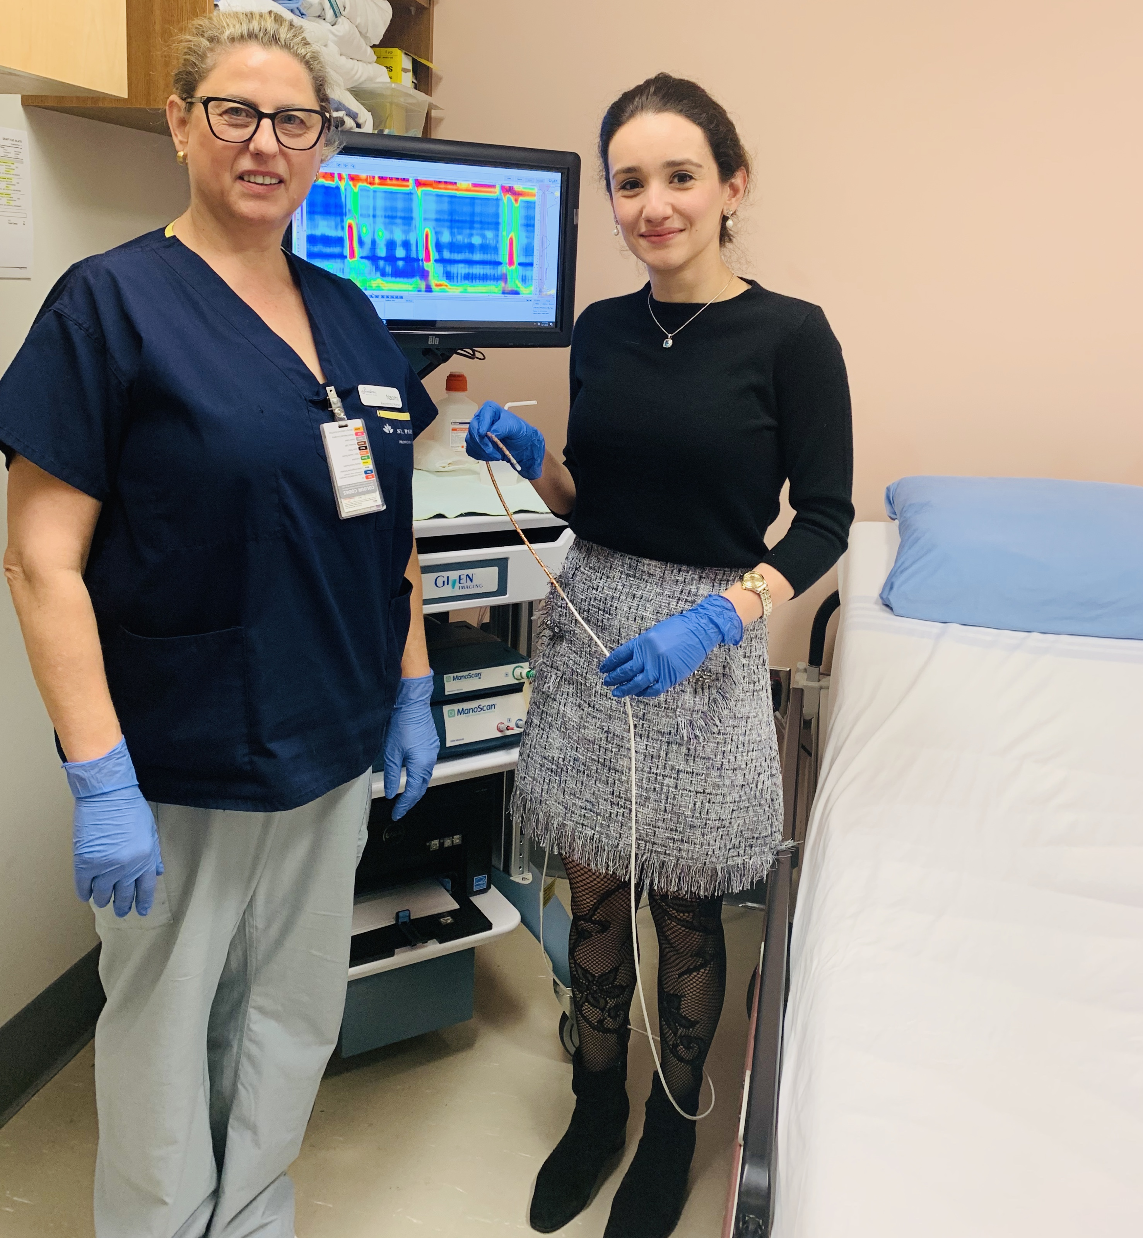
Esophageal Motility Lab at St. Paul’s Hospital

Slide 15
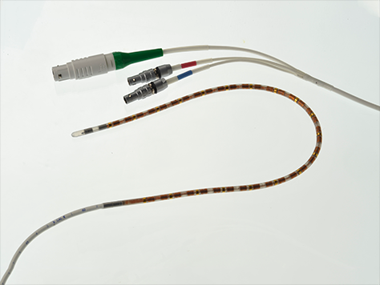
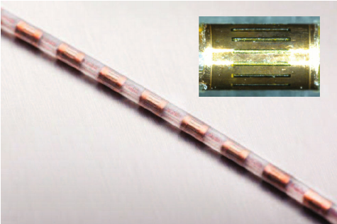
High-resolution esophageal manometry

Slide 16
High-resolution Esophageal Manometry (HRM)

Slide 17
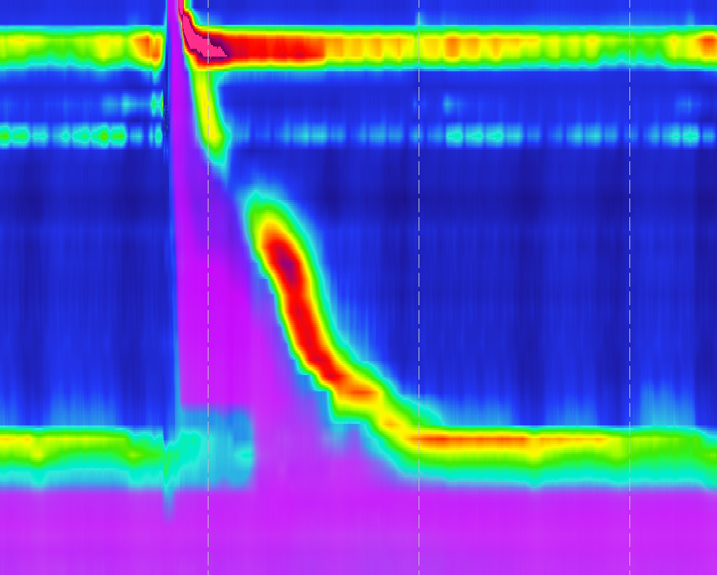
Normal Esophageal Manometry and Impedance
UES
Striated esophagus
Smooth muscle esophagus
LES
Notes:
- I urge the clinicians to move away from conventional manometry, as HRM with impedance is the current gold standard for assessment of esophageal dysmotility; higher sensitivity, more comprehensive evaluation

Slide 18
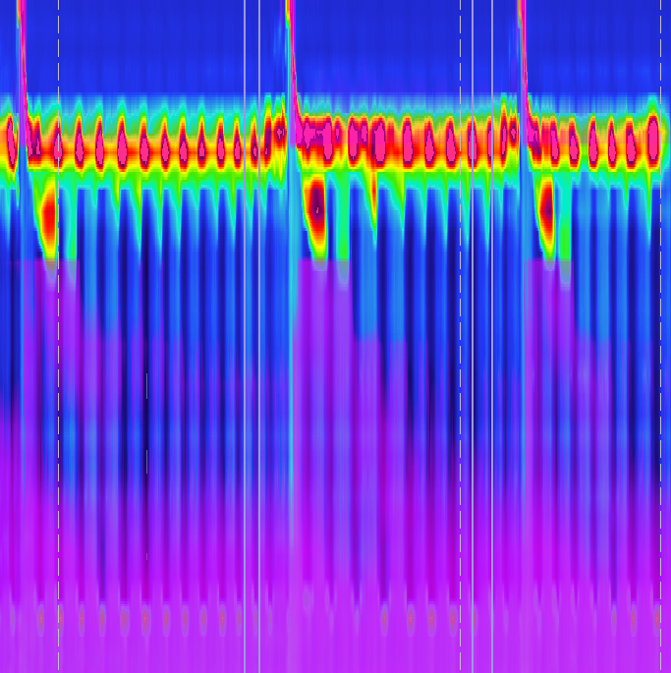
HRM Manometry and Impedance:
UES
UES
Absent Contractility
Hypotensive LES
LES
LES
Notes:
Esophagus is the most commonly affected part of GI tract and dominates in up to 90% of patients: heartburn, regurg, dysphagia.
There is no specific treatment to alleviate the underlying esophageal dysmotility; therefore, treatment is really basedon sympomtatic management.

Slide 19
Esophageal dysmotility in Scleroderma
79 Scleroderma patients
Worse pulmonary function & advanced skin disease in AC
AC: ↑ reflux esophagitis, Barrett’s
Symptoms do not correlated with esophageal dysmotility
The association between systemic sclerosis disease manifestations and esophageal HRM parameters. Kimmel J, Pandolfino et al. Neurogastromotil. 2016 Aug : 28 (8): 1157-1165
Notes:
In a study by Emanuelli G et al., it was shown that there is no correlation between esophageal symptoms and the severity of esophageal dysmotility on manometry → esophageal manometry remains the gold standard to evaluate the severity of GI involvement, which allows further optimization of therapy in patients with more aggressive phenotype. (esophageal dysfunction in scleroderma: relationship with disease subsets. Bassotti et al. arthritis Rheum 1997 Dec; 40(12): 2252-9
Others: , 1 achalasia type I, 2 EGJ outflow obstruction, 1 Jackhammer esophagus, 19

Slide 20
Non-Pharmacologic Management
If Sicca syndrome, use artificial saliva, gum, drink liquid/ water
Exercise to maintain BMI less between normal range 19-25
Avoid large meals at night, last meal should be 3-4 hours before bedtime
Elevate head of bed by 30-40 degrees
Eat frequently, smaller potion during the day
Avoid trigger food
Ensure adequate chewing, space out bites, drink small amount of fluid after each bite
Carbonated drinks (may improve esophageal clearance, worsens bloating)

Slide 21
Pharmacologic Therapies
OTC options: Tums, Liquid Gaviscan
H2-receptor antagonist: Ranitidine, Famotidine
Coating agents: Liquid Gaviscan, Sulcrate (Sucralfate)
Proton-pump inhibitors: - Pantoloprazole (Pantoloc, Tecta) - Omeprazole (Losec) - Esomperazole (Nexium) - Rabeprazole (Pariet) - Dexlansoprazole (Dexilant) - Lansoprazole (Prevacid)
Baclofen (less tolerated)
Buspirone: (off-label use) - Case-series in scleroderma patients shown it may improve esophageal body contraction, increases LES pressure
Promotilic agents: (main site of action is beyond the esophagus, less effect on esophagus itself) - Metoclopramide (Maxeran, Metonia) - Domperidone (Motilium) - Prucalopride (Resotran, Resolor) - Erythromycin/ Azithromycin

Slide 22
Safety Concern of PPI Use: true fact or fake news?

Slide 23
Most of these studies were observational studies, high risk of biases → Studies were not powered to show causation, but only association.

Slide 24
Any evidence to show safety of PPI?
First randomized, prospective, controlled study for a duration of 3 years of nearly 18’000 patients
Moayyedi P et al. safety of PPI based on a large, multi-year, randomized trial of patients receiving Rivaroxaban or aspirin

Slide 25
Bottomline: Risk versus benefit
PPIs are safe to be used at a smallest dose that provides symptomatic relief with good control of GERD for the shortest period of time
Fluid discussion between patients and physicians regarding PPI duration & dose
50% of patients with scleroderma have esophagitis, 20% with GERD complications (ulcers erosion), 9% have Barrett’s esophagus
In scleroderma patients with significant GERD, the risk outweighs the benefit of treating reflux esophagitis, reducing peptic stricture, Barrett’s esophagus
Overall, PPI are considered SAFE in the setting of APPROPRIATE USE

Slide 26
Anti-reflux surgery?
Generally not done in patients with scleroderma due to diminished esophageal contraction
Nissen fundoplication can potentially exacerbate underlying dysphagia
Limited studies with alternative surgical technique (Roux-en-Y gastric bypass): risk of intra-operative and post-operative complications
VERY selected patients, last resort for refractory reflux
Multi-disciplinary decision between patients, expert surgeons, rheumatologists, respirologists, gastroenterologists

Slide 27
Delayed gastric emptying: Gastroparesis
Symptoms range from early satiety, abdominal bloating, epigastric pain, nausea to complete PO intolerance with severe vomiting, weight loss and malnutrition
Up to 50% of scleroderma patients may have diminished gastric emptying and decreased gastric accommodation
Gastroparesis can worsen GERD symptoms
Gastric emptying scintigraphy(4-hours study) remains gold standard
Piskorz MM et al. Acta Gastroenterol Latinoam 2015
Notes:
Affects 50% of SSc patients
Delayed gastric emptying defined as >60% in 2 hours and/or >10% retained standard meal at 4 hours.

Slide 29
The symptoms of functional dyspepsia can likely be caused by many different central and peripheral processes
Hypothalamic-pituitary- adrenal axis
?TRpV1-mediated increased secretion of Substance P & CGRP-1
Enteric nervous system
Increased alpha4Beta7 integrin, cytokines production
Reduced TJP1 expression-> impaired barrier
Disturbances in (ENS) neuroimmune system
Notes:
Multiple diseases
- Additionally, TrpV1, which is activated selectively by capsaicin, induces release of neuropeptides, such as CGRP-1 and substance P.53 These neuropeptides might increase visceral sensitivity and trigger symptoms, including abdominal pain and nausea.53 TrpV1 receptors were upregulated in functional dyspepsia in one study54 and are activated by mechanical stimulation, inflammatory mediators, acid, nerve growth factor, prostaglandins, and even microbes.55 Paradoxically, persistent exposure to capsaicin had analgesic effects56 and led to improvement in early satiety and bloating in some patients with functional dyspepsia.57 Such improvements might occur via desensitisation of TrpV1 by depletion of neuropeptides, such as substance P, or by inhibition of Piezo proteins, which are ion channels involved in the reduction of pain during mechanical stretching
- Duodenal eosinophilia was also associated with anxiety in one study.63 Furthermore, in response to stress, eosinophils release substance P and corticotropin-releasing hormone,78 which might lead to mast cell activation and, ultimately, dysfunction of the duodenal epithelial barrier. MRI in patients with functional dyspepsia showed abnormalities of structural and functional connectivity in areas of the brain responsible for processing visceral afferent information.79,80 These abnormalities appeared more marked in epigastric pain syndrome than in postprandial distress syndrome.8

Slide 30
Non-pharmacologic therapies
Minimize medications such as Opioids, or any other slowing gastric emptying
Optimize diabetic control
Refer to dietitian for gastroparesis diet/ functional dyspepsia
Eat small portion, frequent meals, low in fat and soluble fibers
Often, anti-emetics are required for symptomatic management
Over the counter ginger and peppermint oil may be beneficial
Neuromodulators: TCA, Mirtazapine, SSRI, SNRI, gabapentin may need to be used as adjuvant therapies to help with disorders of gut-brain interaction

Slide 31
Prokinetics: Gastroparesis
Metoclopramide * Johnson et al: (SSc) Improved LES resting P, improved GE, reduce GERD sx Limited use d/t irreversible TD, prolonged QTc
Domperidone *No study in SSc. does not cross BBB, risk of arrythmia
Buspirone: Improves gastric accommodation (gastric fundus relaxation), no study in SSc with gastroparesis
Prucalopride: * Improves symptoms of gastroparesis and enhances rate of gastric emptying ** Improves # BM, reduces reflux and bloating, by alleviating symptoms of dysmotility
Erythromycin (motilin agonist)
Johnson et al. 1987 JAMA Internal Med
Pasha et al. Gastroenterology 2006
Fuorucci et al: Am Journal Of Gastroenterol 1994
Vigone et al. Arthritis Res Ther 2017
Carbone et al. Am J Gastroenterol 2019
Notes:
Most effective in early phase of disease, before smooth muscle atrophy
Johnson: 12 patients with progressive SSc, 4 with CREST→ Metoclopramide (D2/ 5HT4 antagonist)
Erythromycin study in SSc patient dose 250 mg TID x 4 weeks

Slide 32
When prokinetics fail in gastroparesis
Anti-emetics
Botox injection in the lower stomach
Semi-elemental and elemental diet
Percutaneous feeding tube
Endoscopic or surgical intervention, targeting the end of the stomach (pyloroplasty, or gastric-per oral endoscopic myotomy)
?? Gastric electrical stimulation
Acupuncture
Parenteral nutrition (last resort)
Notes:
Double blind, placebo controlled studies have shown improvement in gastric emptying study with Botox, but no significant improvement in pt’s symptoms. Therefore, positive trials are needed before recommending it.
Acupuncture shown to improve gastric emptying and symptoms.

Slide 33
Weight loss/ malnutrition
Multifactorial: Perioral contracture, avoidance of bulky food, Esophageal dysmotility, gastroparesis and gut dysmotility, SIBO, ↓appetite, depression, Pancreatic enzyme deficiency, Celiac, etc.
Recognizing weight loss is crucial in order to Institute nutritional support earlier on
Multi-disciplinary approach, with dietitian and OT/ PT
Ensure age-appropriate cancer screening: Breast, prostate, colon cancer
Ideally Enteral nutrition, enteral nutrition, enteral nutrition.
Enteral nutritional support through PEG, jejunostomies, PEG-J.
If all fail, TPN as last option

Slide 34
Small intestinal bacterial overgrowth
Defined as abnormal, excessive bacterial load >10³ in SB in duodenal aspirate
Myriad of Symptoms: bloating, abdominal distension, flatulence, diarrhea, nausea, fatigue, dyspepsia, constipation (CH4-producing bacteria)
Weight loss, malabsorption, and nutritional deficiencies in severe cases
Risk factors in scleroderma: underlying disease, meds, ↓ cholorhydria (PPI)
Diagnosis: Lactulose or Glucose breath test measuring BOTH CH4 and H2 (Q15 mins x 3hr)
Treatment plan: Induce remission, maintenance and ?modify underlying cause
1. Rezaie et al. Current GI reports 2016
Notes:
SB hypomotility, poor intestinal clearance, reduced gastric acid secretion secondary to PPI, thickened valvulae conniventes can increase the risk of developing SIBO (more often seen in diffuse SSc rather limited SSc)
Problem with empirical treatment: nonspecific symptoms to diagnose SIBO and inability to predict subsequent response to Abx, risk of Abx resistance and C-diff (note there is no breath test available at lifelab to my knowledge)
Comment on current commercially available gas chromatography not able to identify H2S (“flat-liners: NonCh4, fixed H2 producing pattern).
Severity of constipation correlates with CH4 amount

Slide 35
Treatment
Rifaximin (550 TID x 2 weeks)
* TARGET 1, 2 trials in IBS (SIBO wasn’t specifically assessed). High prevalence of SIBO in IBS
Elemental diet (for H2 producing) * Pimental: Vivonex in SIBO pts for 2-3 weeks. 85% cumulative response and improvement in breath test
Herbal antibiotics * Breath test improvement better than Rifaximin group, no Sx correlation
Rezaie et al. Current GI reports 2016
Pimental et al. Dig Dis Sci 2004
Chedid V et al. Glob Adv Health Med May 2014
Notes:
Rifaximin nonabsorbable antibiotics, first introduced in US in 2004 (overall breath test resolution rate of 50%) (Shah et al Meta-analysis: antibiotics therapy for small intestinal bacterial overgrowth)
TARGET 1 and 2: 2 identical RCT 1258 IBS without constipation. By Wk 4, treatment arm > placebo global IBS symptoms (40% vs. 32%, p< 0.001), bloating improved (40% vs. 30%), no CDI.
Pimental:124 with methane- or hydrogen SIBO treated exclusively with elemental diet for at least 2 weeks, repeated breath test at 2 weeks, if abnormal, then extended diet for total 3 weeks. 14 pt dropped out due to intolerance. By day 15, 80% of subjects normalized their breath test. Of 19 subjects who did not normalize their breath test, 5 had normalized breath test by day 22 for a cumulative response 85%. If normalized breath test, 66% improvement in sx as opposed to 12% improvement in patients with persistent abnormal breath test
- Smitii is resistant to many Abx. In a study by Pimental et al. (RCT showed combination of rifaximin and neomycin is more effective than neomycin alone in treatment of constipation associated with methane-predominant SIBO. Neomycin + placebo vs. Rifaximin + Neomycin in 31 IBS-C pts: abdominal pain was the same after 2 weeks of therapy at 4-week followup, but constipation, bloating and straining improved. No trials with Neomycin alone, but anecdotally it can be done.
Use of statins in Methanobrevibacter due to it interfering with mevalonate synthesis for isoprenoid lipid synthesis in methanogens (Gottlieb K Aliment Pharmacol Ther
2015)

Slide 36
Maintenance Treatment
High-rate of relapse: 45% at 9 months
TARGET 3 trial: retreatment with Rifaximin is safe
Use of promotility drugs
? Diet restriction (low FODMAP) - Lacking studies in SIBO
Better to avoid probiotics & prebiotics - Lacking evidence in SIBO, especially in Scleroderma. - More bloating in PLACIDE trial (Antibiotics-associated diarrhea)
Shah et al. Aliment Pharmacol Ther 2013
Lauritano Am J Gastroenterol 2008
Notes:
SIBO is relapsing, especially in this patient population 30% at 6 months and 45% at 9 months (in SIBO pts, without underlying rheumatologic disease). RF: older age, history of appendectomy and chronic PPI use associated with GBT positivity recurrence (Lauritano Am J Gastroenterol 2008)
TARGET 3: Safety/ efficacy of repeated Rifaximin tx in IBS-D. Of 2500 pt who received open-label rifaximin, 1000 showed a clinical response within 4 weeks of tx, and were followed for 18 weeks. Of initial responder, 636 relapsed and were randomized to receive rifaximin or placebo for 2 weeks with 4-week followup post-tx. Then, pts received a second blinded treatment with placebo or Rifaximin and were followed for 4 more wks. Response: >30% decrease in pain, % 50% in stool consistency of type 6/7. Open-label part: 46% had response, 72% improvement. 32% had a clinical response after first repeat and similar pattern with second repeat. Adverse events same in both arms. 1 pt had CDI in Rifaximin group, but was co-tx with cephalosporin for UTI
Promotility agents to improve MMC (Q 90-120 mins) studies done with Cisapride showed it is noninferior to rotating antibiotics for 6 months and superior to placebo.
Systematic review by Rao (dietary fiber and FODMAP-restricted diet in the management of constipation and irritable bowel syndrome Aliment Pharmacol Ther 2015) improved overall IBS symptoms in IBS, success dependent on dietary education

Slide 37
Diarrhea
Various etiologies: overflow diarrhea, SIBO, lactose intolerance, microscopic colitis, IBS-Diarrhea, medications, malabsorption due to celiac or pancreatic insufficiency
Generally requires thorough assessment to identify the underlying cause and treat accordingly.

Slide 38
Fecal incontinence
Generally due atrophy of internal anal sphincter secondary to Systemic sclerosis
Often presents with fecal leakage and urgency
Significantly impacts quality of life and mental health
Patients are often embarrassed to discuss this with their care providers
Treatment options vary depending on severity: - Kegel exercises: Strengthen pelvic floor muscles - Biofeedback: Through trained PT/ RN - Bowel training/ timed toileting - Bulking agents: fiber - Sacral nerve stimulation - Severe cases: Surgery (Sphincteroplasty, treating rectal prolapse/ rectocele, and ultimately colostomy with bowel diversion)

Slide 39
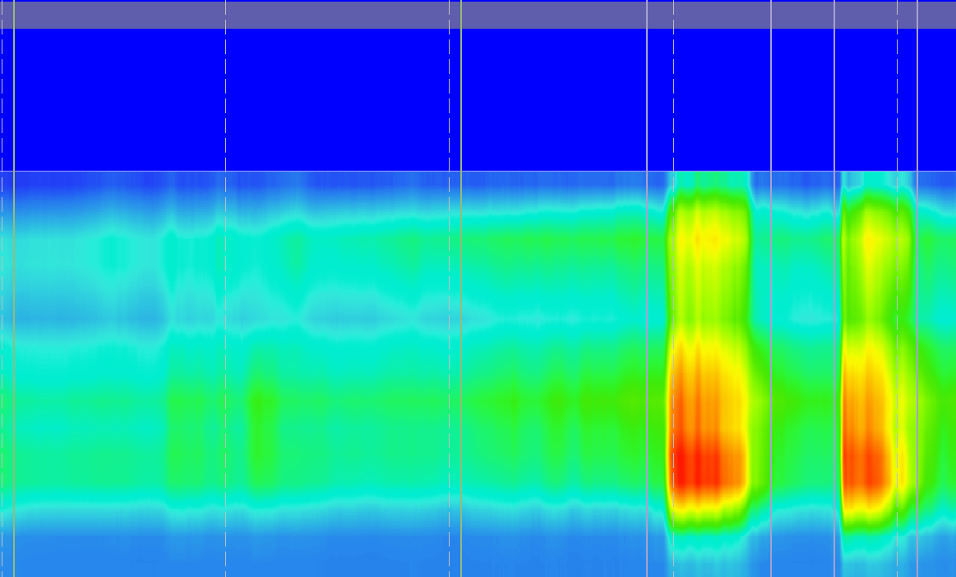
Fecal incontinence
Rectal sensors
Int. sphincters
External
Int. sphincters
Notes:
After esophageal involvement, colonic and anorectal symptoms are the second most common areas of the GI tract to be affected→ seen in 50-70% of SSc patients
0ther tests to be considered include barium defecography, MR deface, endoanal ultrasound (limited access). Same applies for constipation
Fecal urgency can be seen due to reduced rectal compliance and capacity from collagen deposition

Slide 40
LOW FODMAP Diet
Low fermented diet with elimination phase of 2-6 weeks
Has shown to reduce bloating, abdominal distension and pain, and improves stool consistency
If no relief after 2-6 weeks of elimination, patients should stop the diet
After elimination, reintroduction and tailoring diet based on identified trigger
Ideally, patient should be assessed and followed by registered dietitian to avoid malnutrition with restrictive diet
Monash app is a helpful adjunctive tool

Slide 41
Pharmacologic Management
Review diet and medications list with your physicians
Treat the underlying cause of diarrhea
Symptomatic anti-diarrheal medications: Loperamide, Lomotil, Ondansetron, ? Bulking agent (psyllium), Eluxadoline (Viberzi, approved for IBS-Diarrhea), cholestyramine, Rifaximin (approved for IBS-Diarrhea)
?? Pancreatic digestive enzymes replacement (PERT), most effective in those with pancreatic insufficiency
Notes:
- Eluxadoline (mu, kappa opioid receptor agonist, delta-receptor antagonist)

Slide 42
Constipation
Tell your physician about your baseline pattern, progression, frequency, urgency, straining, incomplete evacuation, manual maneuvers to assist evacuation, and fecal incontinence
Associated symptoms: N/V/abdo pain/ bloating
Review medications and diet with your doctor
Laxatives use - Dose, frequency, duration, response, side-effects
Your doctor may recommend further investigations including abdominal imaging, colonoscopy
Notes:
Colonic involvement in 20-50% of SSc patients. Colonic inertia (end-stage SSc) could lead to constipation and associated overflow diarrhea.

Slide 43
Non-pharmacologic agents:
Adequate exercise and fluid intake
Fruits such as Kiwi (low fermented, helps with softening bowel movements)
Timed toileting
Soluble fiber (psyllium, start small and gradually increase)
Squatty Potty “raise feet 6 inches off ground in front of the toilet”

Slide 44
Pharmacologic Options:
- Stool softener: Docusate (colace) - Bulking agents: fiber (psyllium, Benafiber) - osmotic laxatives (Lactulose, PEG, Milk of Magnesia) - Stimulants: Bisacodyl (Dulcolax), Senna - Enemas/ suppository/ manual disimpaction - Prescription medications: * Linaclotide (Constella), Plecanatide (Trulance), tenapanor (IBSrela) **Prucalopride (promotilic agent) - Non-absorbable antibiotics (Rifaximin) +/- Flagyl/ Neomycin
Bharucha et al. Existing and emerging therapies for managing constipation and diarrhea. Current opinion in pharmacology. Dec 2017, Vol 37, pg 158-166
Notes:
Can increase the dose to maximum tolerated dose, combine
Once there is significant fibrosis and neuropathy, these medications become less effective !
Side-effect

Slide 45
Conclusion
Systemic Sclerosis in a multi-system disease that deserves multidisciplinary approach
Gastrointestinal impacts of scleroderma is driven by abnormal GI tract motility
Depending on the predominant symptoms, the treatment is tailored.
Mindfulness of an underestimated world of GI motility disorders: beyond “normal upper endoscopy and colonoscopy
Ongoing need for research and clinical support in advancement of patients care
Dire need for support and expansion of GI motility in province of BC
Notes:
- Point 2: Buspirone for esophageal dysmotility and improving fundal accommodation or Prucalopride with gastroparesis/ CIPO/ constipation

Slide 46
Thank you for your attention

Slide 47
Questions ?

