Slide 1
Living with pulmonary hypertension
Lisa Kolkman, NP (F)
Vancouver General Hospital
October 2024
Notes:
Nurse Practitioner working with PH patients since 2012
Wisdom is not my own but can attribute to people like you

Slide 2
Objectives
Preserve lung function
Any topic we should know about

Slide 3
Questions
How many of you have scleroderma?
How many of you are here to support someone with scleroderma?
How long have you been diagnosed?
Do you have any family members with Scleroderma?
How many people have pulmonary hypertension?
How many of you have met another person before today with scleroderma? Pulmonary hypertension?
How many of you are from the Lower Mainland?
Who has had to travel the farthest to come here?

Slide 4
Strategies to Preserve Lung Function
Early detection
Medication adherence
Immunizations/Iron deficiency
Supplements/stimulants
Prevention of heart failure
Exercise
Mental Health
Health literacy/Self advocacy
STRATEGIES TO LIVE THE BEST LIFE YOU CAN FOR AS LONG AS YOU CAN

Slide 5
Early Detection
Getting diagnosed early with pulmonary hypertension can improve your chance of living longer with pulmonary hypertension

Slide 6
You know yourself best
Pay attention to your symptoms
Describe them objectively
Screening tests
Notes:
If you think about the time you spend with your health care team
Make your own 6 MWT
Once every year or two

Slide 7
Medication Adherence
Take your medications as prescribed
Let your prescriber know if you are having side effects
Finances should not be a barrier
Notes:
]. Medication adherence as low as 50% has been reported among patients with PAH and CTEPH [5–8]. High age, the number of comorbidities and the integration of a specialist in pharmacology at the outpatient clinic have been shown to correlate with increased treatment adherence [8, 9]. Treatment with monotherapy versus combination therapy, on the other side, is showing conflicting results [8, 10]. In a recent Swedish survey, almost all patients with PAH or CTEPH said they understood why they took their drugs, but a third reported that they did not always take them according to the prescription [7]. Concerns about side-effects, reported by half of the study population, likely contributed to the low adherence. Further, a longer elapsed time since diagnosis and start of treatment related to lower self-reported treatment adherenc

Slide 8
Avoid Things Known to Make Pulmonary Hypertension Worse
Weight loss pills and pre-workout
Supplements to improve concentration
Medications to treat ADHD
Over the counter medications such as nasal decongestants pseudoephedrine phenylephrine
Methamphetamines/Amphetamines

Slide 9
Immunizations
Influenza
Strep pneumo
Covid 19

Slide 10
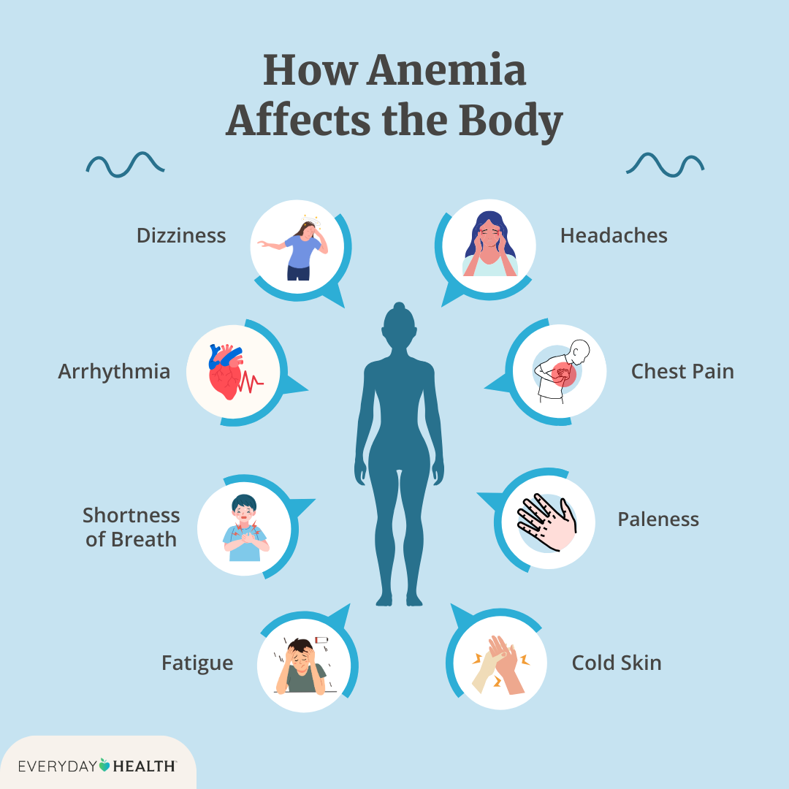
Iron Deficiency
Check your iron levels and your hemoglobin once a year
Diet with iron rich foods
Oral supplementation
IV iron

Slide 11
Prevention of Heart Failure
Definition
Weigh yourself daily
Notice how your clothes fit
Watch how much fluid you drink in 24 hours
Watch the salt in your diet
Let your health care team know early

Slide 12
Exercise
Builds reserve
Improves functioning
Progressive
CONSISTENCY IS KEY
Looks different for different points in your journey
Referral for supervised exercise training

Slide 13
Mental Health
Social support (from friends, coworkers, or others)
Family relationships
Worries about money
Beliefs and values
Health behaviors
Access to support and resources

Slide 14
Mindfulness
Meditation
Support
Counselling
Psychology
Medications
Body scan/Progressive muscle relaxation
Yoga/Tai chi /qui gong
Breathwork
Massage
Music and art therapy
Peers

Slide 15
Mental Health
Radical acceptance
Anticipate uncertainty and change
Foster a sense of self worth
Rest
Meaning
JOY

Slide 16
Health Literacy/Self Advocacy
You know yourself best
Learn to choose the right person for the problem at hand
Learn to communicate clearly and concisely on a priority basis
Medical history
Medications
Side effects
Weight
Normal blood pressure
Names of specialists
Symptoms

Slide 17
Resources
https://www.healthlinkbc.ca/health-topics/organizing-your-medical-records
https://www.heartandstroke.ca/-/media/pdf-files/canada/health-failure/hs_heartfailure_medicationlist_en.pdf?rev=97b1b1b10a964396824661d850c148e9
http://www.cardiacbc.ca/Documents/Heart-Failure-Zones-%20English.pdf
https://bclung.ca/lung-health/copd/exercise-support/#:~:text=Pulmonary%20Rehab%20Programs%20in%20BC,cope%20with%20the%20condition%20itself.

Slide 18
Questions?
Some day we will die. True. But on all the other days, we will not.

