Slide 1
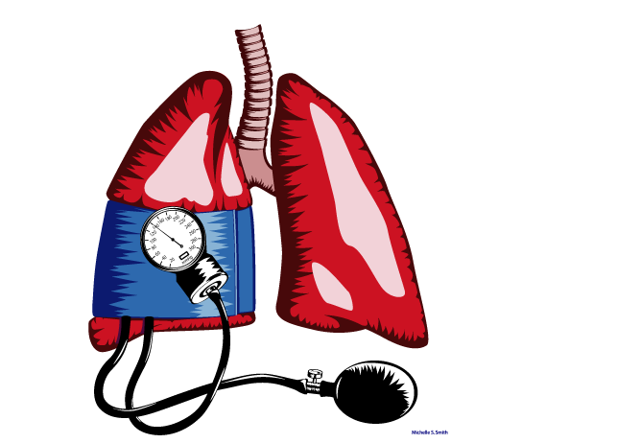
Pulmonary Hypertension: Evaluation and treatment
Nathan Brunner, MD, FRCPC
Clinical Associate Professor
Division of Cardiology
University of British Columbia

Slide 2
Disclosure
            I have received educational support and/or honoraria for speaking engagements, consultations, and participation in advisory boards, as well as participated in collaborative research with the following pharmaceutical companies:
            Actelion
            Bayer

Slide 3
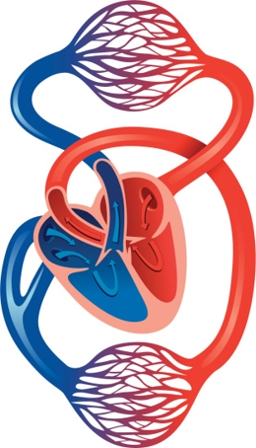
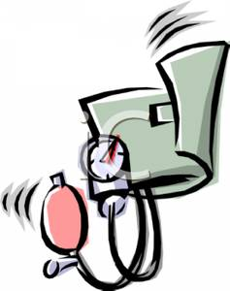
Definitions
Pulmonary hypertension = High pressures in the pulmonary arteries (mPAP > 20 mmHg)
By comparison, normal BP is 120/80 mmHg
(MAP ~ 90 mmHg)

Slide 4
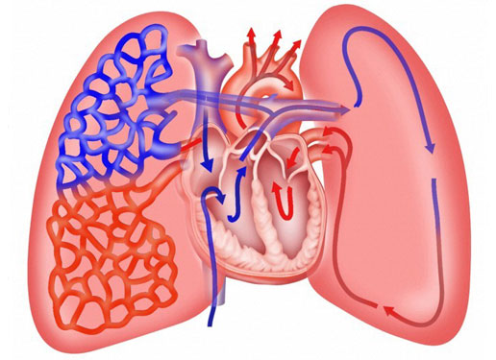
Obstruction of PA
Destruction of pulmonary parenchyma
Increased resistance to flow
High back pressure from left heart

Slide 5
Pulmonary Arterial Hypertension
A small subset of pulmonary hypertension
Rare, affecting only 10-52 people per million
Pulmonary pressures are elevated to due thickening, narrowing and fibrosis of the small pulmonary arteries
    Effects arteries on the order of <500 microns
    Associated with certain other medical conditions (especially systemic sclerosis)

Slide 6
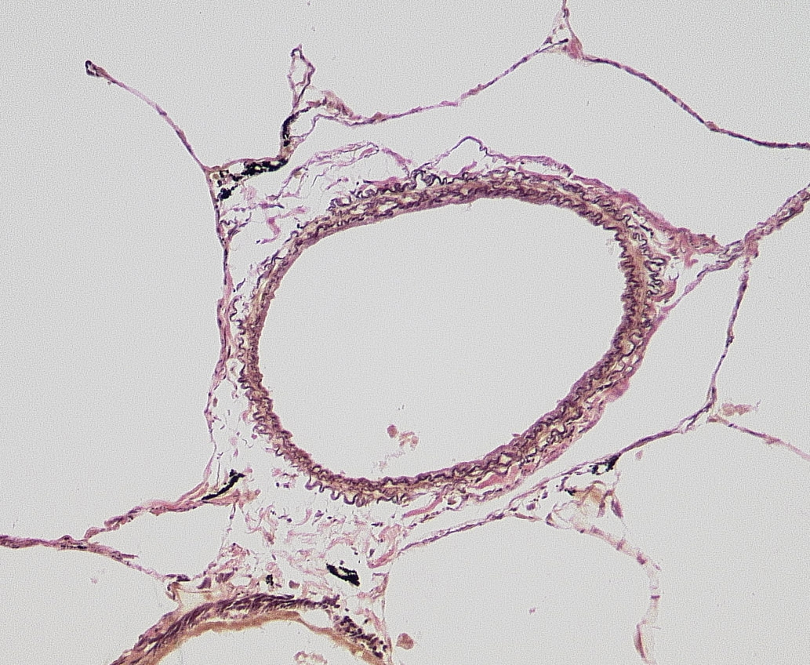
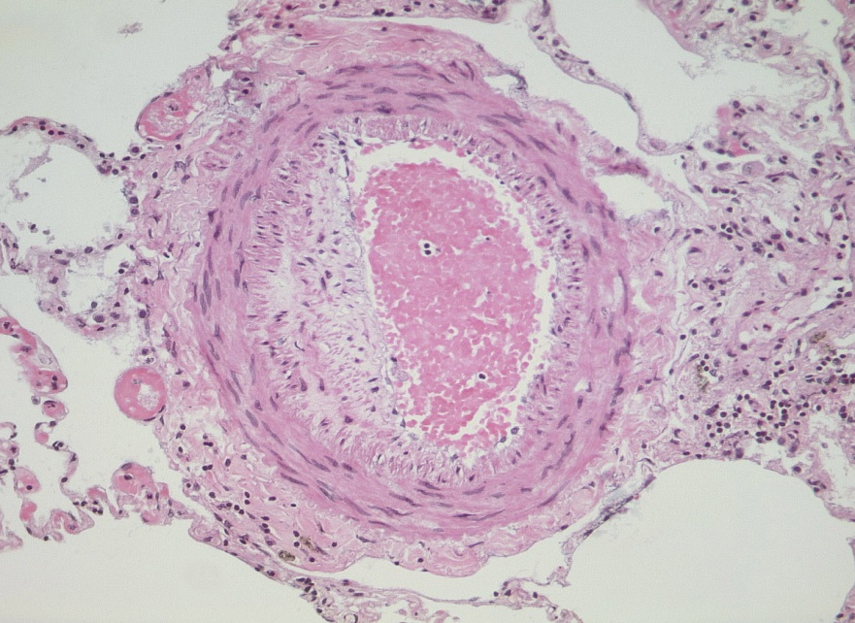

Pulmonary arterial hypertension (PAH)-
What goes wrong?
Normal
PAH
clot
intimal proliferation
medial hypertrophy
RV
Notes:
6

Slide 7
Pulmonary arterial hypertension in Scleroderma
Seen in about 8-12% of patients with scleroderma
Much more common with limited systemic sclerosis compared to diffuse systemic sclerosis
Common enough that regular screening is warranted

Slide 8
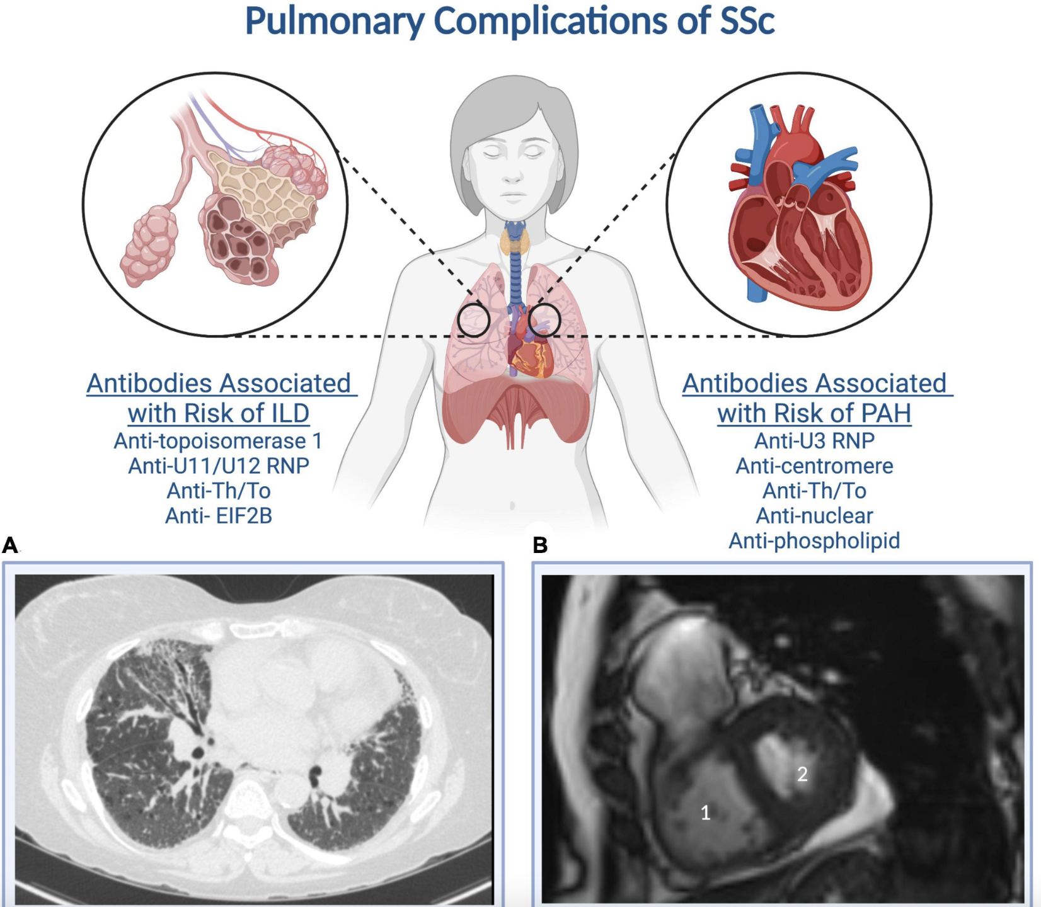

Slide 9
Clinical Presentation: Symptoms
Cardinal PH symptoms
  Difficulty Breathing (60%)
  Chest pain (47%)
  Passing out (36%)
  Fatigue (73%)
  Leg/abdominal swelling
  Abdominal pain
  Hoarseness
  Symptoms typically do not develop until pressures double
Delayed diagnosis remains common
Peacock et al., Pulmonary Circulation 3rd Ed
Saggar et al., Semin Respir Crit Care Med 2009;30:399–410
Notes:
Dyspnea (60%) due to
Poor CO, increased CO₂, underperfusion of ventilated lung
Angina
RV ischemia
Syncope
Failure to augment CO

Slide 10
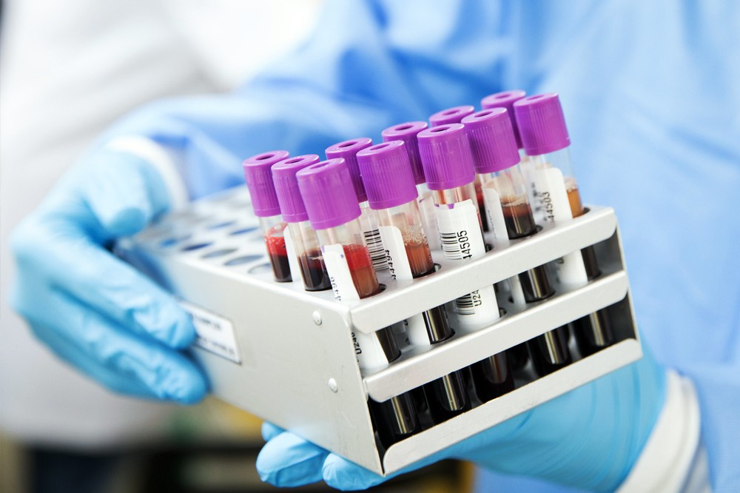
Investigating for PH: Blood tests
BNP/NTproBNP
High with strain on the heart
Influenced by kidney function
Raises suspicion for PAH or other heart conditions

Slide 11
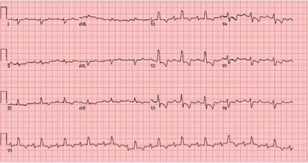
Investigating for PH: ECG

Slide 12
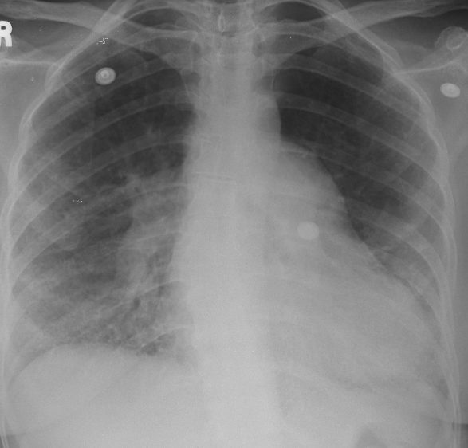
Investigating for PH: Chest x-ray

Slide 13
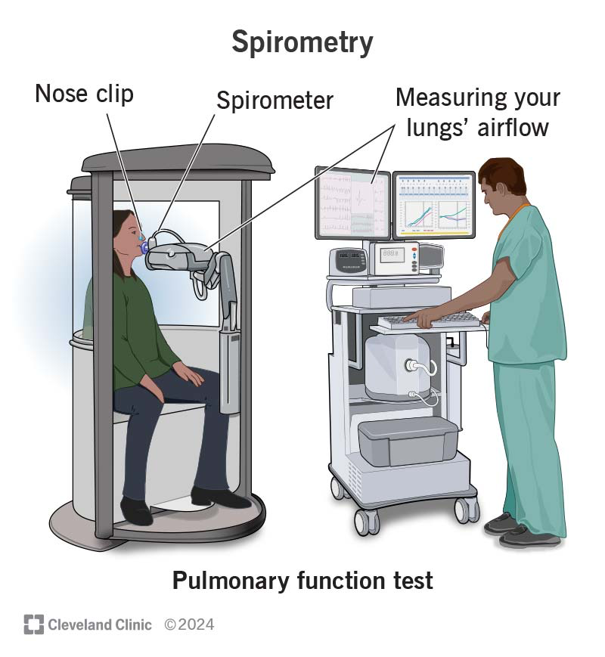
Investigating for PH: Pulmonary Function tests

Slide 14
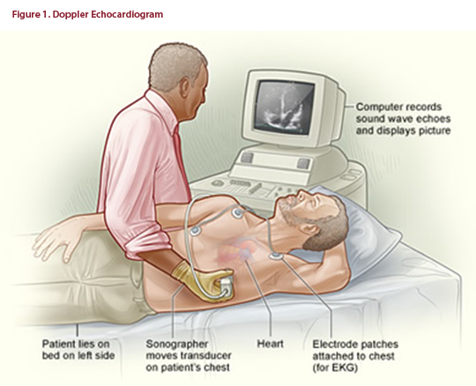
Investigating for PH: Echocardiography

Slide 15
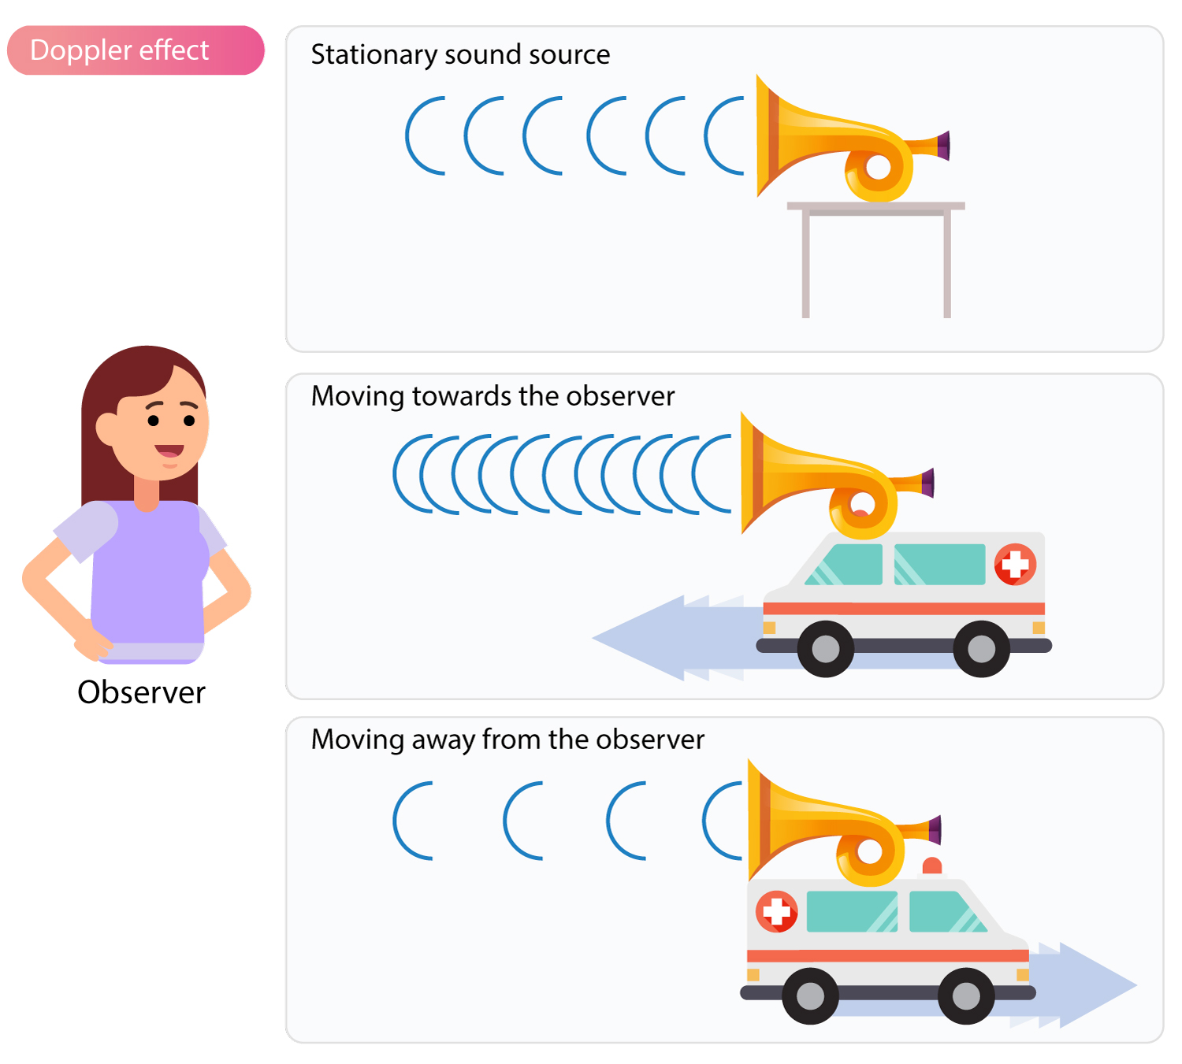
Doppler effect

Slide 16
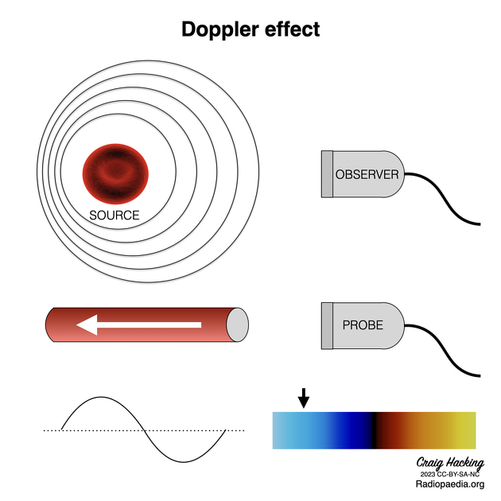
Doppler effect

Slide 17
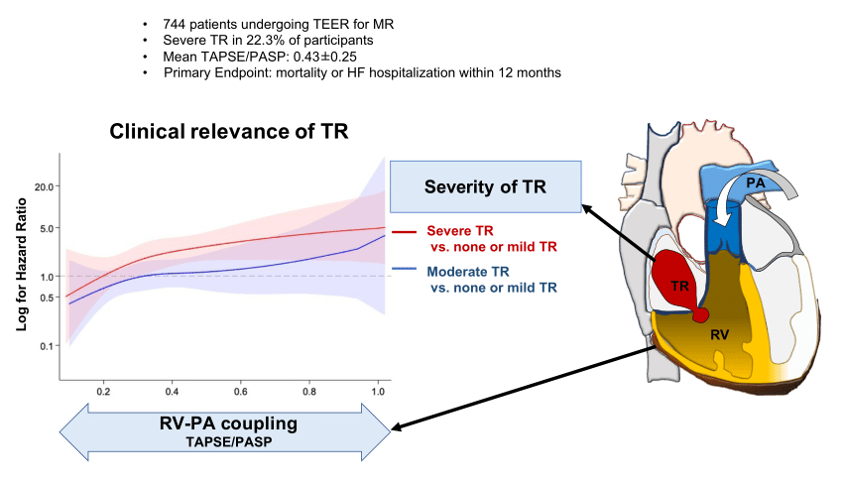

Slide 18
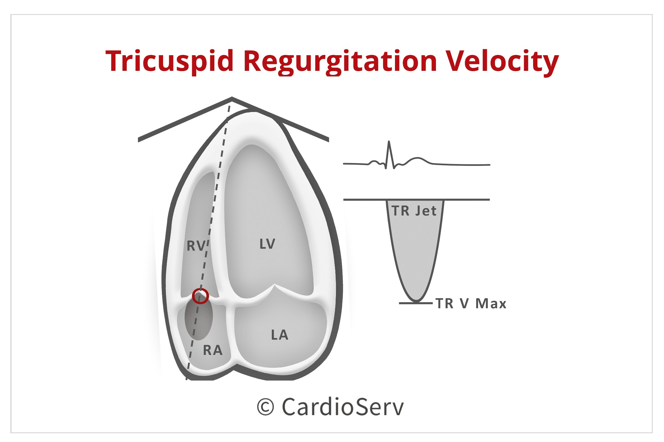

Slide 19
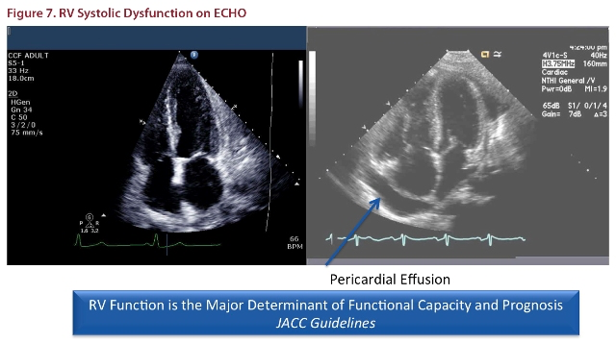
Other features

Slide 20
Diagnosis of PAH: Cardiac Catheterization
Why is it needed?
  Echocardiogram pressure measurements are often not accurate
  Echocardiograms do not differentiate if pressure is coming from the heart or the lungs

Slide 21
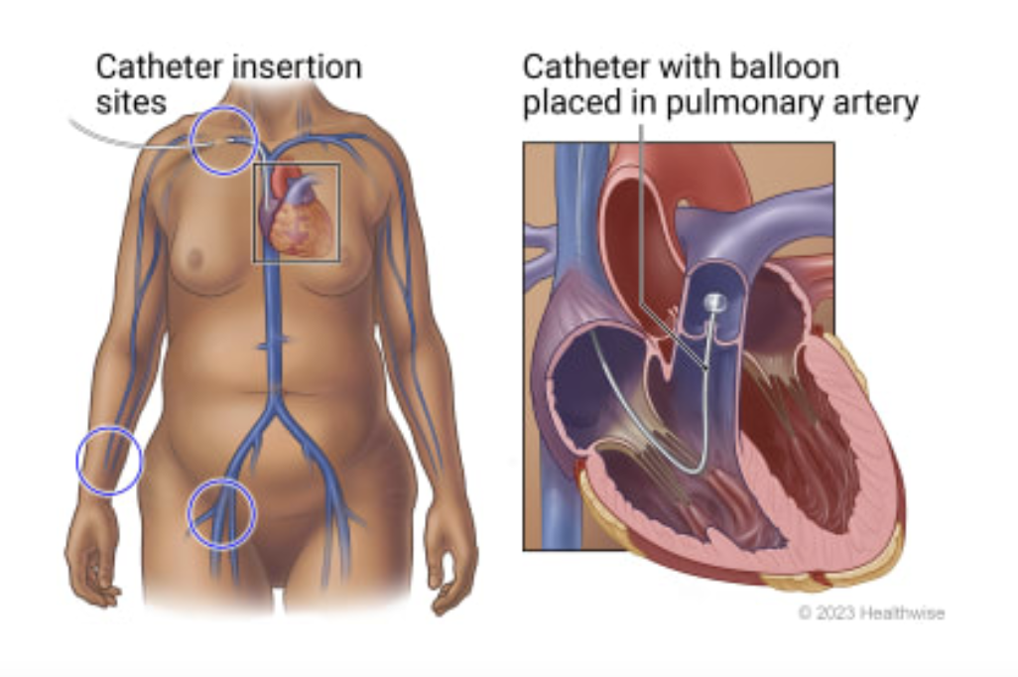
Diagnosis of PAH: Cardiac Catheterization

Slide 22

Pulmonary arterial hypertension therapy

Slide 23
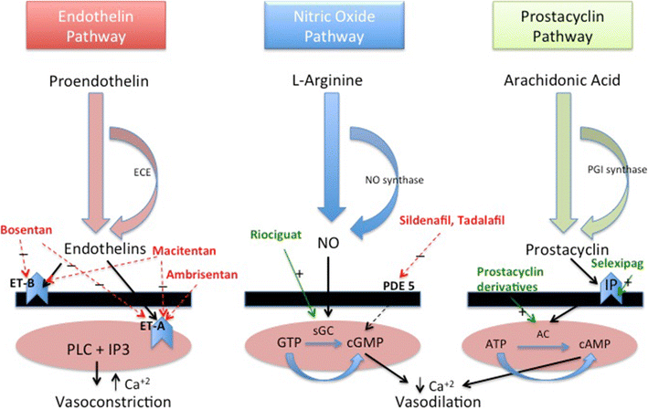

Slide 24
PAH therapies: Nitric oxide pathway
Phosphodiesterase 5 Inhibitors
  Sildenafil (Revatio, Viagra)
  20mg three times daily
    Tadalafil (Adcirca, Cialis)
    40mg once daily
    Soluble guanylate cyclase stimulators
    Riociguat (Adempas)
    Variable dose three times daily

Slide 25
PAH Therapies: Endothelin receptor antagonists
Bosentan (Tracleer)
125mg twice daily
10% risk of liver inflammation, needs regular blood tests
Ambrisentan (Volibris)
10mg daily
Should not be used with interstitial lung disease
Macitentan (Opsumit)
10mg daily

Slide 26
PAH therapy: Prostanoid Receptor Agonists
Selexipag (Uptravi)
    Started at a low dose with gradual increase
    Dose titration stops when side effects develop
    Even patients who can’t get to max dose do better
Bonus
All of these meds tend to improve Raynaud’s phenomenon

Slide 27
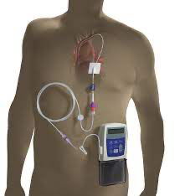
Parenteral prostanoids: Epoprostenol (Caripul)

Slide 28
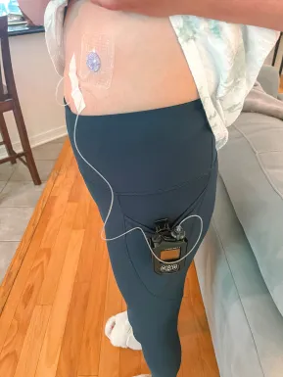
Parenteral prostanoids: Treprostinil (Remodulin)

Slide 29
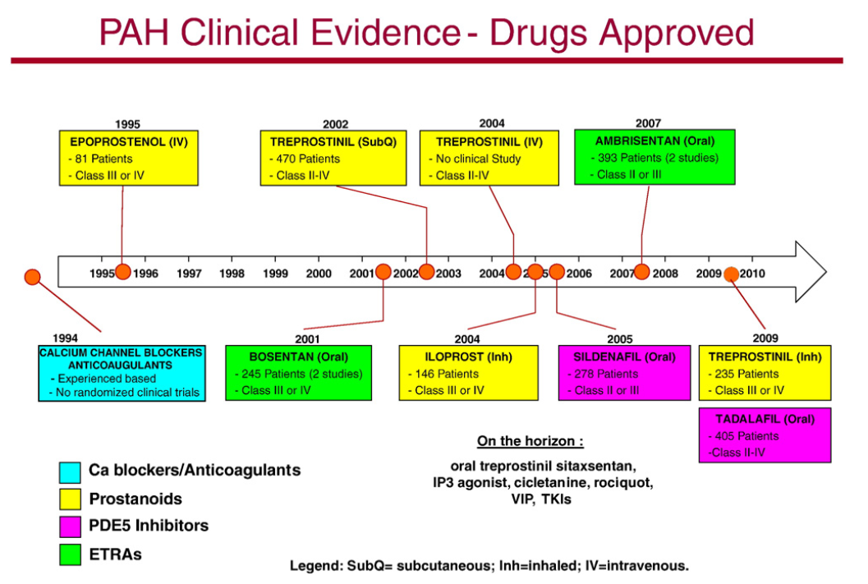
MACITENTAN (oral)
-742 Patients
-Class I-IV
RIOCIGUT (oral)
-443 Patients
-Class I-IV
2013
Agarwal et al. Am Heart J 2011;162:201-13
Notes:
These agents have really only become available for clinical use in the past 10-15 years
As we alluded to previously, epoprostenol became available in 1995
It was not until 2001 that the first oral therapy became available, which was bosentan.
The first PDE5 inhibitor, sildenafil did not become available until 2005
So, in a relatively short amount of time
We have gone from an untreatable disease, to a disease with several treatment options
29

Slide 30
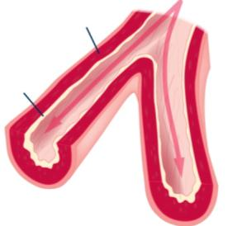
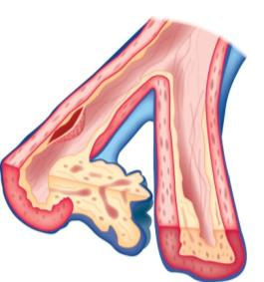
Role for earlier Rx in PAH?
No functional impairment
Functional capacity
Early intervention
Progressive remodelling & right-heart failurein absence of treatment
Intervention
Time
Irreversible disease
Notes:
30

Slide 31
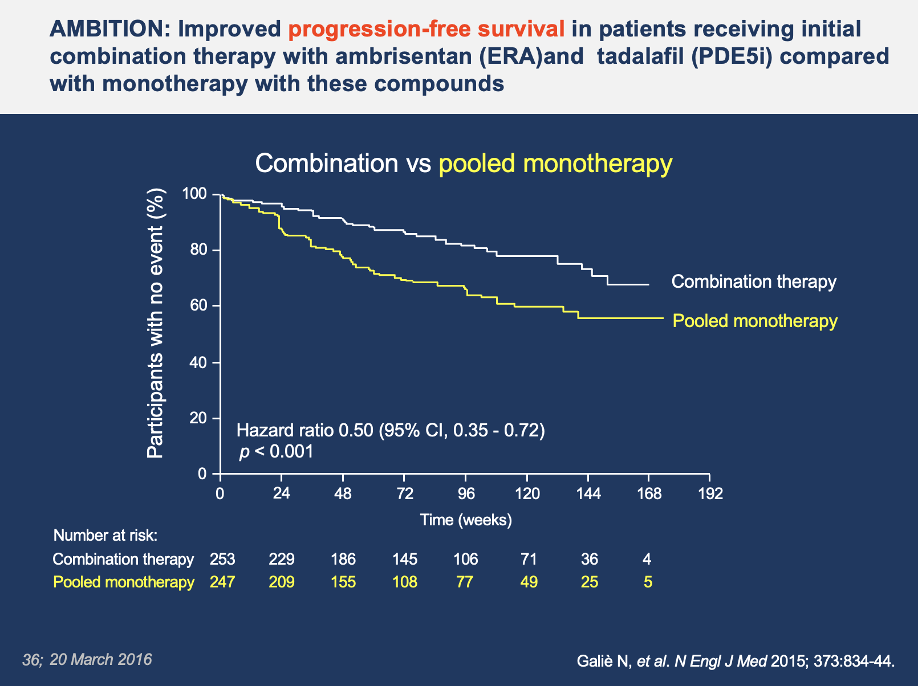

Slide 32
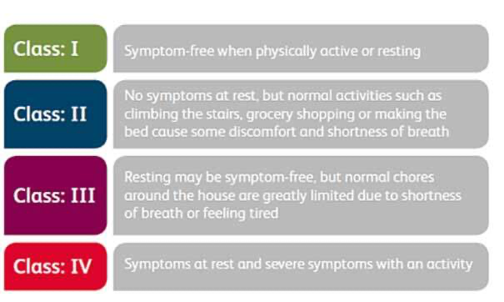

Follow up: How do we know the meds are working?
You feel better!
WHO Functional class

Slide 33
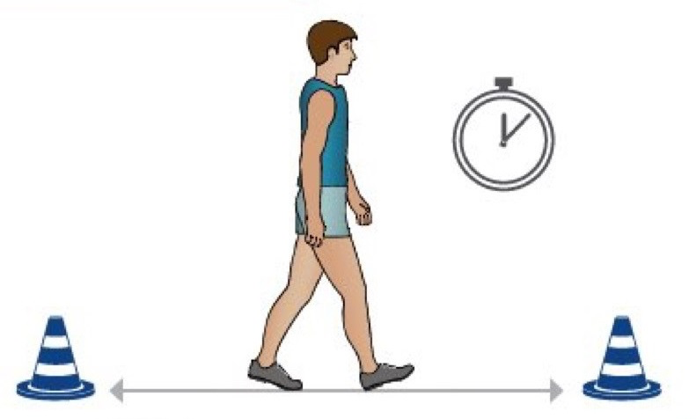
Follow up: How do we know the meds are working?
2. You walk farther!
Six minute walk target 440 m

Slide 34
Follow up: How do we know the meds are working?
3. Your blood tests are better
BNP < 100 pg/mL
NT-proBNP < 300 pg/mL

Slide 35
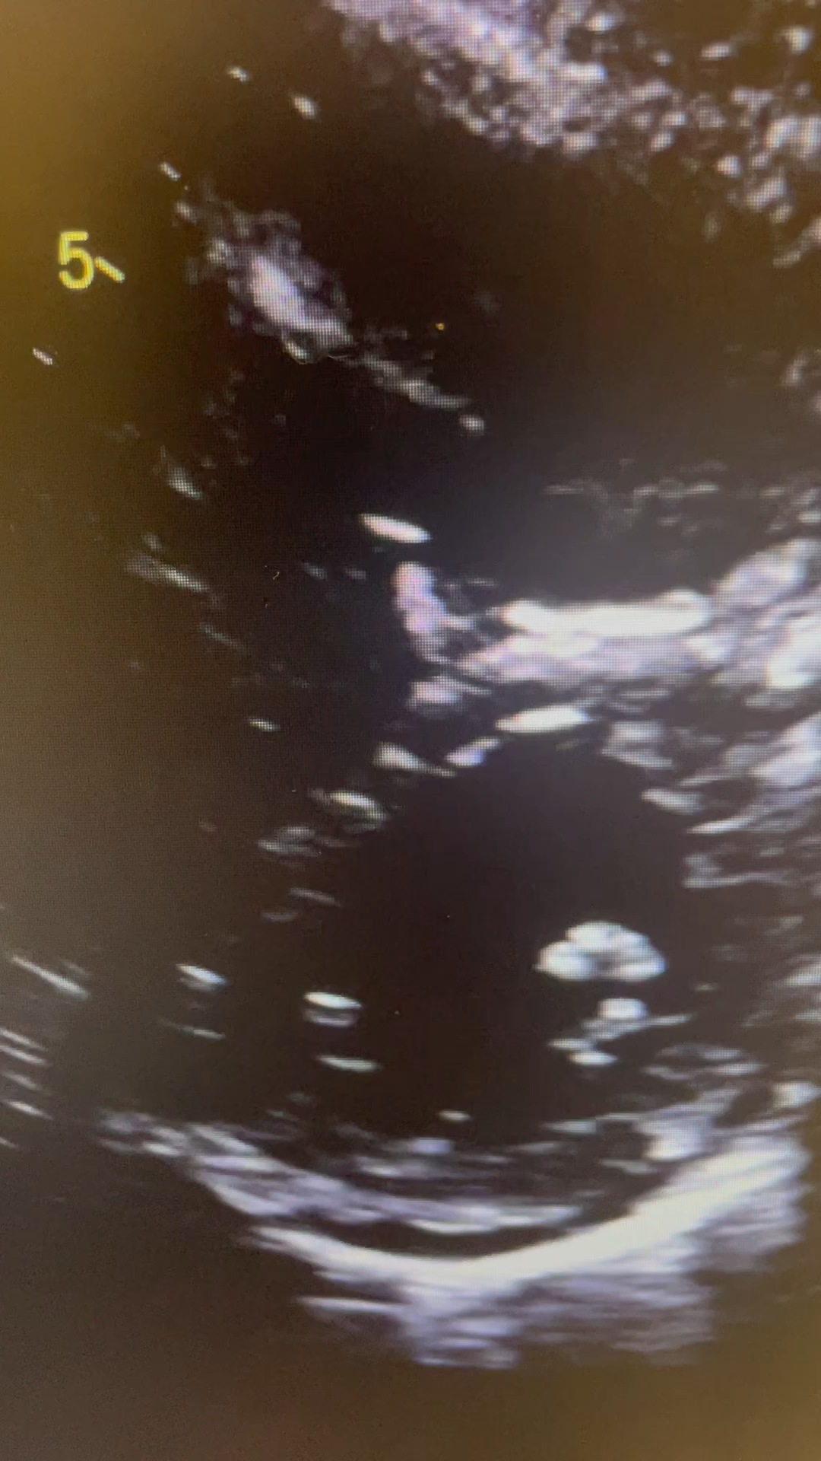
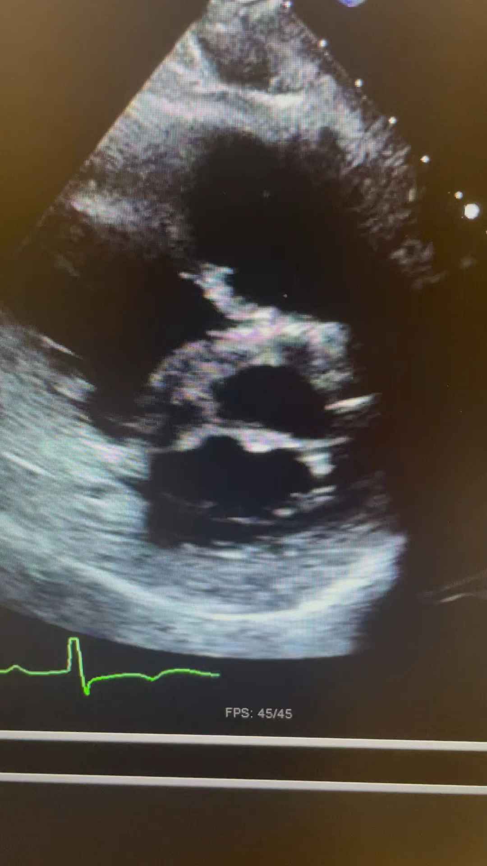
Follow up: How do we know the meds are working? Follow up echo

Slide 36
What if the medications aren’t working?
Follow up catherization is sometimes done to assess response to therapy if targets are not being achieved
If we aren’t at target
    Add more therapy
    Move to parenteral therapy
  If maximal therapy isn’t enough
    Lung transplantation

